Slide 1


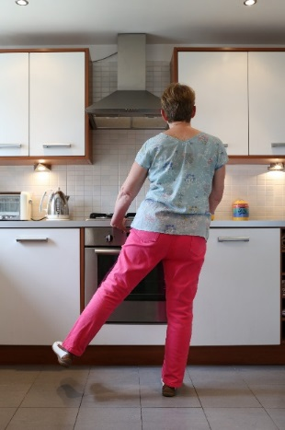
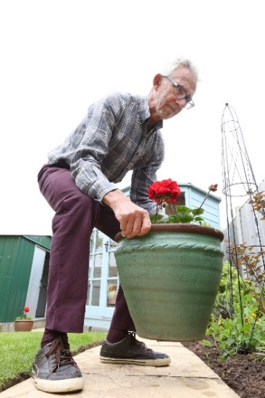
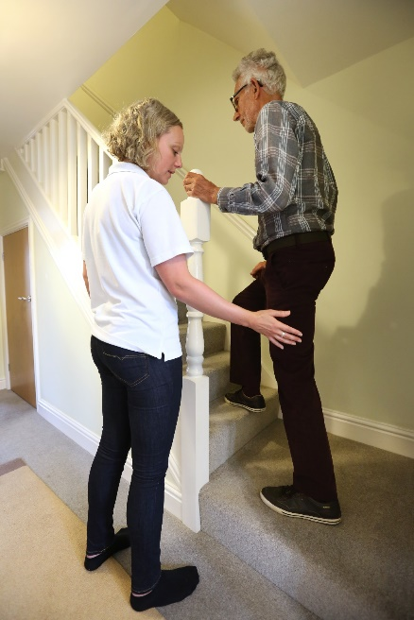

Process Evaluation of the Promoting Activity, Independence and Stability in Early Dementia and Mild Cognitive Impairment (PrAISED 2)
Dr. Claudio Di Lorito
University of Nottingham
United Kingdom

Slide 2
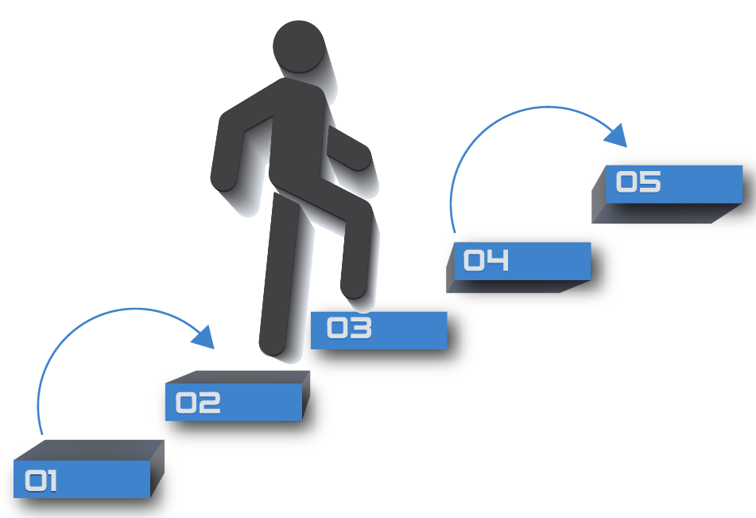

Outline
Discussion
Preliminary results
Methods
Process evaluation in PrAISED
What is PrAISED

Slide 3
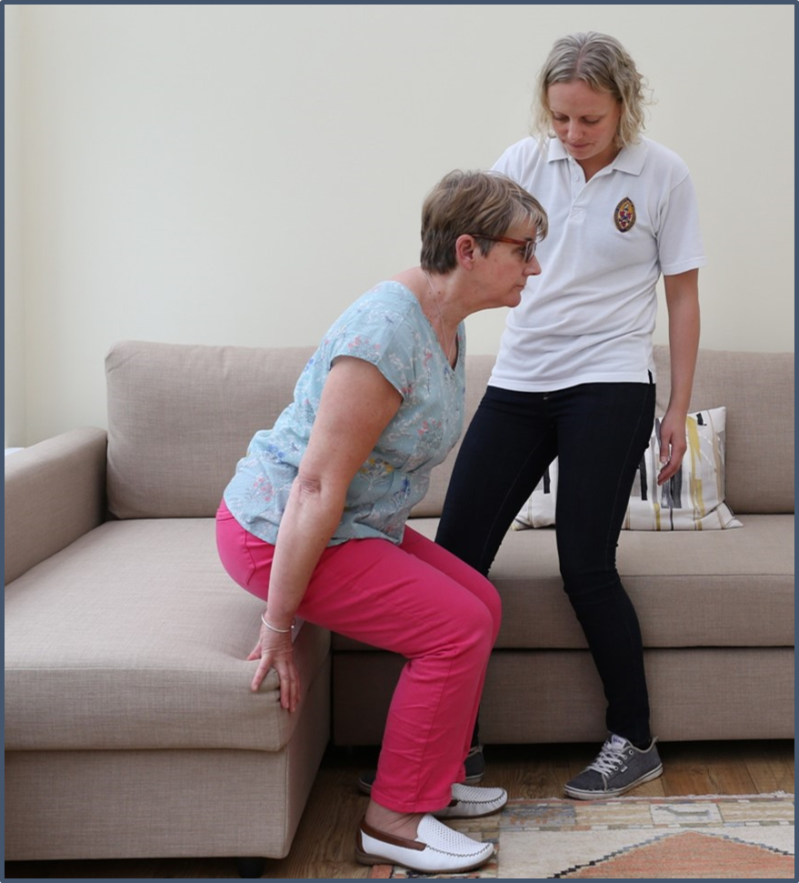
What is PrAISED?
A randomised controlled trial (RCT) testing the effectiveness of an intervention to promote activity and independence amongst people with dementia
368 participants from 5 regions in England;
Intervention arm: 12-month intervention comprising individually tailored functional activities (e.g. walking the dog) and physical exercises (e.g. progressive strength exercises) delivered by trained therapists;
Control arm: Treatment As Usual (falls assessment and advice);
Primary outcome: Disability in activities of daily living, measured through the
Disability Assessment in Dementia (DAD);
Secondary outcomes: Rate of falls, quality of life, physical activity levels, mobility, mood, comorbidities, cognition, time to first fall, fractures and injurious falls, health and social service use, carer strain and cost-effectiveness;
Further info on: Harwood, R. et al. (2018). A development study and randomised feasibility trial of a tailored intervention to improve activity and reduce falls in older adults with mild cognitive impairment and mild dementia. Pilot and feasibility studies, 4(1), 49.

Slide 4
Process evaluation in PrAISED
‘A process evaluation is undertaken to determine the extent to which a program is being implemented according to plan, to provide feedback on the quality of implementation.’
  Agency for Clinical Innovation framework (2013) Understanding program evaluation. Retrieved from: https://www.aci.health.nsw.gov.au/__data/assets/pdf_file/0008/192437/Framework-Program-Evaluation.pdf
The PrAISED process evaluation comprises two studies:
1. Implementation study, investigating the process through which PrAISED is implemented;
2. Mechanisms of impact and context study, investigating participants’ experience of PrAISED and contextual mechanisms affecting intervention outcomes;
…The study is still ongoing…

Slide 5
Methods

Slide 6
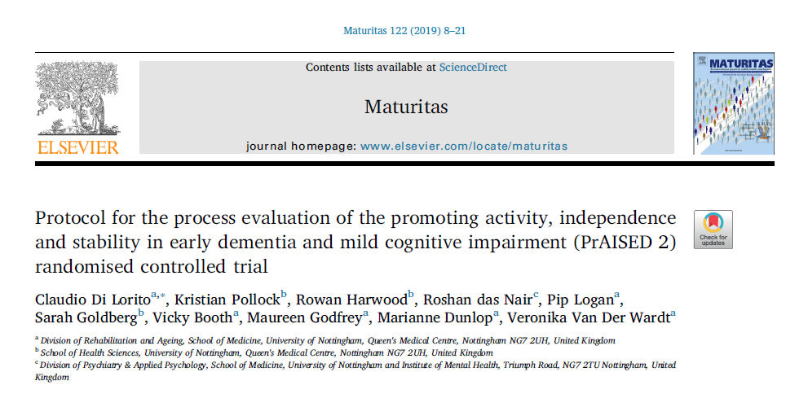
More info on…
Di Lorito, C., Pollock, K., Harwood, R., das Nair, R., Logan, P., Goldberg, S., ... & Van Der Wardt, V. (2019). Protocol for the process evaluation of the promoting activity, independence and stability in early dementia and mild cognitive impairment (PrAISED 2) randomised controlled trial. Maturitas, 122, 8-21
https://www.sciencedirect.com/science/article/pii/S0378512218307874

Slide 7

Preliminary results – implementation study
Core training (beginning of therapists’ involvement)
Delivered by academic team on how to deliver the PrAISED intervention;
12 two-day training sessions;
48 PrAISED therapists trained to deliver the intervention since September 2018 (n=17 Occupational Therapists, n=13 Physiotherapists and n=18 Rehabilitation Support Workers) across 5 research sites in England;
Each PrAISED therapist completed a questionnaire to assess their understanding of the training. Mean = 94%.

Slide 8
Preliminary results – implementation study
Ongoing training (Throughout the therapists’ involvement)
Two 2-hour mentoring sessions per research site (mandatory);
One-hour monthly teleconferences (recommended); average attendance: 7 therapists.
Study participants
Number of participants in PrAISED at end of November 2019: 226 people with a diagnosis of dementia and their identified caregiver;
Number of participants who completed the 12-month programme:
Number of participants who have self-withdrawn from the study: 23.

Slide 9
Preliminary results – Mechanisms of impact and context study
Qualitative interviews in participants’ homes;
Aim: To identify, the personal, relational and environmental variables that had an impact on the participant’s experience of PrAISED;
40 participants (20 participant with dementia and their caregiver) involved (10 per region) and interviewed in pairs;
Seventeen carers (all spouses) lived with the participants with dementia. Two carers were adult children and one was a sibling of the participant with dementia and lived independently;
The interviews lasted 48 minutes on average (range = 31-65);
Analysed through content analysis.

Slide 10
Preliminary results – Mechanisms of impact and context study

Slide 11
Preliminary results – Mechanisms of impact and context study
Variable | Operational definition | Example of how the construct might mediate behaviour change
Characteristics of the person with dementia | Characteristics of the person affecting behaviour change, which include personality, temperament, and identity | Risk-takers might be more willing to challenge themselves in a physical activity programme than overly cautious subjects, thus potentially obtaining more positive outcomes
Support | Practical and emotional support from others (e.g. carer, therapist, society) which affects behaviour change | People might need an initial external push to initiate behaviour change, which may be provided by family members
Expectations / goals | Expectations / goals around the behaviour, including benefits, barriers and facilitators | A person with dementia will sign up to an intervention delivering home-based physical exercise, if they believe that it will improve their health
Carer(s) | Any aspect, behaviour and attitude of the carer, which mediates behaviour change and maintenance | A carer might have risk-averse attitudes toward physical exercise and developing gate-keeping behaviour toward the person with dementia
Progress | Perceived or actual improvement in the person’s physical or mental health, following the behaviour | A person will find motivation to initiate / maintain behaviour change if they see progress / improvements
Social opportunity | Social contacts and networking opportunities (or lack thereof) granted through engaging in the behaviour | The opportunity for socialisation presented by a physical activity group in the community might encourage a person with dementia to sign up

Slide 12
Discussion
PrAISED is ongoing. Full data will be available in 2022;
So far, implementation study results found that PrAISED has been implemented as per original plans;
So far, mechanisms of impact and context study results found that a number of variables have affected participants’ study uptake;
The participants have generally reported positive feedback on the programme
I quite like the exercises on the stairs, because it is simple ones that you can break (P13, female)
If I was doing the exercise with him, he would not feel as confident as when the therapist is, because of her expertise (C09, female)
When I did the exercise, it was about fun, seeing if I could do this. It was a bit of a challenge and that’s great, I enjoyed the session (P05, male)

Slide 13
Thank you for listening. Any questions?
  Further information available from: claudio.dilorito1@nottingham.ac.uk
  This work was funded by the National Institute for Health Research (NIHR) under its Programme Grants for Applied Research Programme (Reference Number RP-PG-0614-20007). The views expressed are those of the author(s) and not necessarily those of the NIHR or the Department of Health and Social Care

