Slide 1
Forest Monitoring of the Congo Basin using Synthetic Aperture Radar (SAR)
James Wheeler
PhD Student
Supervisors: Dr. Kevin Tansey, Prof. Heiko Balzter
Department of Geography
University of Leicester
james.wheeler@le.ac.uk

Slide 2
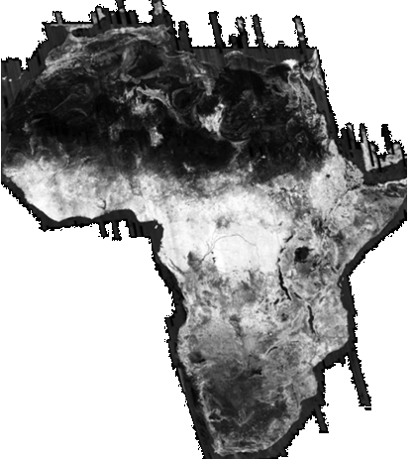
Outline
Congo Basin Background
Congo Rainforest and REDD
Remote Sensing for monitoring deforestation
Optical
Radar
Objectives

Slide 3
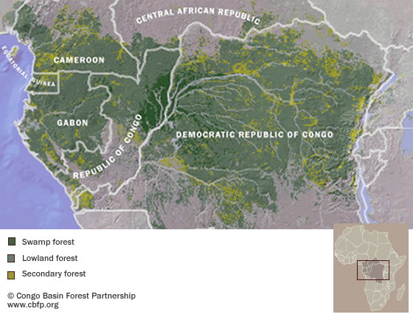
Congo Basin Background
Area drained by the Congo River
~3.8 million km²
1.5 million km² tropical forest
Swamp forests – mountain ecosystems
2nd largest rainforest

Slide 4
Congo Rainforest and REDD
Reducing Emissions from Deforestation and Forest Degradation (REDD)- requires Measurement, Reporting and Verification (MRV) system.
Congo contains approx. 46 billion Mg Carbon
Rate of forest loss in Central Africa ~0.2%/year (Duveiller et al. 2008)
Change occurring on fine scale – spatial resolution for monitoring ideally 100m or higher

Slide 5
Measuring Deforestation in the Congo
Ground based measurements – only ~300 Ha of permanent sample plots in Congo Basin (Nasi et al. 2010)
Useful for validation of remote sensing methods
Forest inventory data important for modelling
Remote sensing methods
Optical
LIDAR
Radar

Slide 6
Rainforest Biomass Data Uncertainty
Biomass study using satellite borne LIDAR dataset by Saatchi et al. (2011)

Slide 7
Optical Remote Sensing
Measure reflectance of visible and near infrared sunlight
E.g. Landsat datasets
Freely available
Continuous time series for >30 years
Affected by cloud/haze
Can be useful for decadal/semi-decadal assessments
Easier to visually interpret

Slide 8
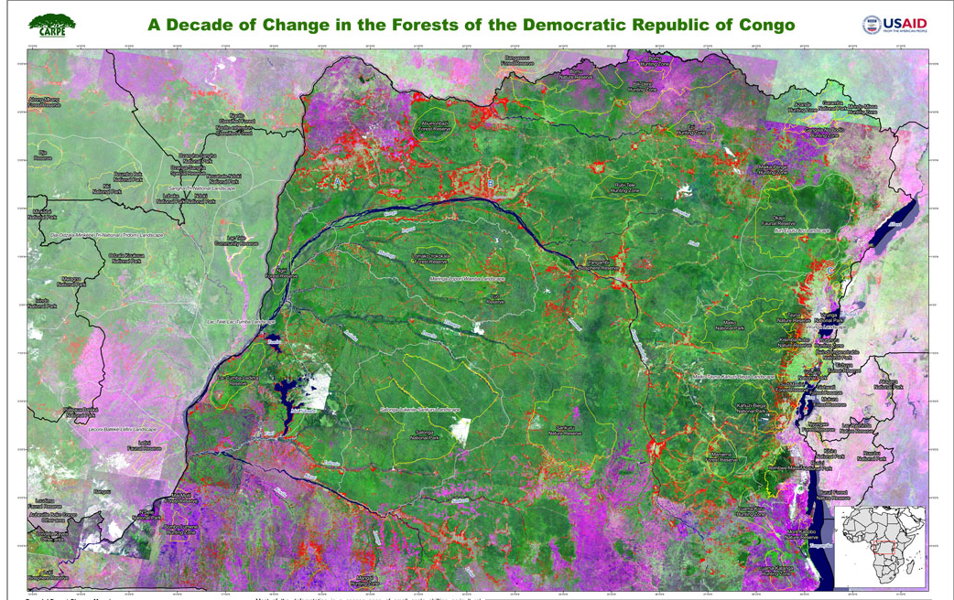
Optical Remote Sensing of the DRC
Image from Hansen et al. (2008)
Notes:
Purple – no forest; green - forest; red – forest loss

Slide 9
Radar Remote Sensing
Synthetic Aperture Radar (SAR)
Penetrates Cloud, not affected by atmosphere/haze
Active system – can operate at night
Measures geometric and dielectric properties
Surface roughness
Moisture content

Slide 10
Image from Canada Centre for Remote Sensing

Slide 11
Radar Remote Sensing
Common radar band wavelengths
X ~3cm C ~5.6cm L ~23cm P~75cm
X-band data available from Tandem-X mission
C-band data available from Envisat, Radarsat, future Sentinel-1
L-band data available from 1992-1998, 2006-2011
Currently no P-band satellite data
Possible future ‘BIOMASS’ mission

Slide 12
Radar
Longer wavelengths (L- and P-) appropriate for forestry applications – higher penetration into canopy
Multiple modes of acquisition benefit forest monitoring
Polarisation of emitted and received signal can be used to measure different characteristics of target
Unfortunately no satellite L-band data from April 2011 until at least 2013

Slide 13
Radar Reflectance
Image from Canada Centre for Remote Sensing
Notes:
Mention backscatter, double bounce, diffuse, spectral, volumetric

Slide 14
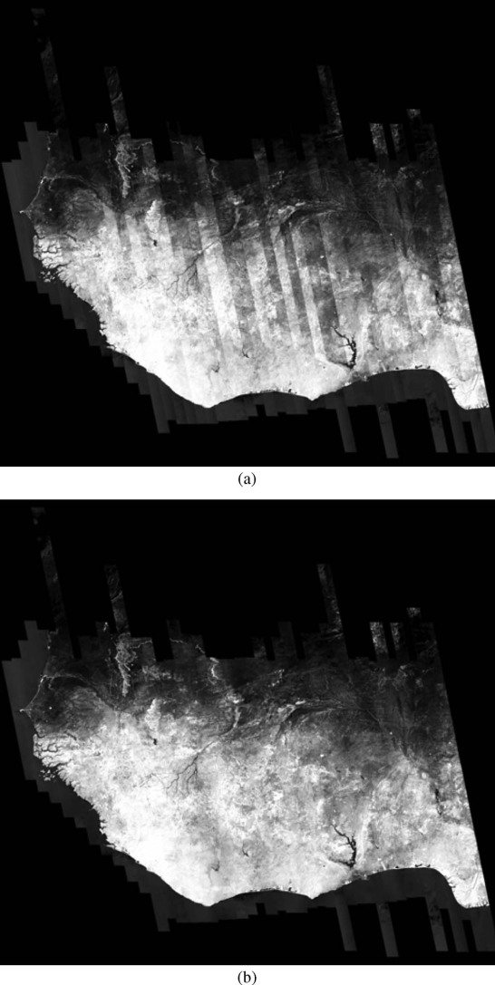
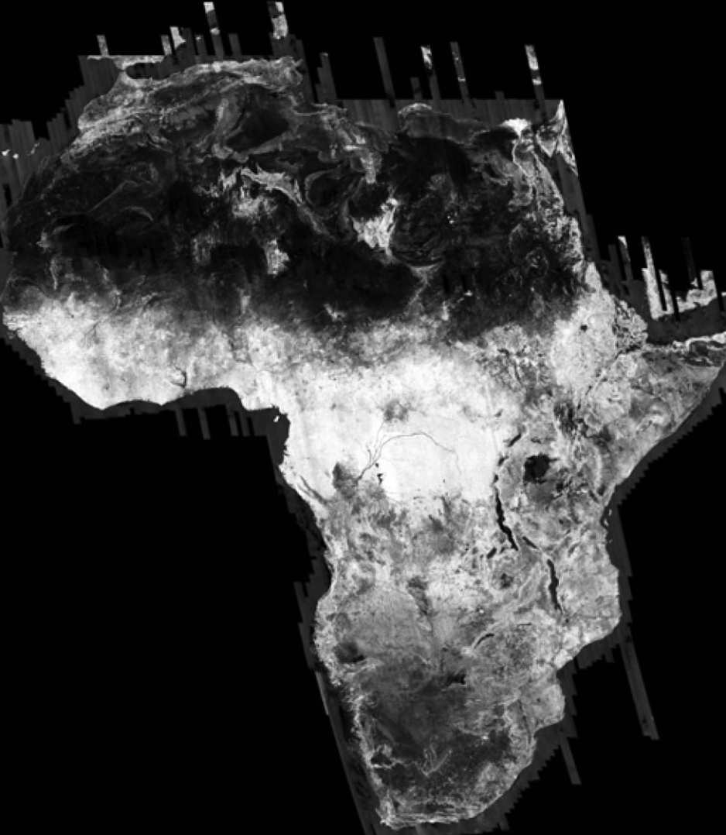
Kyoto and Carbon Initiative PALSAR Mosaic
L-band
Long data strips
Data collected over 2 months
De Grandi et al. 2011

Slide 15
Multi-sensor approach
E.g. Congo wetlands mapping project
Optical data
L-band radar
Digital Elevation Model
Image from Bwangoy et al. (2010)

Slide 16
Current Objectives
Using L-band SAR data
Produce map of forest loss from analysis of backscatter, signal coherence
Combine different techniques in a multi-sensor approach
Field expedition to Republic of Congo 2012/2013
Develop a method for biomass estimation from satellite data to complement knowledge about deforestation

Slide 17
References
Bwangoy, J.-R.B. et al., 2010. Wetland mapping in the Congo Basin using optical and radar remotely sensed data and derived topographical indices. Remote Sensing of Environment, 114(1), pp.73-86.
Canada Centre for Remote Sensing. http://ccrs.nrcan.gc.ca/resource/tutor/gsarcd/index_e.php
Duveiller, G. et al., 2008. Deforestation in Central Africa: Estimates at regional, national and landscape levels by advanced processing of systematically-distributed Landsat extracts. Remote Sensing of Environment, 112(5), pp.1969-1981.
De Grandi, G. et al., 2011. The K&C PALSAR mosaic of the African continent: processing issues and first thematic results. IEEE Transactions on Geoscience and Remote Sensing, 49(10), pp.3593-3610.
Hansen, M.C. et al., 2008. A method for integrating MODIS and Landsat data for systematic monitoring of forest cover and change in the Congo Basin. Remote Sensing of Environment, 112(5), pp.2495-2513.
Nasi, R. et al., 2010. Carbon Stocks and Land Cover Change Estimates in Central Africa - Where Do We Stand? In M. Brady & C. de Wasseige, eds. Monitoring Forest Carbon Stocks and Fluxes in the Congo Basin. Brazzaville, Republic of Congo, pp. 10-13.
Saatchi, S.S. et al., 2011. Benchmark map of forest carbon stocks in tropical regions across three continents. Proceedings of the National Academy of Sciences of the United States of America, 108(24), pp.9899-904.

Slide 18
Thank you for listening

