Slide 1
Modelling Urban Ecology
Connecting ecological policy and theory
Laura Graham, PhD Candidate
Supervisors: Roy Haines-Young and Richard Field

Slide 2
Why urban ecology?
Increasing human population and industrialisation leading to more people living in urban areas:
1900: 10% in urban areas
2000: 50% in urban areas
2030: 60% expected to live in urban areas (Marzluff, 2005)
This leads to degradation of flora and fauna and fragmentation of habitats
Biodiversity is said to be the underpinning force of ecosystem health (Natural Environment White Paper, 2010; Norris et al., 2011)
Humans rely on ecosystem services

Slide 3
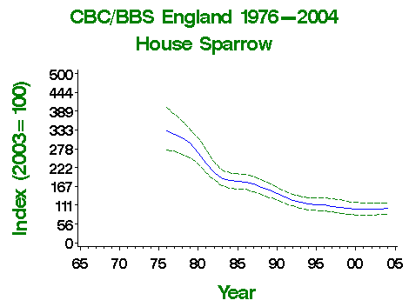
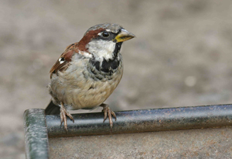
Case study: House Sparrow
The house sparrow has declined by 62% over the last 25 years (RSPB, 2011)
Source: BTO (2011)

Slide 4
Urban Ecology in Policy
Biodiversity Strategy for England (2002)
Lawton Report: Making Space for Nature (2010)
Foresight: Land Use Futures (2010)
Natural Environment White Paper (2011)
UK National Ecosystem Assessment (2011)

Slide 5
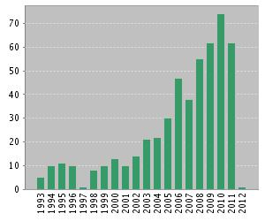
Urban Ecology in theory
Recent reviews and collected works
Douglas et al. 2011
Gaston 2010
Marzluff 2008
Increase in publications through late 2000s
Source: Web of Science (2011)

Slide 6
Key Questions arising from policy and theory
How can we deal with the trade off between development and the need for green space in urban areas?
What targets to we need to set to achieve sustainable urban landscapes?

Slide 7
Metapopulation Ecology
Key concepts and overlaps with urban ecology
Fragmented habitats
Connectivity
Species-area relationship
BUT models cannot simply be borrowed from traditional ecology and applied (Gaston, 2010)

Slide 8
Provisional Research Aim
Map the case study area
Develop a set of research questions which are relevant, rigorous and credible
Investigate how the model can be adapted
Use the model to investigate planning scenarios
Adapt a predictive metapopulation model such as the incidence function model to be suitable for urban green space planning

Slide 9
Next Steps
Further define research questions through
Interviews with those involved in policy
Further review of policy documentation
Define a case study area
Begin looking at adjustments to the model

Slide 10
Any Questions?

