Slide 1

Global Hydrology Modelling and Uncertainty:
Climate Change and Hydrological Extremes
Katie Anne Smith

Slide 2
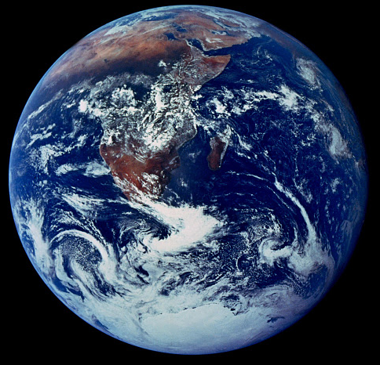
Background
Climate Change
  Regardless of efforts to reduce carbon emissions we are committed to significant changes in our climate [Stainforth et al., 2007]
  IPCC best estimates of temperature change range from an increase of 1.8°C to 4°C at 2090-2099 relative to 1980-1999
  Sea level could rise by up to 0.59m before the end of this century.
  [IPCC Synthesis Report, 2007]
But what does this mean for global hydrology?
‘The Blue Marble’ - NASA
Notes:
We are being bombarded with media about climate change at the moment, but what do these quotes of temperature rise and precipitation change mean for our environment and our society?
I intend to examine the effects of climate change on our global hydrology, and more specifically on hydrological extremes.

Slide 3
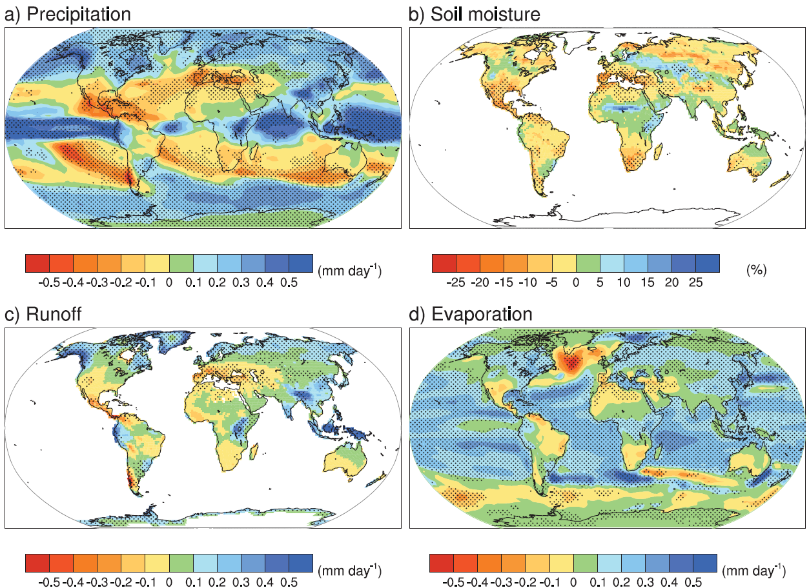
IPCC 4AR 2080-2099
Notes:
From SRES A1B in comparison with 1980-1999
A1 scenario assumes a world of very rapid economic growth, a global population that peaks in mid-century and rapid introduction
of new and more efficient technologies. A1B specifies that energy sources are balanced between all sources (fossil, nuclear and renewables)
Here we can see that significant increases in precipitation are expected in the polar regions and around the equator, whilst significant decreases in rainfall are expected in the tropics.
According to the IPCC’s multimodel experiment, these changes are likely to be reflected in global runoff volumes, with the strongest decreases in the Mediterranean, central America, and southern Chile.

Slide 4
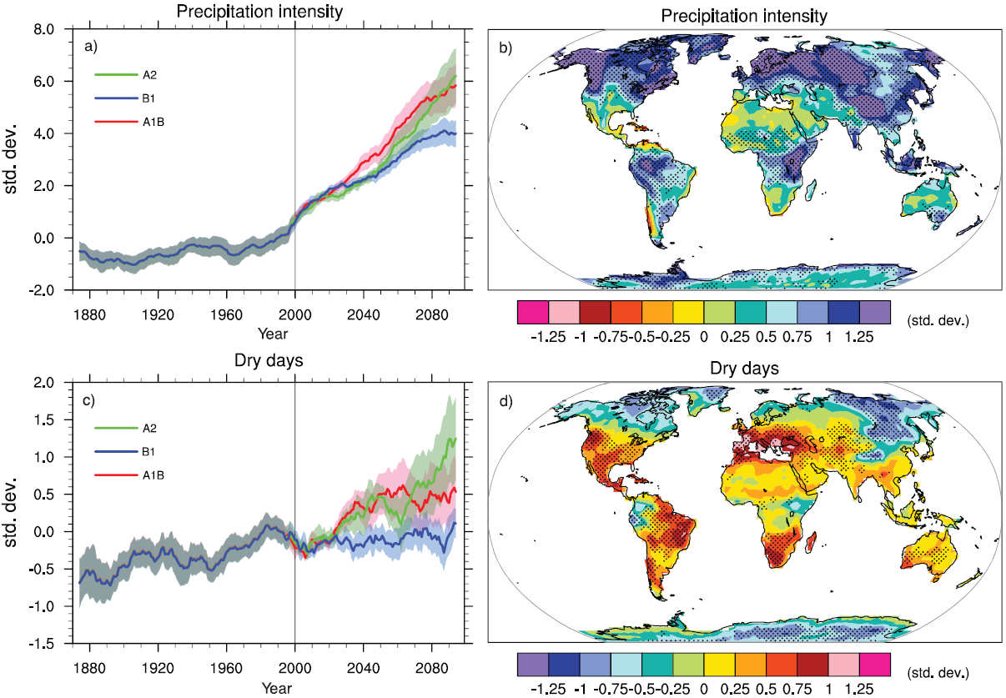
Hydrological Extremes
Notes:
These images were also taken from the IPCC’s Fourth Annual Report, sadly, the updated estimates in the rather lengthily named ‘Special Report on Managing the Risks of Extreme Events and Disasters to Advance Climate Change Adaptation (SREX)’ has only been released in summary so far…..
However, from this we can see that most of the world is expected to experience stronger precipitation intensities with the exceptions of north Africa, central America, and again, Chile.
Also, most of the world is expected to see more dry days (annual maximum number of dry days), except in very high latitudes.
Again though, how does this affect global hydrology? We have seen the estimated impacts on annual average runoff, but what about extreme events? What does it mean for flood risk and our water supplies?

Slide 5
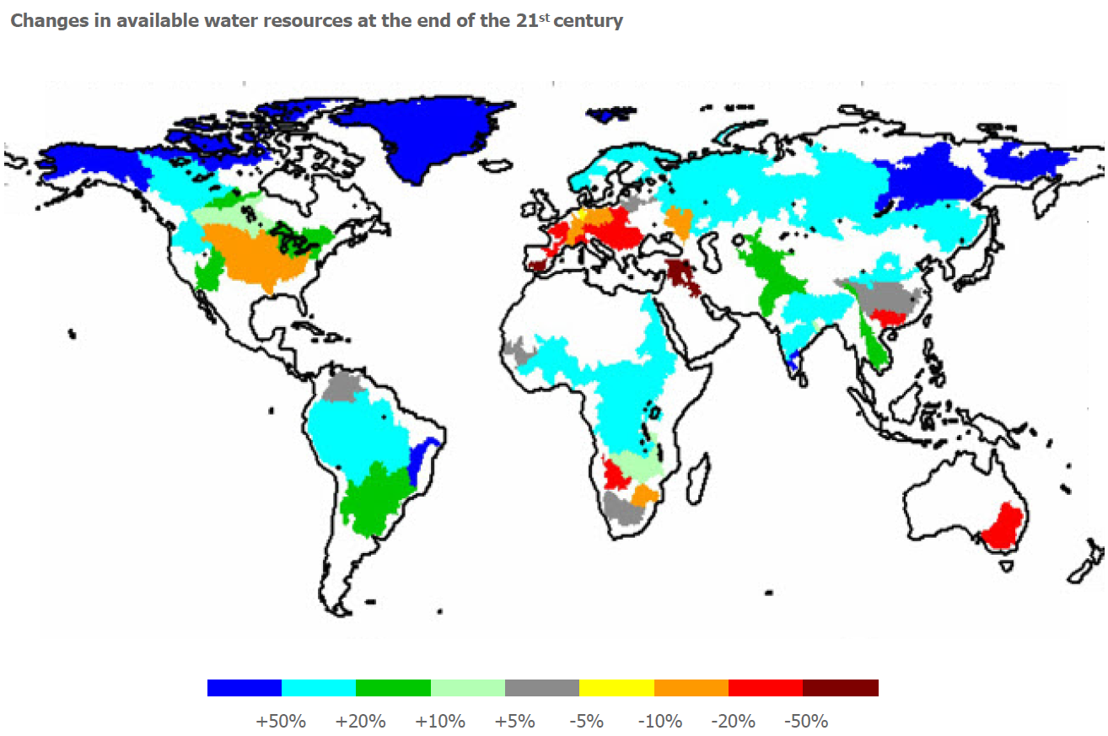
WATCH
[WATCH Outreach Report, Oct 2011]
Notes:
This is where WATCH – Water and Global Change have focussed their research.
This map shows individual river basins across the world, and how much water they will have available by the end of the century. Here we can see that unlike in the IPCC reports, the trends are not according to location, but according to river basin. For example in Africa, Okavango River (in red) that is predicted to provide just over half of the amount of water by 2071-2100 than it did in 1971-2000 , borders the Zambeze (in light green) which may have up to 10% more water by the end of the century than they did a decade ago, and Congo, Volta, Niger and Nile (in light blue) rivers which are predicted to have up to 50% more water. This shows that it is more than just precipitation amounts and temperature that will affect our water resources, but that it will depend strongly individual catchment behaviour, and on our management of water abstractions from each river basin.
However, this map was derived from the total runoff for selected large-scale river basins minus an estimate of the environmental flow requirements in the respective basins. We have to ask ourselves where the uncertainties in these derivations originate. The runoff was projected from an ensemble of eight global hydrology models using data from three global climate models, which has been excellent pioneering research, but the calibration of and uncertainties within these models needs to be challenged. Furthermore, the origins of the estimate of environmental flow requirements is not explained.

Slide 6
Problems
Uncertainties are seldom recognised in modelling studies, and are even more rarely quantified.
Studies of the effects of climate change on river discharge have previously been at the catchment, or regional scale, and models are rarely globally applicable.
[map drawn with data from USGS Hydro1K]
Notes:
So, how do I intend to build on this?

Slide 7
Aims
To rigorously test the sensitivity of the Global Hydrological Model to a full range of parameters.
To assess how climate change may affect global daily runoff, including extreme flows.
To understand the uncertainties inherent in global hydrology projections.

Slide 8
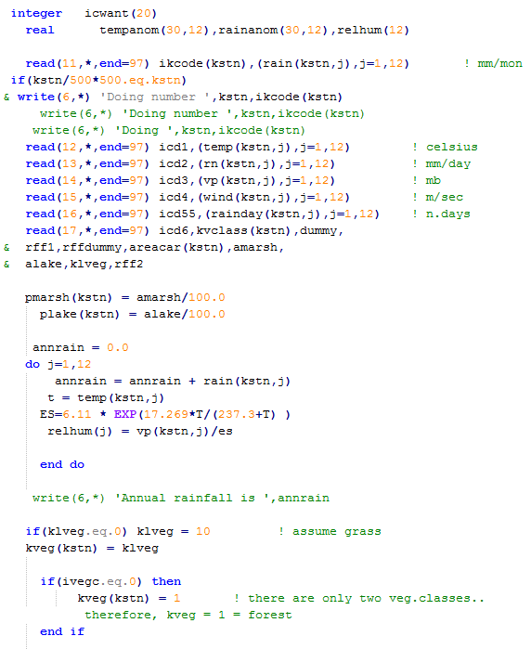
The Model
Using MacPDM.09 (Macro scale Probability Distributed Moisture model)
  Written in FORTRAN -------→
Used as one of the models in the WATCH report
Going to use forcing data from WATCH
Notes:
The model is 0.5° x 0.5° resolution and written in FORTRAN, as shown here. I’m currently trying to decipher it!
It was used as one of the eight models in the WATCH report, though it was used in its default calibration, which may not have been appropriate.
But Im going to use the forcing data that WATCH produced as part of that project and have only just released. They’re good observational and projected climate datasets, formatted for MACPDM.
I’m currently trying to familiarise myself with this model, learn FORTRAN, UNIX and MATLAB coding, and secure the hard disk space I’ll need for the data (several terabytes in size!!)

Slide 9
Progress
Notes:
So far, I’ve successfully run the model on the Nottingham High Performance Computing Cluster (which quickly deals with projects that require lots of processing power) with a different climate forcing dataset from ClimGen.
It was a little difficult to get the model to work on the system as it was previously based in Reading, and our systems are a little ‘pickier’ than theirs.
I have also managed to find a way to plot up the results in ArcMap, as we don’t have the toolbox in MATLAB that Simon used to use!

Slide 10
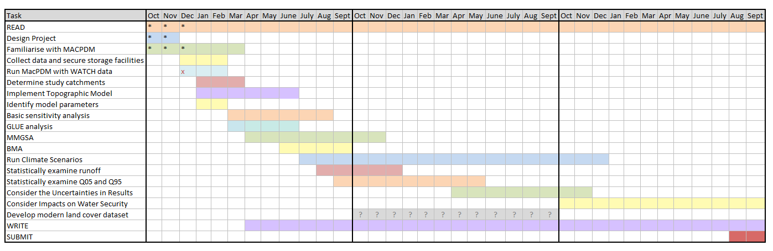
The Plan
My Timeline – Gantt Chart
‘Living Document’
Checking off what I’ve completed (or not) so far
Have an option for further work in developing a more modern land cover dataset (GlobCover2009) if I have time.
Notes:
This is my timeline, breaking down the specific parts of my project, how long they should take, and when I think I should be getting them done
It’s a ‘Living Document’ – year 1 is currently broken down quite well, the following years are more uncertain. The specifics of those tasks will come to light nearer the time.
The line of grey question marks indicates a branch of extra work I could do if I have the time, in developing a more modern land cover dataset and investigating the changes that has on the model outputs.

Slide 11
Next Steps for This Year
Run the model with the WATCH data.
Identify a set of catchments I want to focus my assessments on
Implement the topographic model
Identify model parameters
Run GLUE, MMGSA and BMA experiments.
Notes:
Run the model with Watch data
Identify catchments:
Catchments in high latitudes and dry climates where the model struggles
Catchments of significant societal importance (cross boundary, especially large, low lying, heavily relied upon for irrigation)
Implement topographic model
Routes MacPDMs surface runoff to river discharge
Identify parameters
Ones I can change easily – e.g. temperature threshold for snowmelt
Ones that are fixed in the model – e.g. field capacity
GLUE – generalised likelihood uncertainty estimation
MMGSA – multi-method global sensitivity analysis
BMA – Bayesian model averaging
All methods to systematically perturb the models parameters to identify the influence of each on the models outputs
GLUE produces a ranking of the ‘realisations’ (set of model parameters) that best predict the observed data from a set of several thousand model runs.

Slide 12
Any Questions?

