Slide 1
PIPELINE ENVIRONMENTAL MONITORING:
MEASURING ENVIRONMENTAL IMPACTS OF OIL PIPELINES USING REMOTE SENSING AND GIS
Bashir Adamu (Mr.)
ba108@le.ac.uk
SUPERVISORS:
Kevin J. Tansey (Dr.) and
Michael J. Bradshaw (Professor)
DEPARTMENT OF GEOGRAPHY
UNIVERSITY OF LEICESTER

Slide 2
Presentation Outline
Introduction
Aim and Objectives
Literature Review
Methodology

Slide 3
Introduction
Increasing legislation and regulatory pressures in many countries to improve the safety of pipelines carrying hydrocarbons
In the USA there are 3, 476, 000 km of pipelines carrying hydrocarbons
In Russia there 0.11 to 0.14 pipe breaks/km/year
Oil spill as a result of pipeline operations in Ogoniland, Nigeria from 1986-2011 (UNEP, 2011)

Slide 4
Background Cont…
The construction of pipelines ushered in many good and bad consequences
It is an efficient and economic transportation means for petroleum products (Da Silva et al, 2005)
Inadequate monitoring and repairs oil facilities results…..
Impact on natural environment (vegetation , water and soil)
Total Petroleum Hydrocarbons (TPH) detected in groundwater exceeds 1 million micrograms/litre in the Niger Delta (UNEP – 2011)

Slide 5
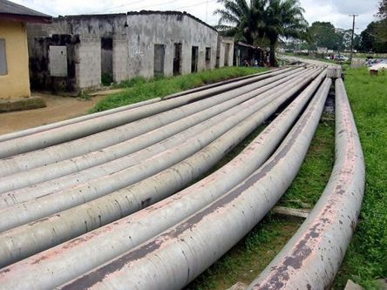
Where is the regulatory compliance?

Slide 6
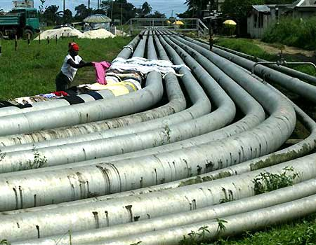
PIPELINE POTENTIAL DANGER TO SURROUNDING COMMUNITIES

Slide 7
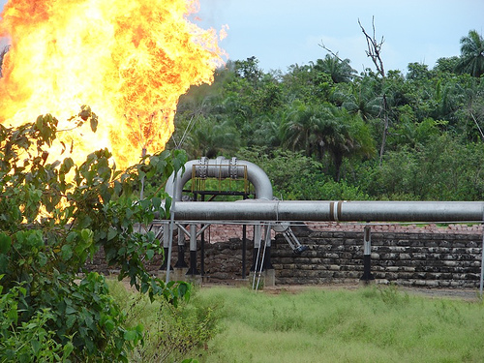
Pipeline Explosion

Slide 8
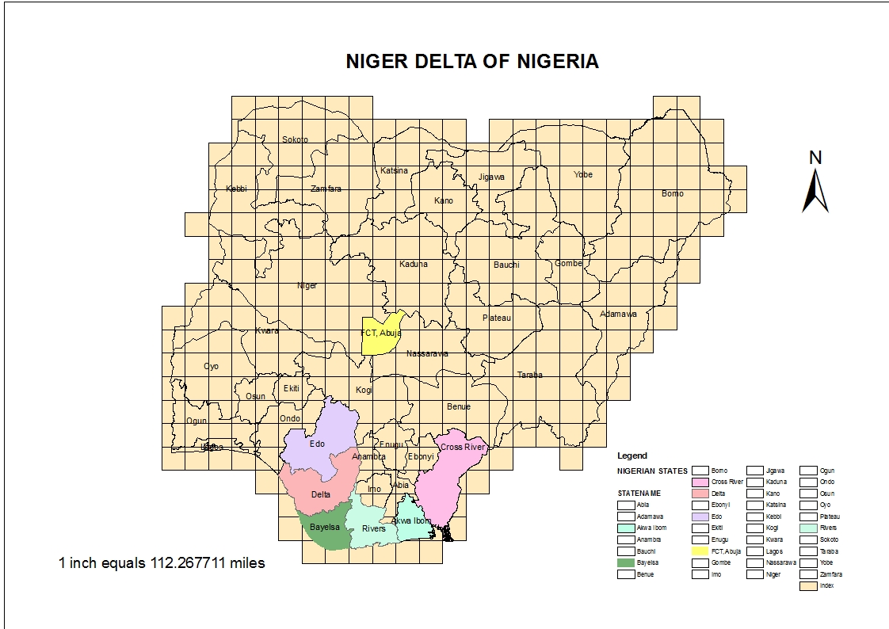
Study Area

Slide 9
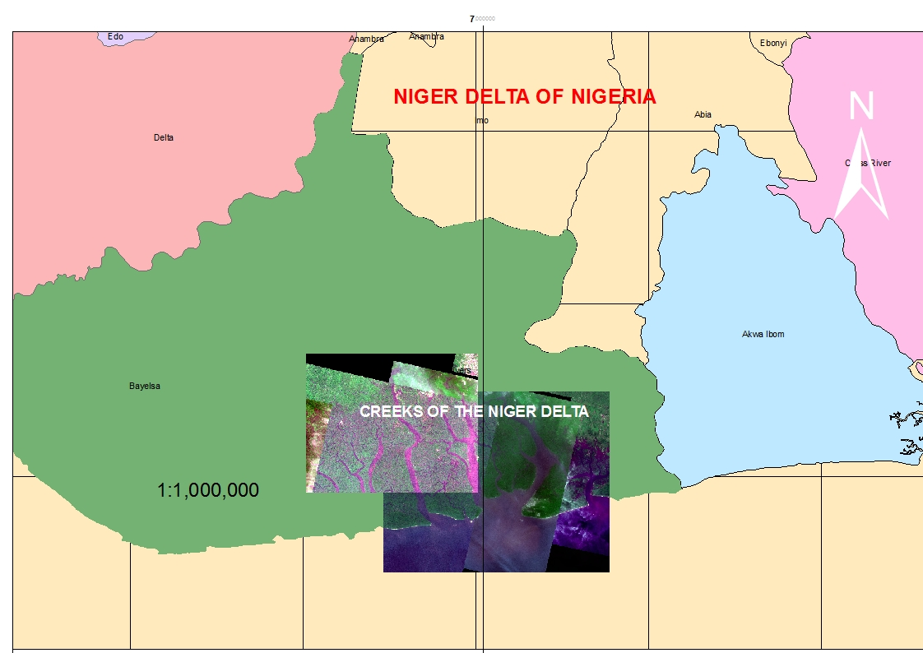
A Spot Image of the Section of Niger Delta

Slide 10
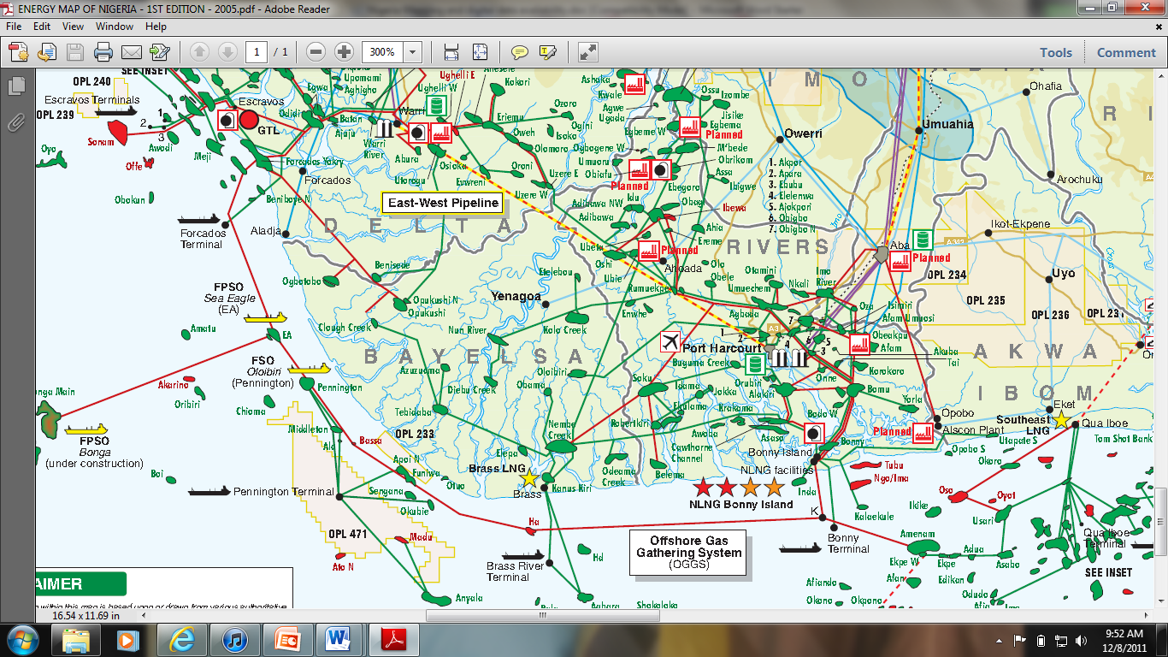
NIGERIA’S ENERGY MAP – THE PETROLEUM ECONOMIST/NNPC(2005)
Creeks of the Niger Delta

Slide 11
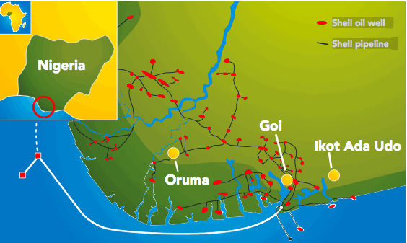
PIPELINE NETWORK BELONGING TO ONE OF THE OPERATORS (SHELL NIGERIA)

Slide 12
PIPELINE SAFETY AND SECURITY IMPLICATIONS –UNEP, 2011

Slide 13
ECOSYSTEMS UNDER THREATS - UNEP, 2011
Pipeline Routes
Polluted Water

Slide 14
Oil Facility: Safety and Security Implications in the Niger Delta
(UNEP, 2011)

Slide 15
CONTAMINATED SITES – UNEP, 2011

Slide 16
POLLUTED SCENE – UNEP, 2011

Slide 17
Aim and Objectives
……..evaluate environmental stress induced by pipeline operations using integrated remote sensing and GIS techniques
Objectives are:
To map oil pipelines and Land Use Land Cover (LULC)
To carry out an assessment of trends in LULC changes as a result of oil pipeline operations
Assess the environmental impacts on the observed changes
Examine the regulatory standards on oil pipeline operations

Slide 18
Literature Review
So far, some relevant materials were identified on:
Remote Sensing/GIS (Bartholome, E. and Belward, A.S. 2007 , Casciello, D., Lacava, T., Pergola, N and Tramutol, V. 2011, Slonecker, T., Fisher, G.B., Aiello, D.P. and Haack, B. 2010)
Land use/land cover classification systems (McCallum, I., Obersteiner, M., Nilsson, S. and Shvidenko, A. 2005, Hansen, M. C., Defries , R. S., Townshend, J. R. G. and Sohlberg, R. 2010, Li, G., Lu, D., Moran, E. and Hetrick, S. 2011)
Environmental impact resulting from oil spills were (Ipingbemi, O. 2009, Nduka, J.K. and Orisakwe, O.E. 2011)
Oil pipeline leakages (Hausamann, D., Zirnig, W., Schreier, G. and Strobl, P. 2005)

Slide 19
Methodology Cont…..
Using hyper-spectral sensors (RADAR/LIDAR):
  Detect oil pipeline routes and leakages/spills
  Signature characteristics of feature targets (vegetation, soil and water)
  Map oil spill sites and classification of LULC

Slide 20
Methodology Cont…
Geographic Information System (GIS):
Creating Attribute Table
Digitizing Pipeline Map
Land Use Land Cover Analysis
New Output Maps

Slide 21
Data Sets and Sources
DATA | YEAR | FORMAT | SCALE/RESOLUTION | SOURCE | PURPOSE
Pipeline Map | Most Recent | Digital /Analogue (raster/vector) | Desired Industry Scale but prefer 1 : 50, 000 | Oil Companies, Department of Petroleum Resources (DPR), NNPC e.t.c | - integrated into remote sensing /GIS package for analysis - Pipeline routes identification
Satellite Data | 1990, 2000 and 2011 | Digital (tiff, img, jpeg) | Both low and high resolution images (<1m to 60m) would be suitable. | USGS, GEDAS Lagos, NASRDA Abuja, etc | Land cover classification Oil spill site detection and Mapping Analysis of changes
Topographical Map | 1990 and the most recent will serve batter | Digital/Analogue | 1 : 50, 000 | Surveyor General of Federation (Nigeria) | Identification of settlements and other land uses
Ancillary Data (Socio-economic, year of spill/incidents etc) | Past and Recent | Soft copies | Not applicable | Oil companies, DPR, NNPC, and other relevant federal environmental agencies | To be integrated into the GIS environment

Slide 22
Work Plan 2011 – 2014
 | RESEARCH WORK PLAN FROM OCTOBER 2011 - SEPTEMBER 2014
TASK SCHEDULE/MONTHS | FIRST YEAR |  |  |  | SECOND YEAR |  |  |  | THIRD YEAR
 | OCT-DEC | JAN-MAR | APR-JUN | JUL-SEP | OCT-DEC | JAN-MAR | APR-JUN | JUL-SEP | OCT-DEC | JAN -MAR | APR-JUN | JUL-SEP
REVIEW OF LITERATURE
COLLATION OF DESKTOP DATA
FIRST YEAR REVIEW
FIELD WORK PREPARATION
FIELD WORK
COMPILATION OF DATA
SECOND YEAR REPORT
DATA ANALYSIS
COMPILATION OF THEISIS MATERIAL
THESIS WRITE-UP
SUBMISSION OF INITIAL DRAFT
REVIEW OF THE FIRST DRAFT
SUBMIT INTENT
SUBMIT FINAL DRAFT
CONTINGENCY

Slide 23
THANK YOU FOR LISTENING

Slide 24
Bibliography
Bartholome, E. and Belward, A.S. 2007 - GLC2000: A New Approach to Global Land Cover Mapping from Earth Observation Data - International Journal of Remote Sensing Vol 26 issn 9 page 1959-1977
Casciello, D., Lacava, T., Pergola, N and Tramutol, V. 2011 - Robust Satellite Techniques for oil spill detection and monitoring using AVHRR thermal infrared bands International Journal of Remote Sensing vol 32 Issue 14, pp4107-4129
Hausamann, D., Zirnig, W., Schreier, G. and Strobl, P. 2005 - Monitoring of Gas Pipelines –A Civil UAV Application –Aircraft Engineering and Aerospace Tech- An International Journal
Hansen, M. C., Defries , R. S., Townshend, J. R. G. and Sohlberg, R. 2010 - Global land cover classification at 1 km spatial resolution using a classification tree approach: International Journal of Remote Sensing V 21:No 6-7, pp 1331-1364
Im, J. and Jensen, J.R. 2008 - Hyperspectral Remote Sensing of Vegetation – Geography Compass
Huang, Z. and Jia, Xiuping 2011 - Integrated Remotely Sensed Data, GIS and Expert Knowledge to Update-Objetc-based Land use/Land Cover information – International Journal of Remote Sensing vol.10 ISSN 1080/01431161.2010.536182 Page 1-17
Ipingbemi, O. 2009 - Socio-economic Implications and Environmental Effects of Oil Spillage in Some Communities in the Niger Delta – Journal of Integrative Environmental Sciences vol. 6 Issn 1 page 7-23
Li, G., Lu, D., Moran, E. and Hetrick, S. 2011 - Land-Cover Classification in a Moist Tropical Region of Brazil with Landsat TM Imagery – International Journal of Remote Sensing Vol. 31, ISSN 23 Page 8207-8230
Mas, J..F. 2010 - Monitoring Land Cover Changes: A Comparison of Change Detection Techniques - International Journal of Remote Sensing Vol 20 Issn 1 Page 139-152
McCallum, I., Obersteiner, M., Nilsson, S. and Shvidenko, A. 2005 - A spatial comparison of four satellite derived 1 km global land cover datasets- International Journal of Applied Earth Observation and Geoinformation 8 (2006) 246–255
Nduka, J.K. and Orisakwe, O.E. 2011 - Water-quality Issues in the Niger Delta of Nigeria: A Look at Heavy Metal Levels and Physicochemical Properties – Environmental Science Pollution Research Vol. 18, doc 10.1007/s11356-010-0366-3, pp 237-246
Slonecker, T., Fisher, G.B., Aiello, D.P. and Haack, B. 2010 - Visible and Infrared Remote Imaging of Hazardous Waste; A Review – Remote Sensing Journal Vol 2 ISSN 2072-4292 Page 2474-2508
UNEP 2011 - Environmental Assessment of Ogoniland, Nigeria – United Nations Environmental Programme

