Slide 1

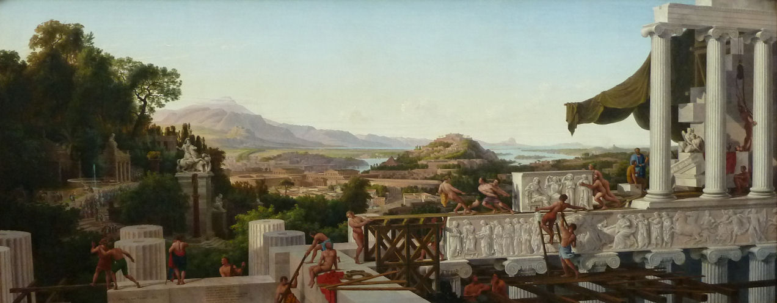
Form as Method.
KG LORENZ 2012
Digital Archives and Ancient Art
#DAMNMethod 

Slide 2
Digital Humanities as Age of the Encyclopedia…
“I believe (…) that we are entering a new phase of scholarship that will be dominated not by ideas but once again by organizing activities, in terms of both organizing knowledge and organizing ourselves and our work. (…)
The new technology of the Internet has shifted the work of a rapidly growing number of scholars away from thinking big thoughts to forging new tools, methods, materials, techniques, and modes of work that will enable us to harness the still unwieldy, but obviously game changing, information technologies now sitting on our desktops and in our pockets.”
Scheinfeldt, Tom (2012) ‘Sunset for ideology, sunrise for methodology?’, in: Matthew K. Gold (ed.), Debates in the Digital Humanities. Minneapolis: 125.

Slide 3
“The history of art often ignores that, by its very nature, it is confronted by analogous problems: by choices of knowledge, alternatives that entail loss, whichever option is chosen. This is called, strictly speaking, an alienation.
A discipline that is »informationizing« itself throughout, that guarantees the »scientific« basis of the world art market, that accumulates staggering amounts of data – is such a discipline ready to come to terms with itself as alienated, as constitutionally alienated by its objects, and thus inescapably subject to loss?”
Georges Didi-Huberman (2005) Confronting Images: Questioning the ends of a certain history of art. Philadelphia: 33.
Data Collection as Alienation…Organising as Ideological Act

Slide 4
Area Studies – well-edited volumes of different kinds of primary evidence.
Formal Typologies – systematic description.
Displacement and Fragmentation – modelling and reconstruction.
Classics…Parameters of a Subject Area

Slide 5
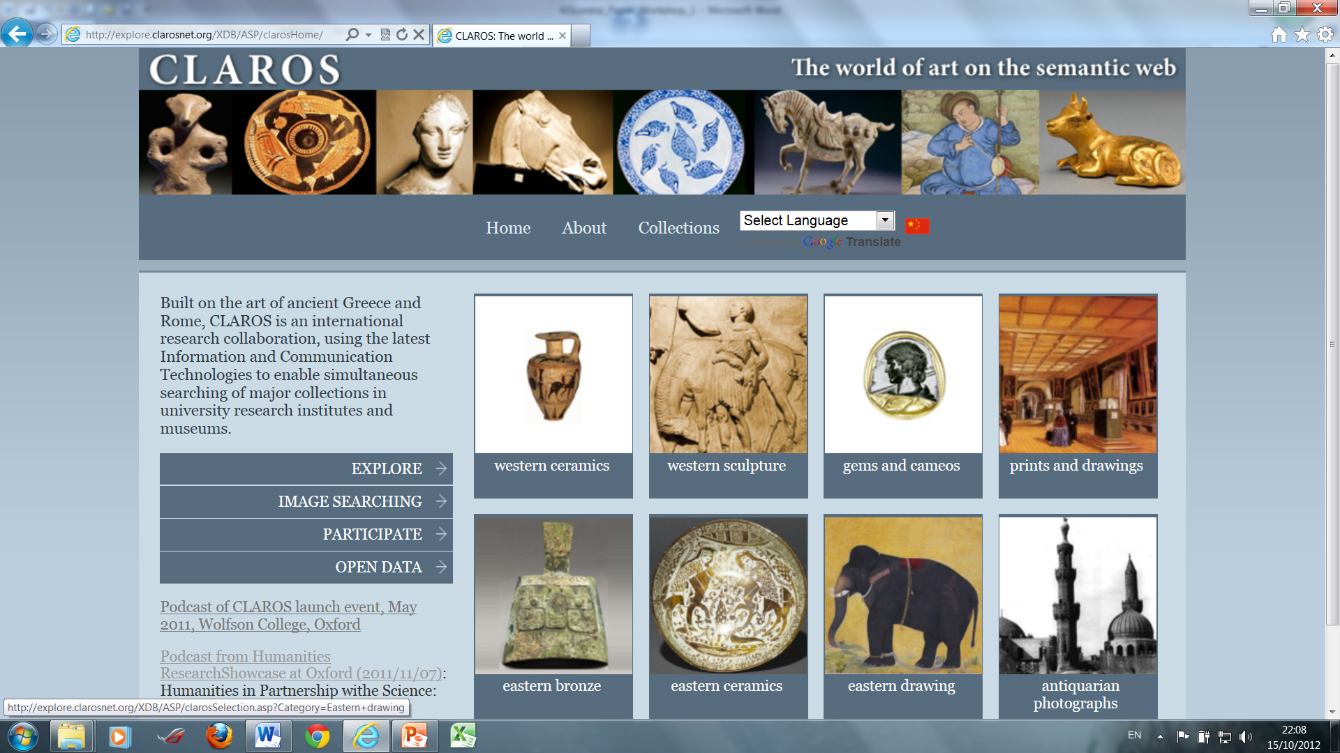
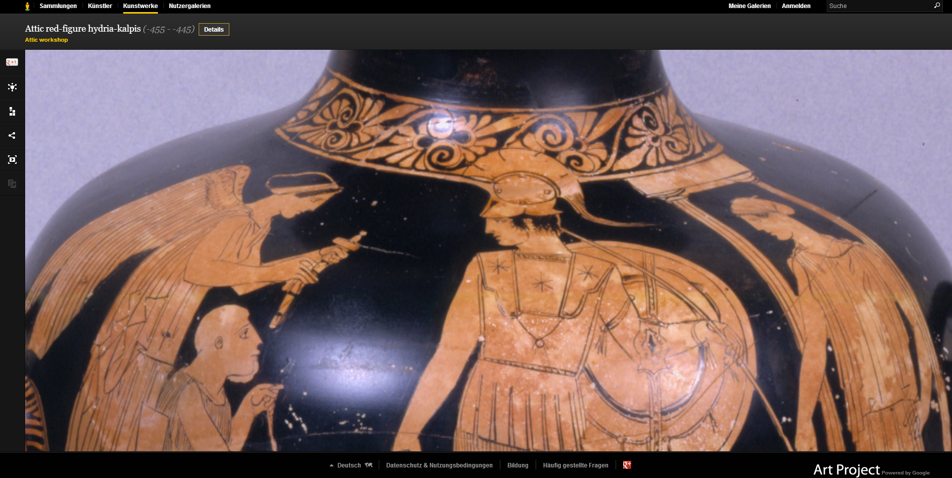
Classics and the Infinite Archive…Museum Sites

Slide 6
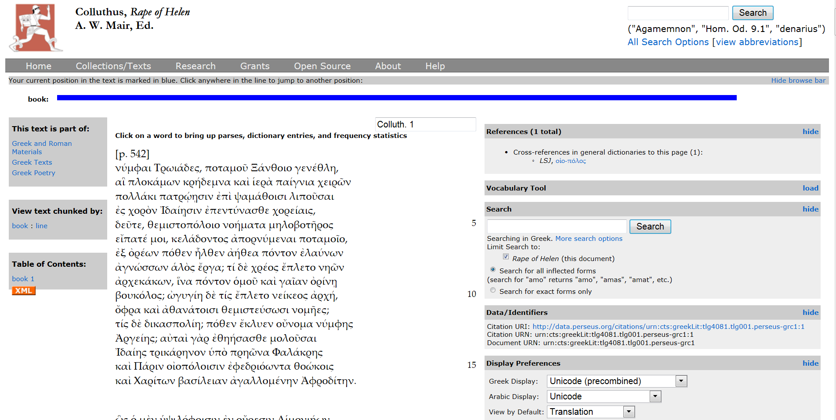
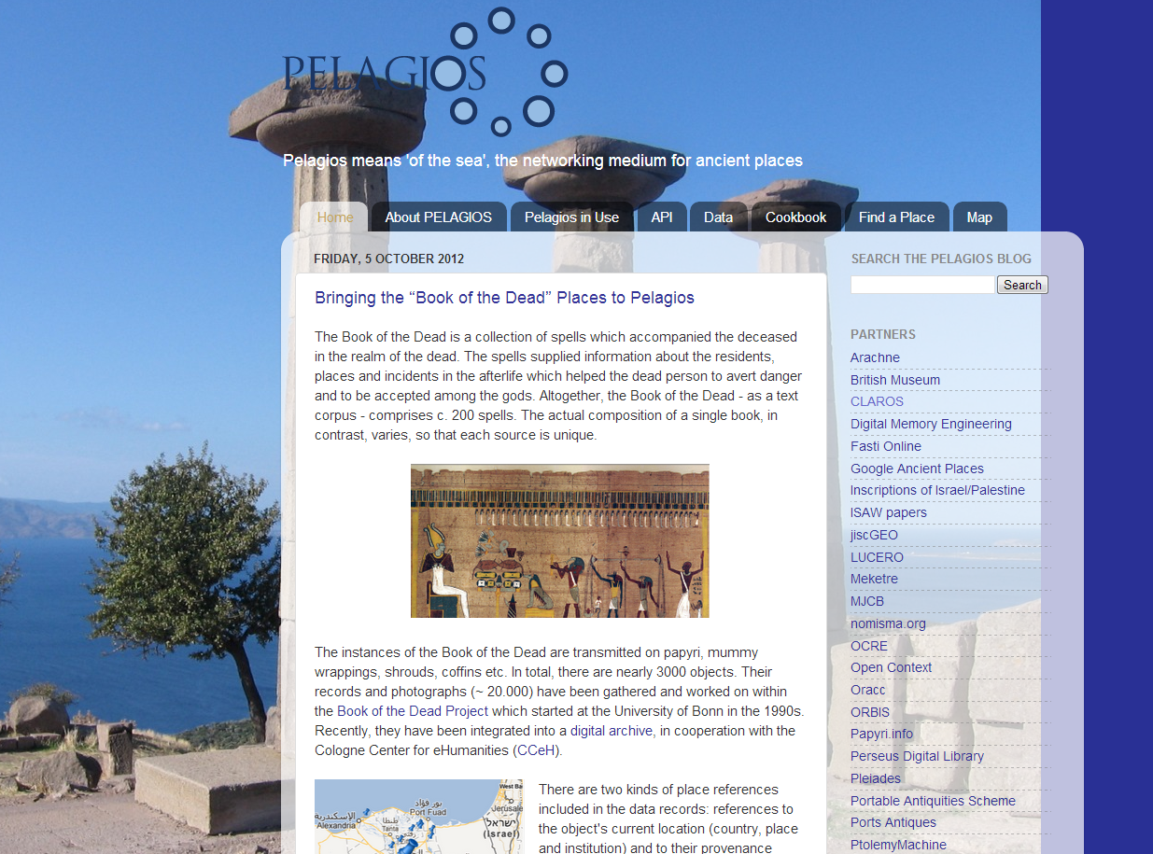
Classics and the Infinite Archive…Perseus & Pelagios

Slide 7
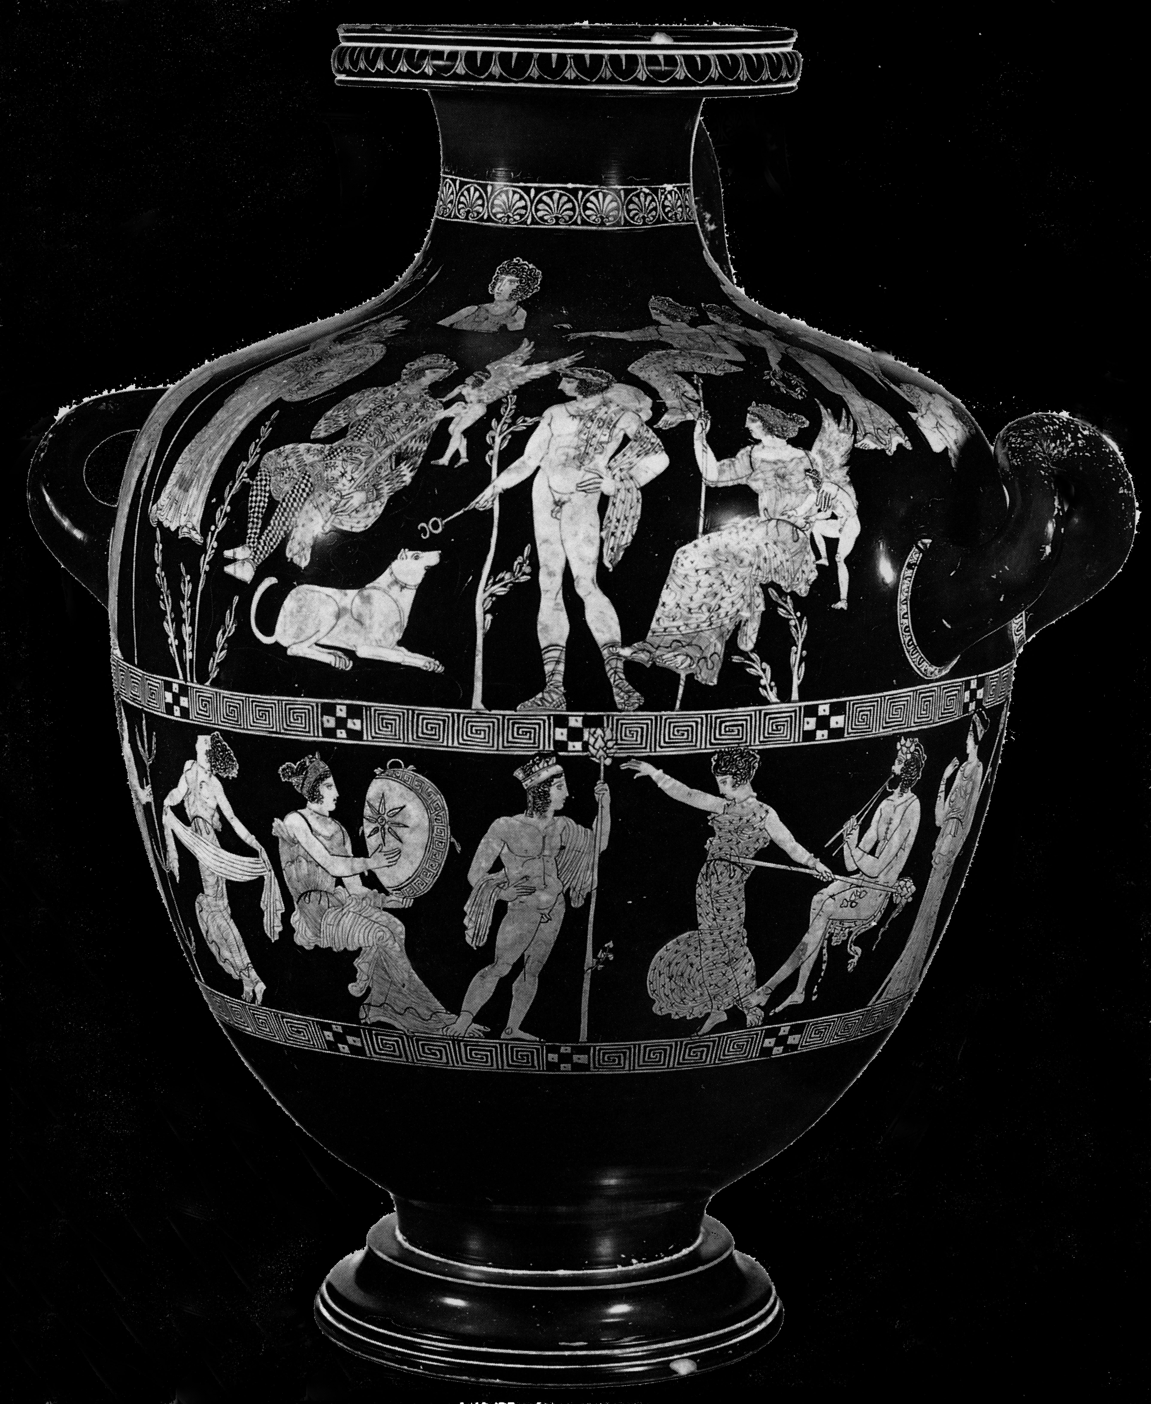
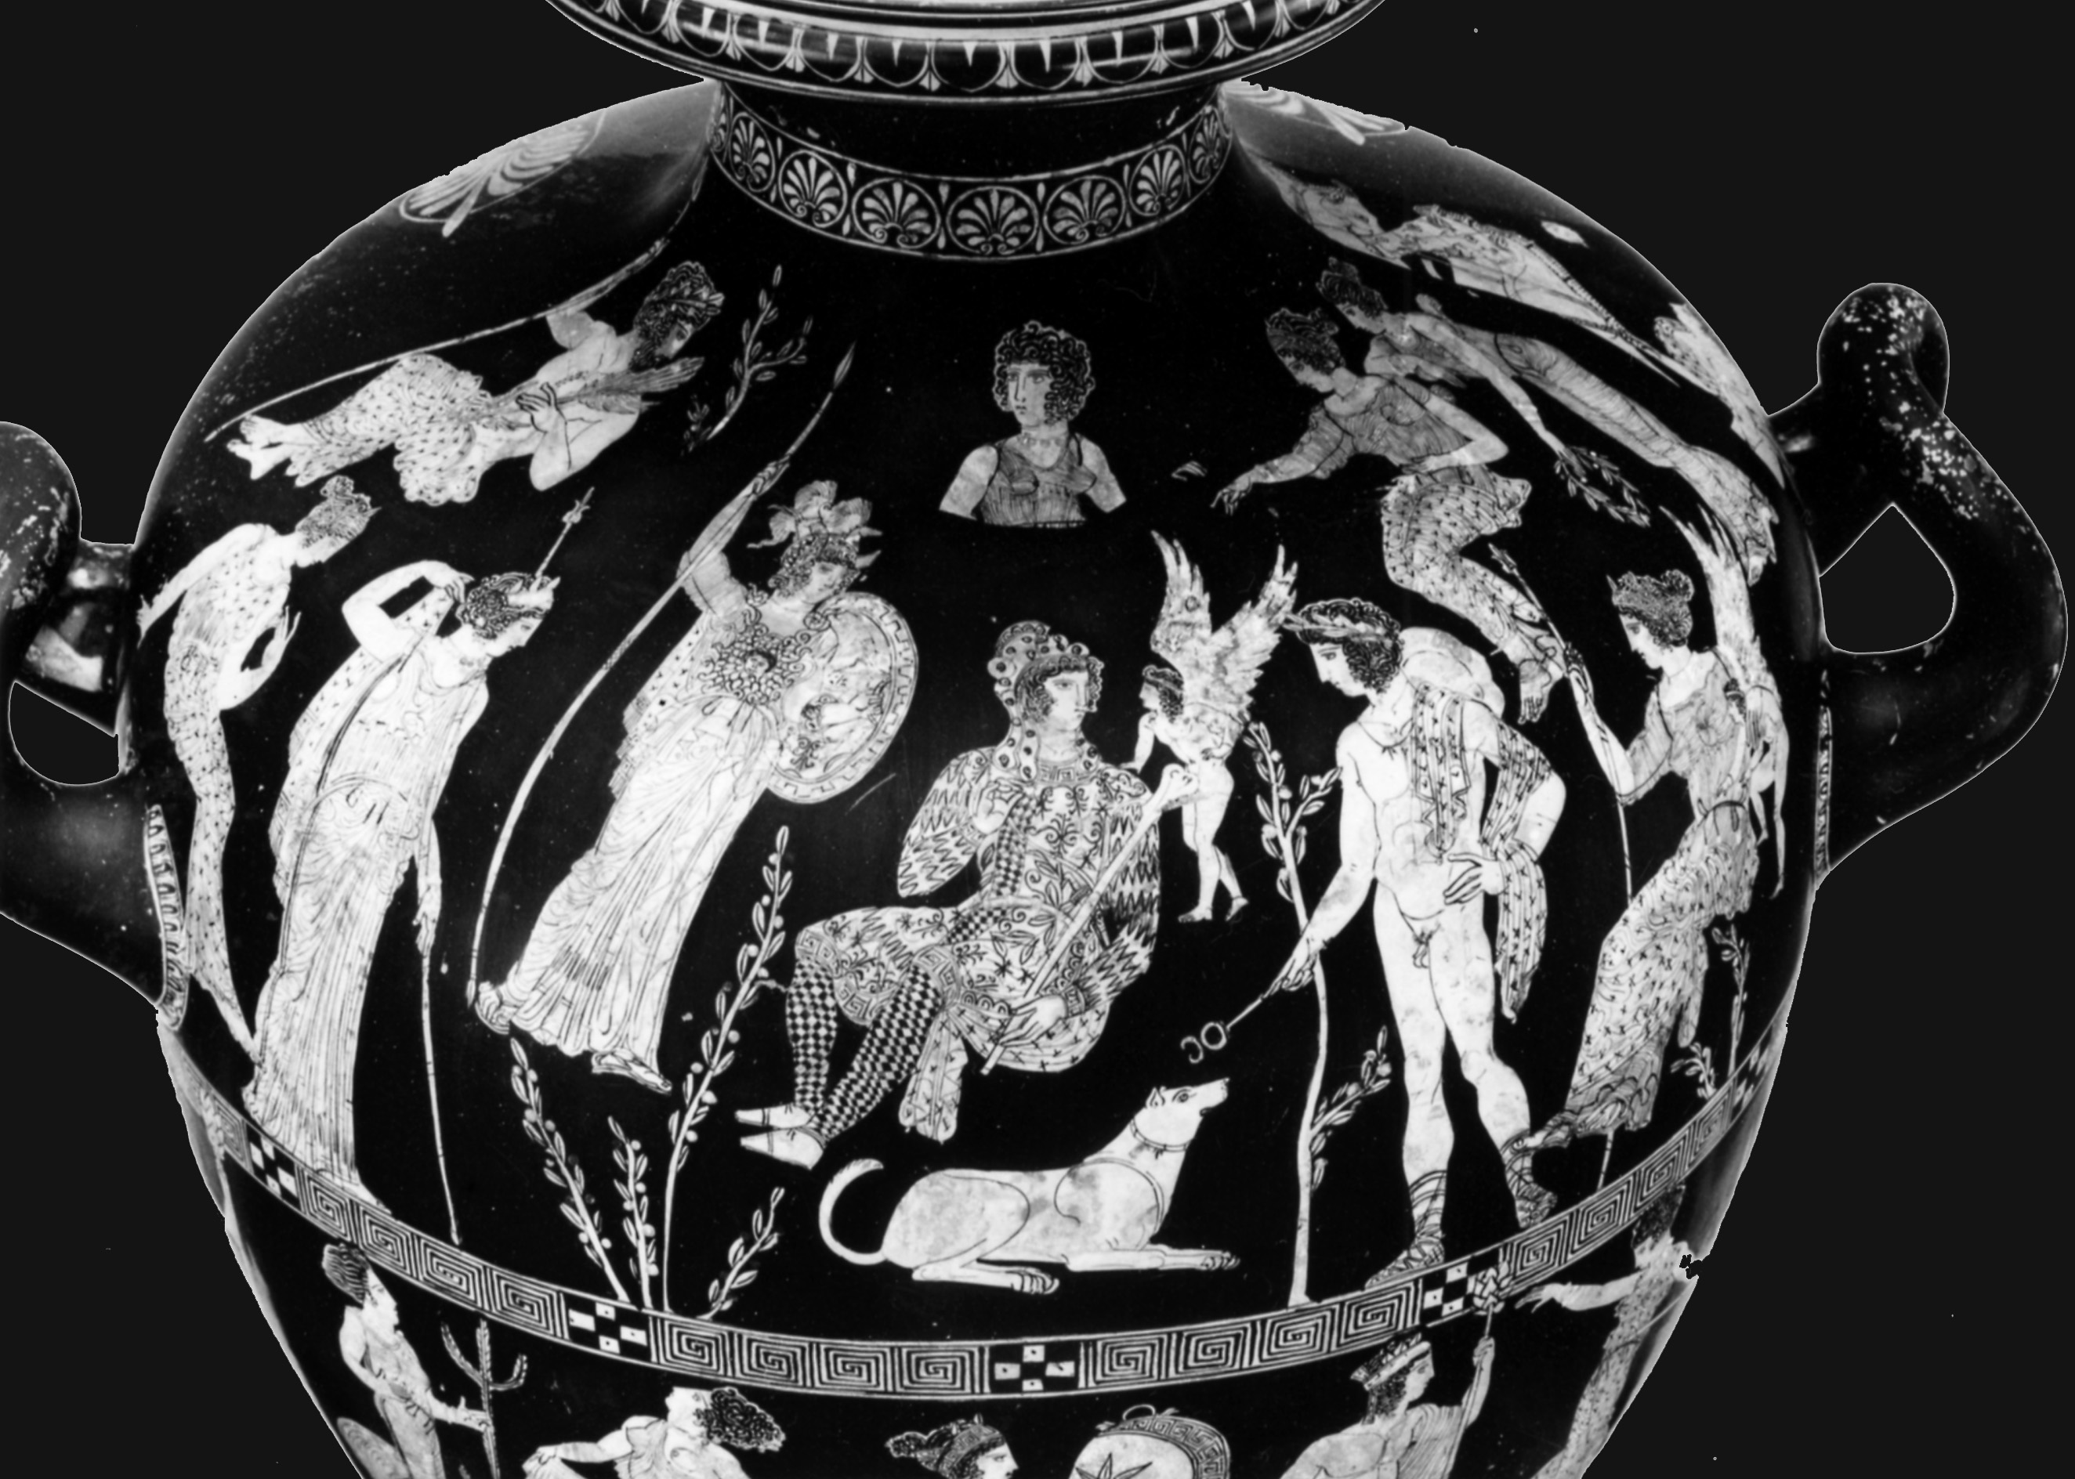
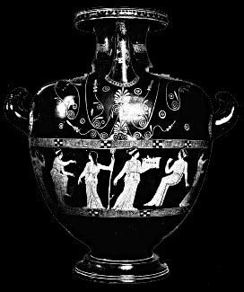
Case Study…The Carlsruhe Hydria. c. 420 BC.

Slide 8
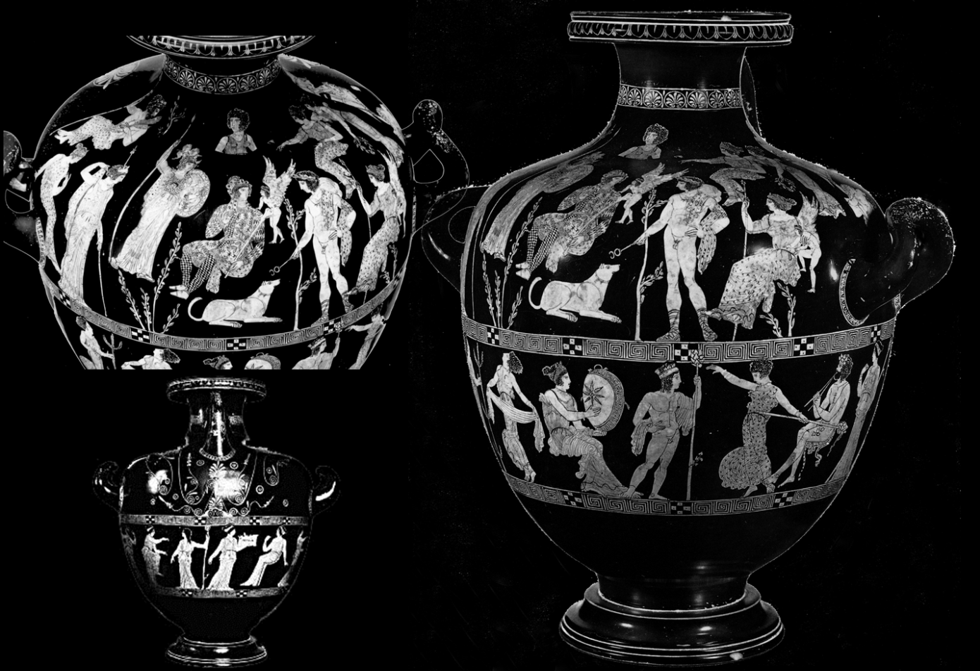
Horizontal iconology:
Parallels for mythological, semi-mythological (personifications), and non-mythological characters?
Vertical iconology:
Relationship/meaning of figures and decorative elements?
The Carlsruhe Hydria…My Questions.

Slide 9
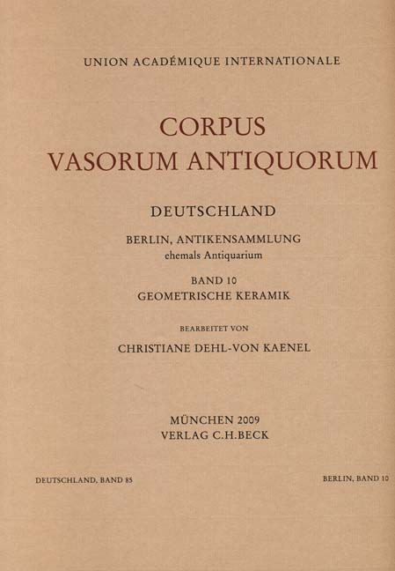
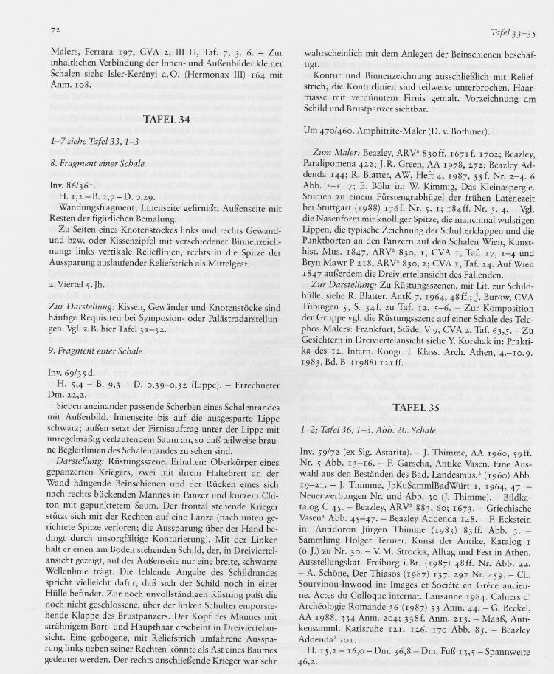
Corpus Vasorum Antiquorum (CVA):
Object-specific [late 19th century and ongoing)
organisation principle: country, collection, formal typology, by piece, incl. illustrations
The Tools of the Vase-Painting Scholar I….Analogous.

Slide 10
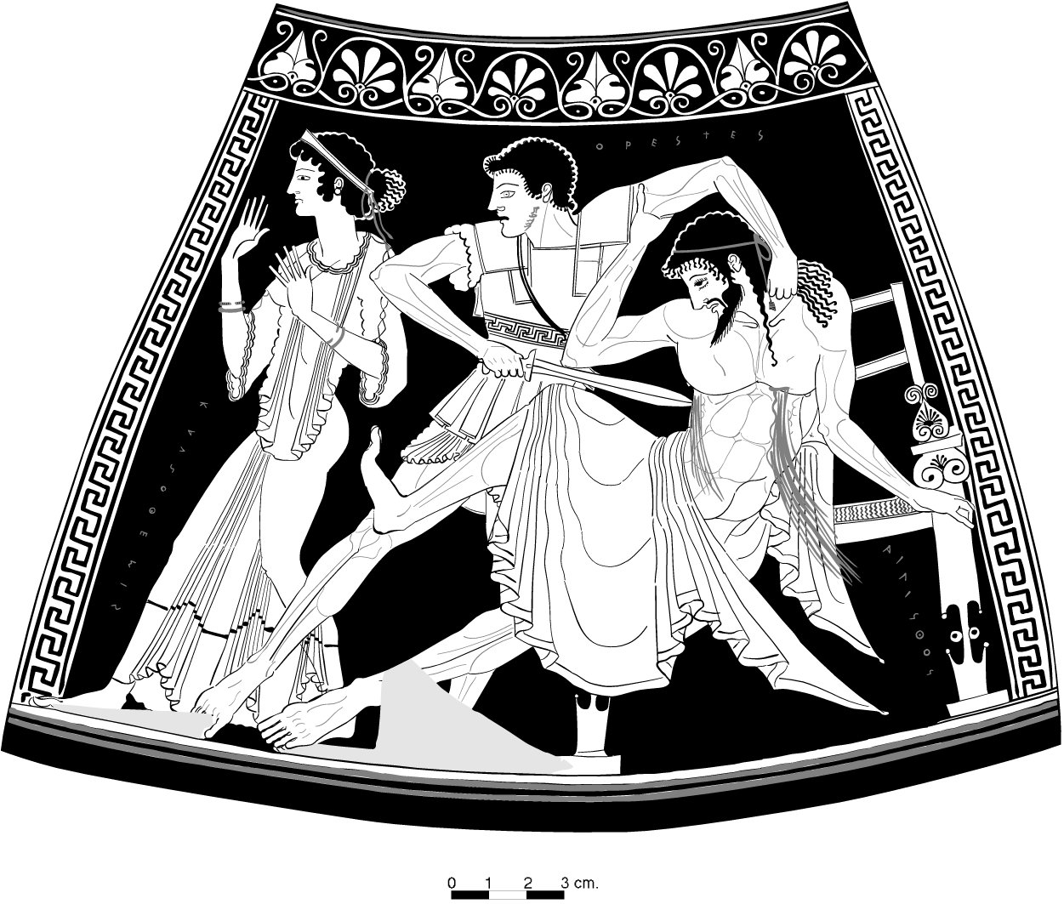
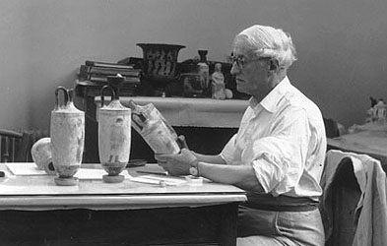
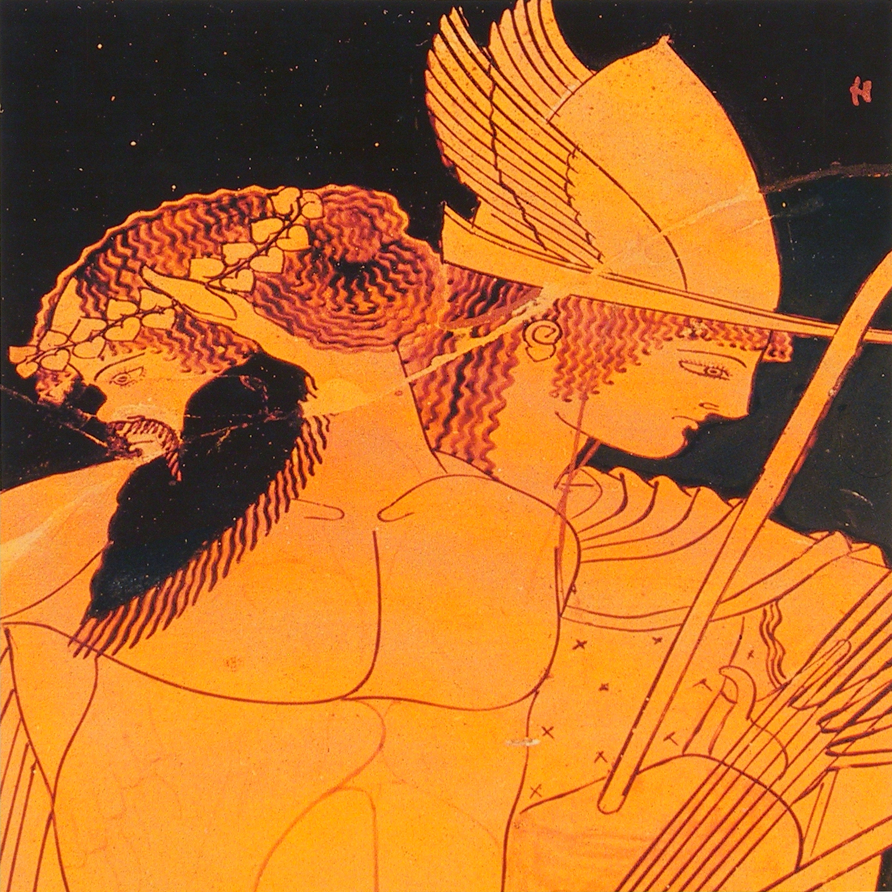
Beazley Archive:
artist-specific, “connoisseurship” [1920s-1960s)
organisation principle: formal typology, groupings of vases attributed to artistic “hands” (phone-book style lists, no illustrations)
The Tools of the Vase-Painting Scholar I….Analogous.

Slide 11
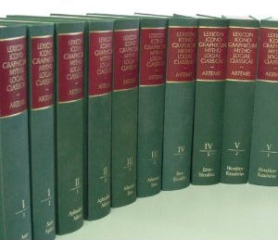
Lexicon Iconographicum Mythologiae Classicae (LIMC):
Iconography-specific [1980s, 1990s)
organisation principle: mythological figures, by object (phonebook-style lists in one volume, illustrations in another)
The Tools of the Vase-Painting Scholar I….Analogous.

Slide 12

Horizontal iconology:
Parallels for mythological, semi-mythological (personifications), and non-mythological characters?
Vertical iconology:
Relationship/meaning of figures and decorative elements?
Corpus Vasorum Antiquorum (CVA):
Answers formal and iconographic aspects – underpins horizontal and vertical iconography.
Beazley Archive:
Answers formal aspects – underpins vertical iconology.
Lexicon Iconographicum Mythologiae Classicae (LIMC):
Answers iconographic asepcts re mythological figures – underpins horizontal iconology.
The Carlsruhe Hydria…Analogous Answers to My Questions.

Slide 13
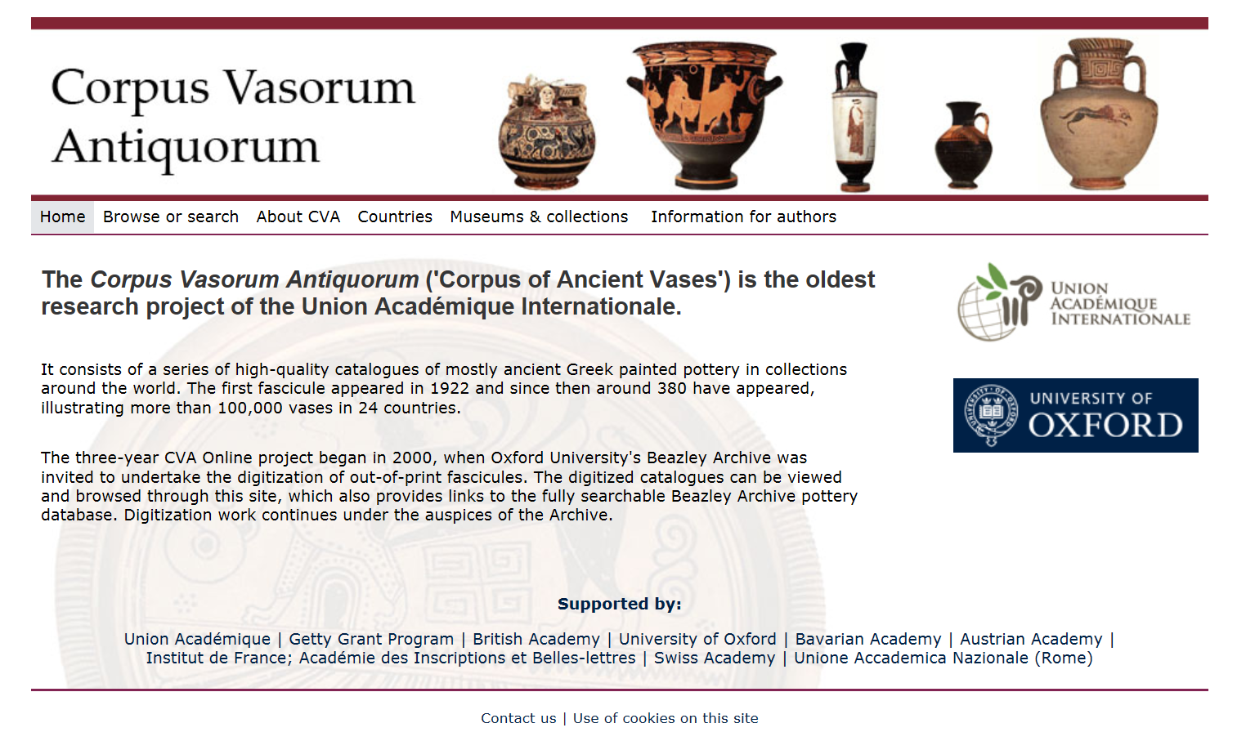

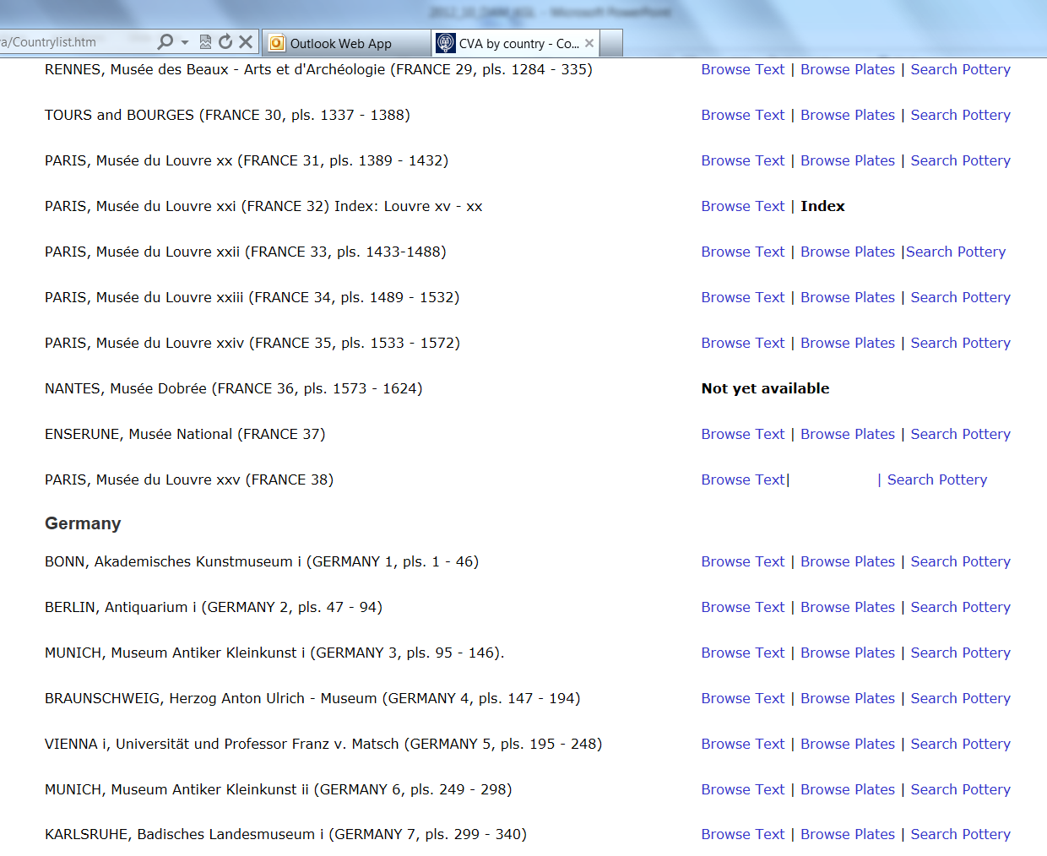
Corpus Vasorum Antiquorum (CVA):
A scanned replication in the digital – identical functionality as paper version.
The Tools of the Vase-Painting Scholar II – Digital.

Slide 14
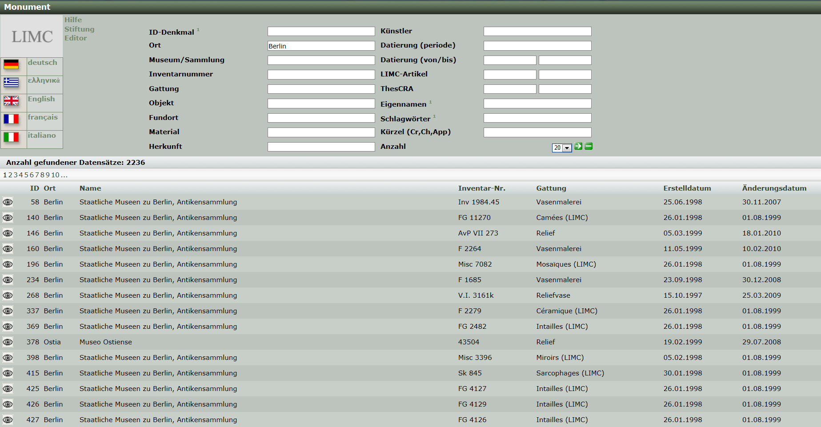
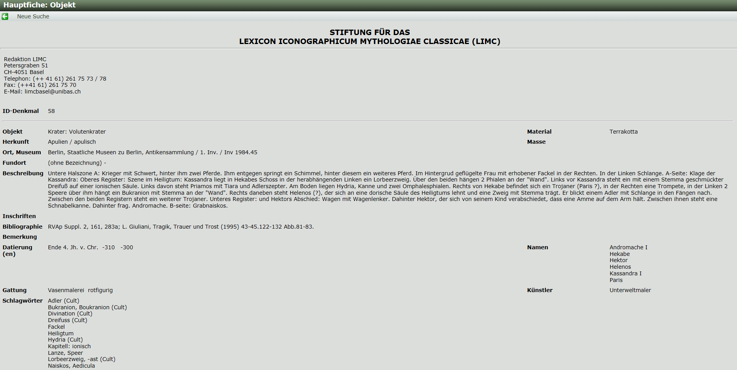
Lexicon Iconographicum Mythologiae Classicae (LIMC):
Data sets (selection) of the paper version, without illustrations – reduced functionality.
The Tools of the Vase-Painting Scholar II – Digital.

Slide 15
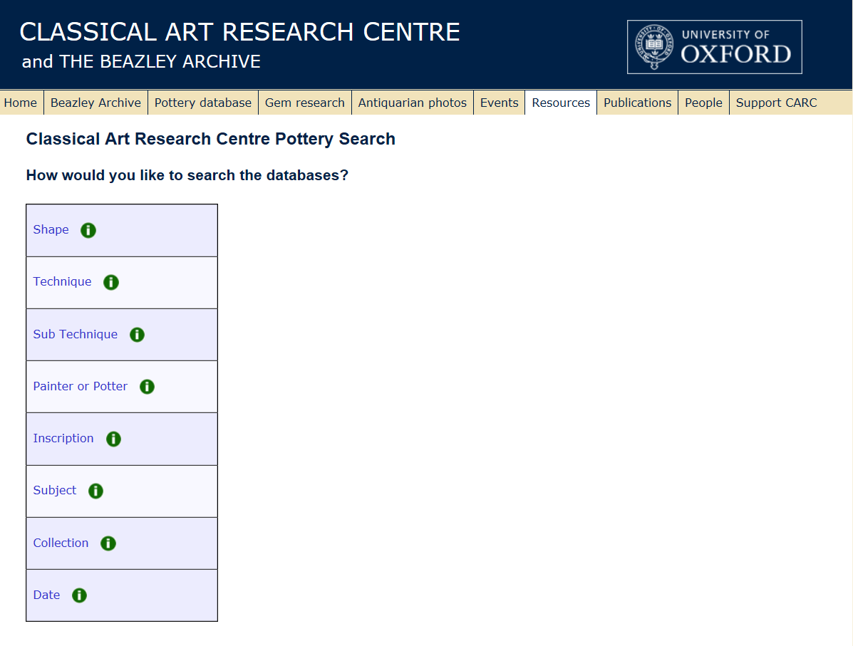
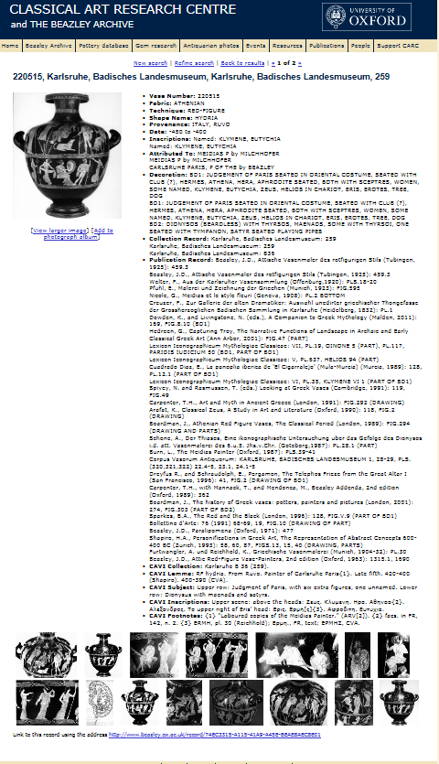
Beazley Archive:
Data sets of the paper version, now including illustrations and keyword search for form and iconography – significantly increased functionality.
The Tools of the Vase-Painting Scholar II – Digital.

Slide 16
Horizontal iconology:
Parallels for mythological, semi-mythological (personifications), and non-mythological characters?
Vertical iconology:
Relationship/meaning of figures and decorative elements?
Corpus Vasorum Antiquorum (CVA):
Still answers formal and iconographic aspects – underpins horizontal and vertical iconography.
Lexicon Iconographicum Mythologiae Classicae (LIMC):
Still answers iconographic asepcts re mythological figures, but now fewer – underpins horizontal iconology.
Beazley Archive:
Now answers formal and iconographic aspects – underpins horizontal and vertical iconology. BUT: the ruptures between the three strands of information remain.
The Carlsruhe Hydria…Digital Answers to My Questions.

Slide 17
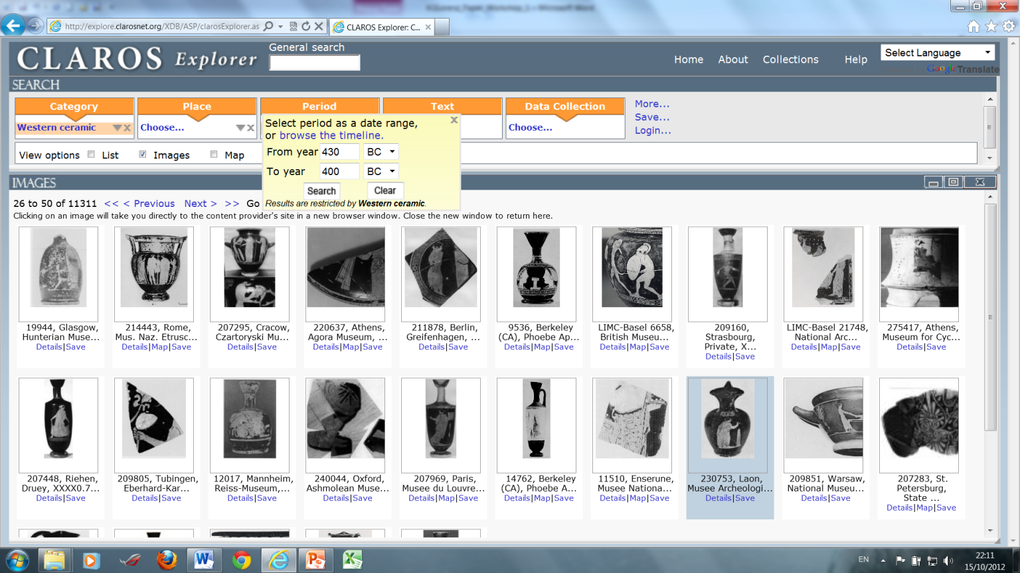
Pseudo Multi-Relationality…Claros Semantic Net.

Slide 18
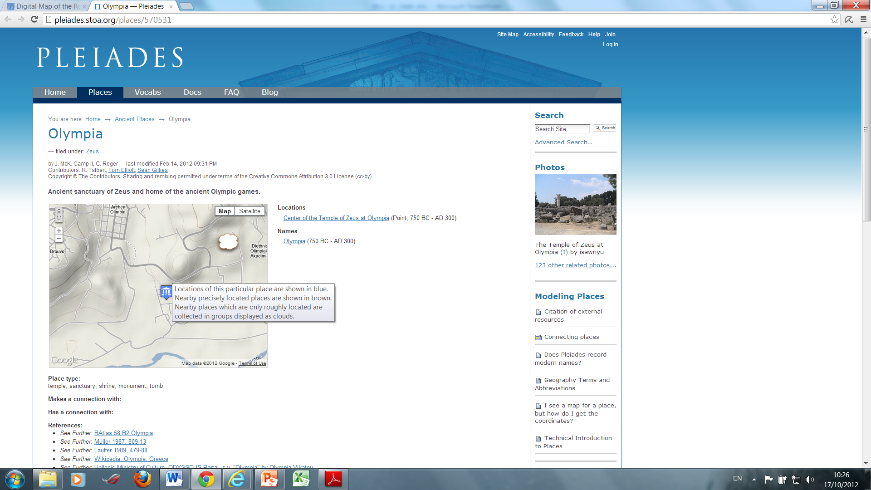
De-Facto Multi-Relationality around Place Names…Pelagios.

Slide 19

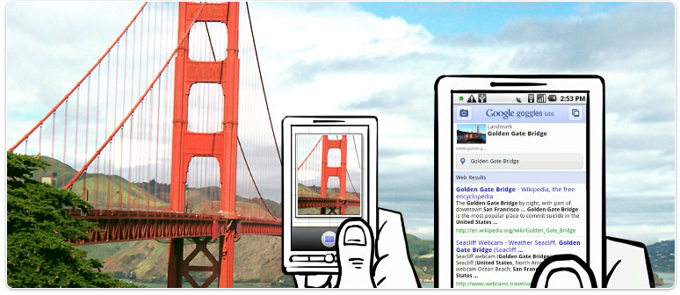
Coda…My Dream Resource: Connex of Form and Content + Visual Search.

