Slide 1
Matthew Tyler-Jones
Is there a place in heritage spaces for the gamification of adult learning?

Slide 2
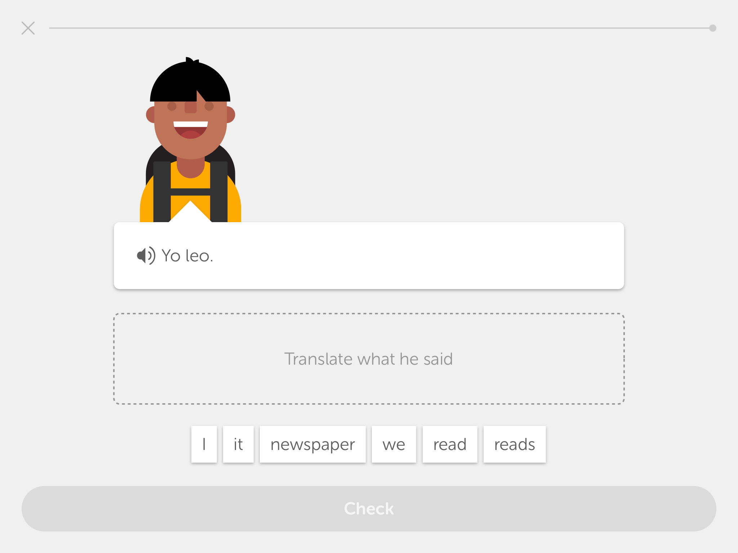

Slide 3
I […] began to wonder whether the kind of games user-interface I had been developing for so long could be used to turbo-charge all manner of transactions and activities on commercial electronic devices – in-flight video, ATM machines, vending machines, mobile phones, etc. Unsurprisingly, this was the point when I coined the deliberately ugly word “gamification“, by which I meant applying game-like accelerated user interface design to make electronic transactions both enjoyable and fast.
Nick Pelling (2011) The (short) prehistory of “gamification”…

Slide 4
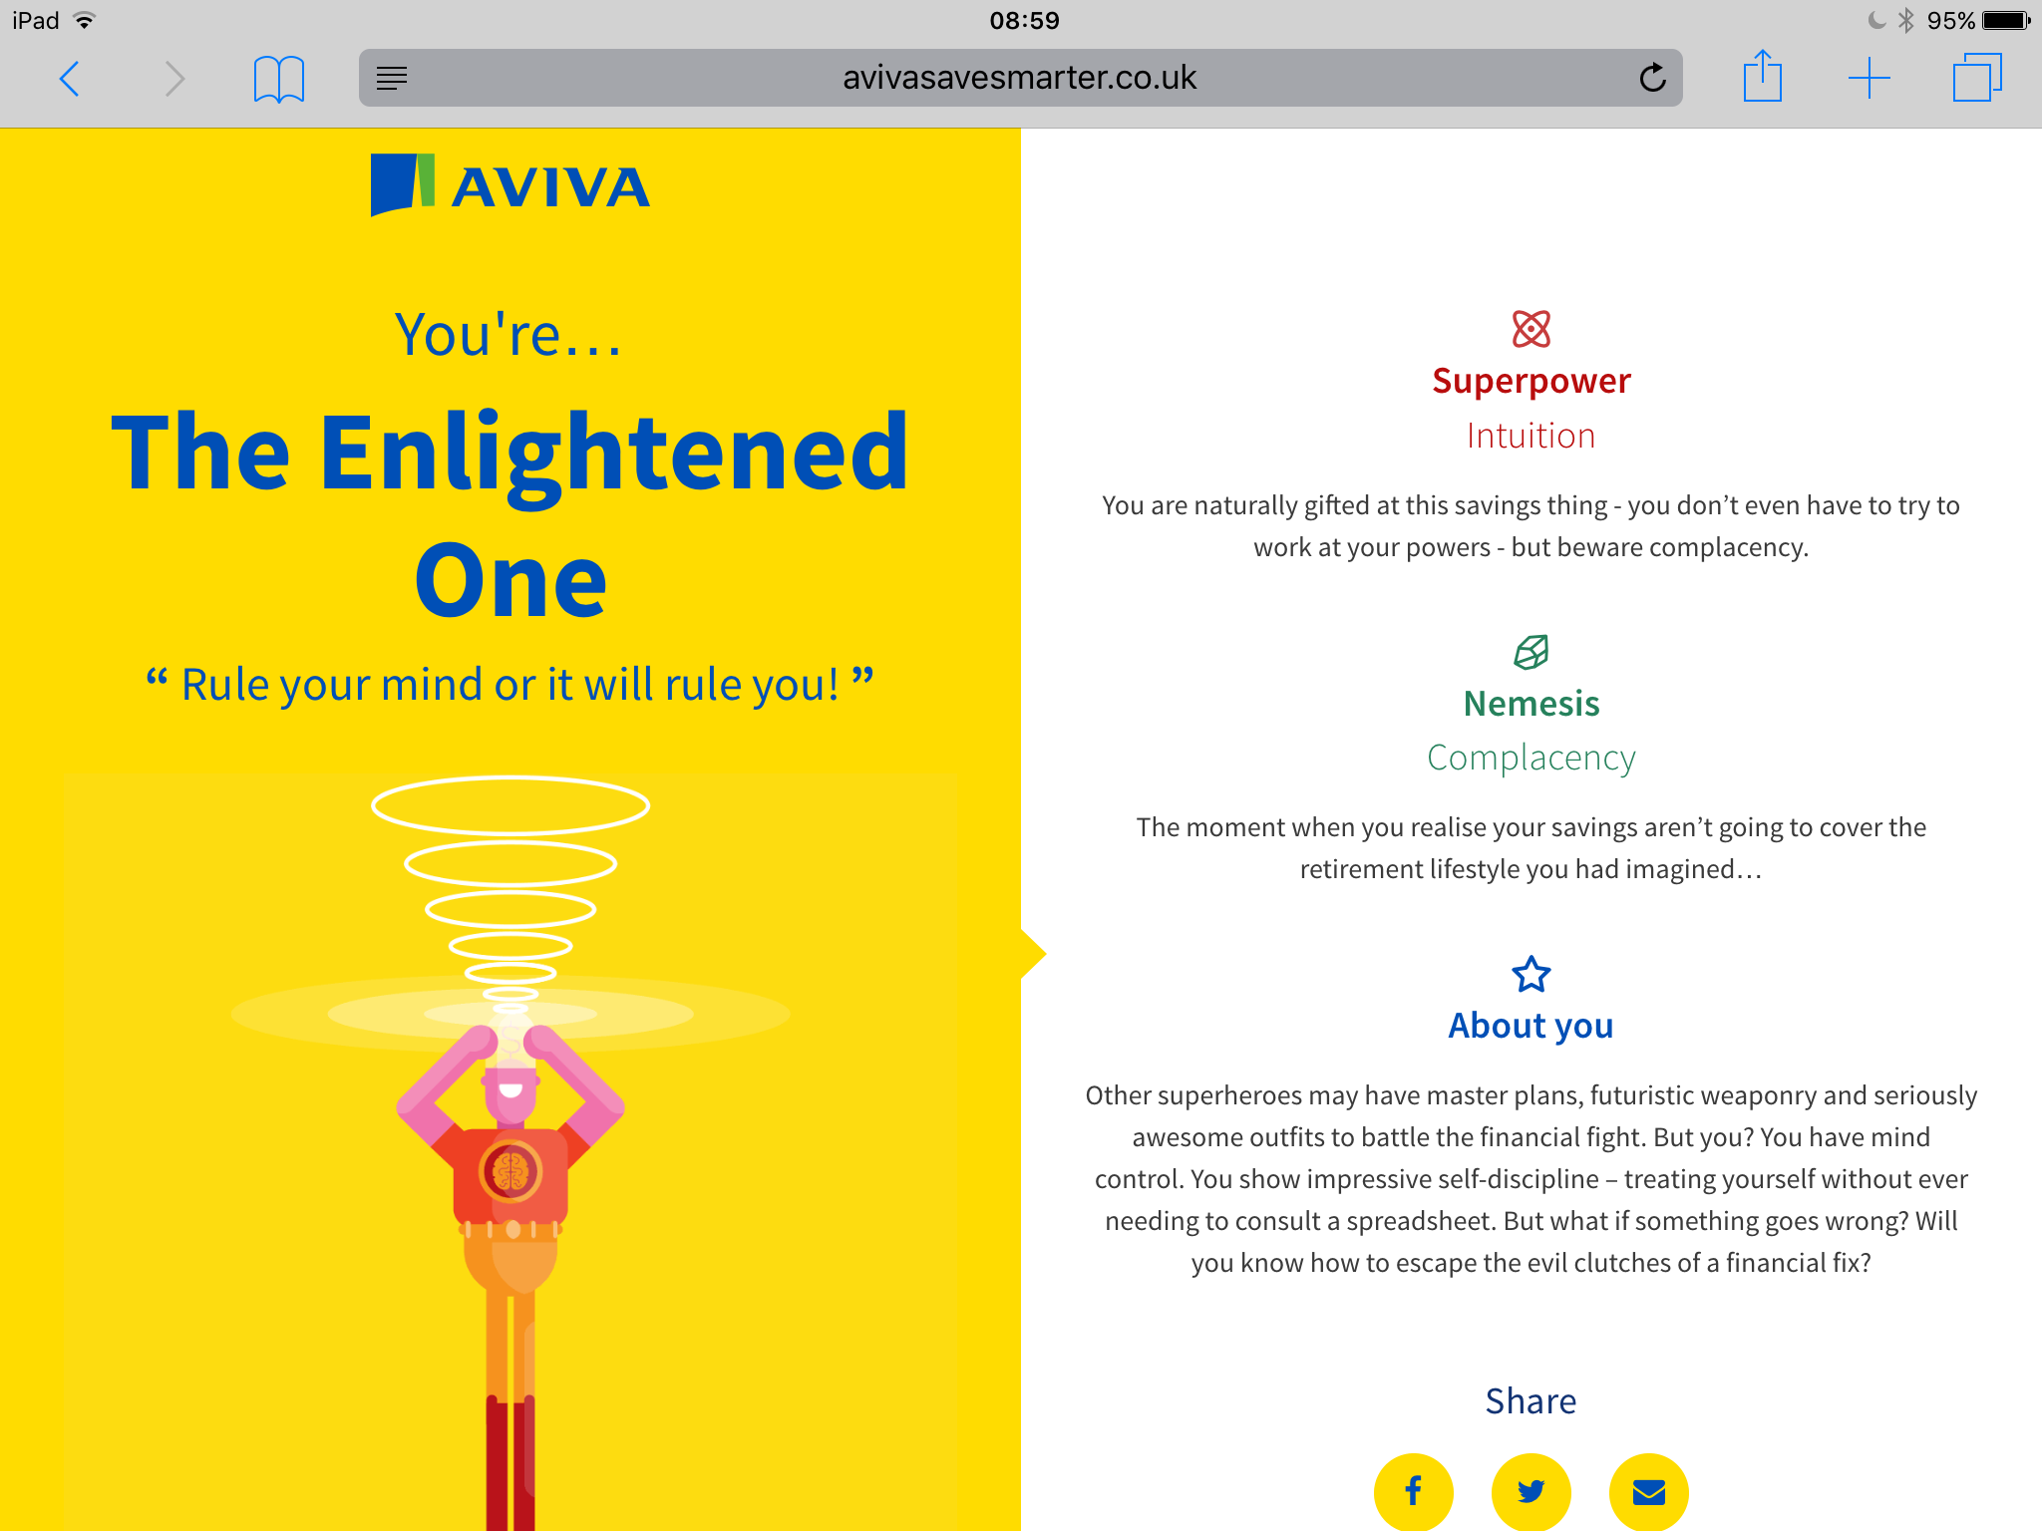

Slide 5
Video games are unique in the field of consumer software in that they intentionally resist their users, establishing barriers between the operator and their goal.
Rob Gallagher (2012) No sex please, we are finite state machines

Slide 7
Gamification can be seen to have three main parts:
the implemented motivational affordances,
the resulting psychological outcomes, and
the further behavioral outcomes
Juho Hamari et al (2014) Does Gamification Work?

Slide 8
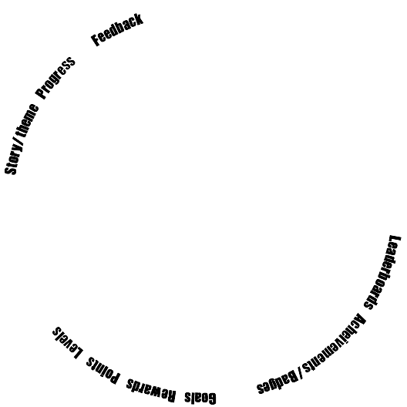
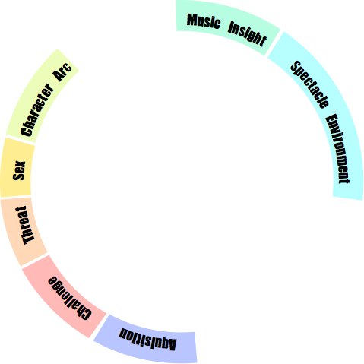
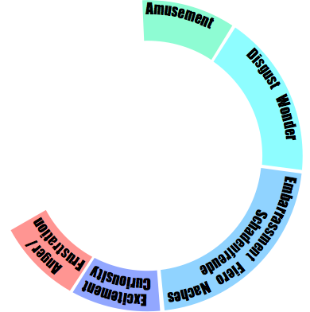
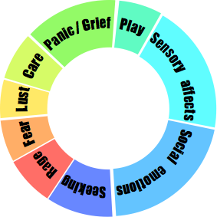

Slide 9
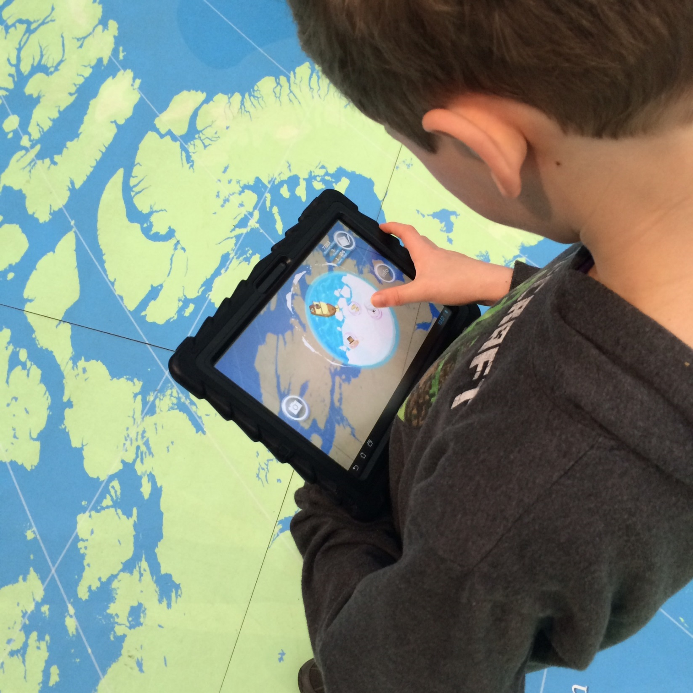

Slide 10
The whole value of a game is in the mental model of itself it projects into the player’s mind
Tynan Sylvester (2013) The Simulation Dream
Most [multimodal analysis of museums] omits the study of those who are ultimately making meaning: museum visitors
Tiina Roppola (2013) Designing for the museum visitor experience

Slide 11
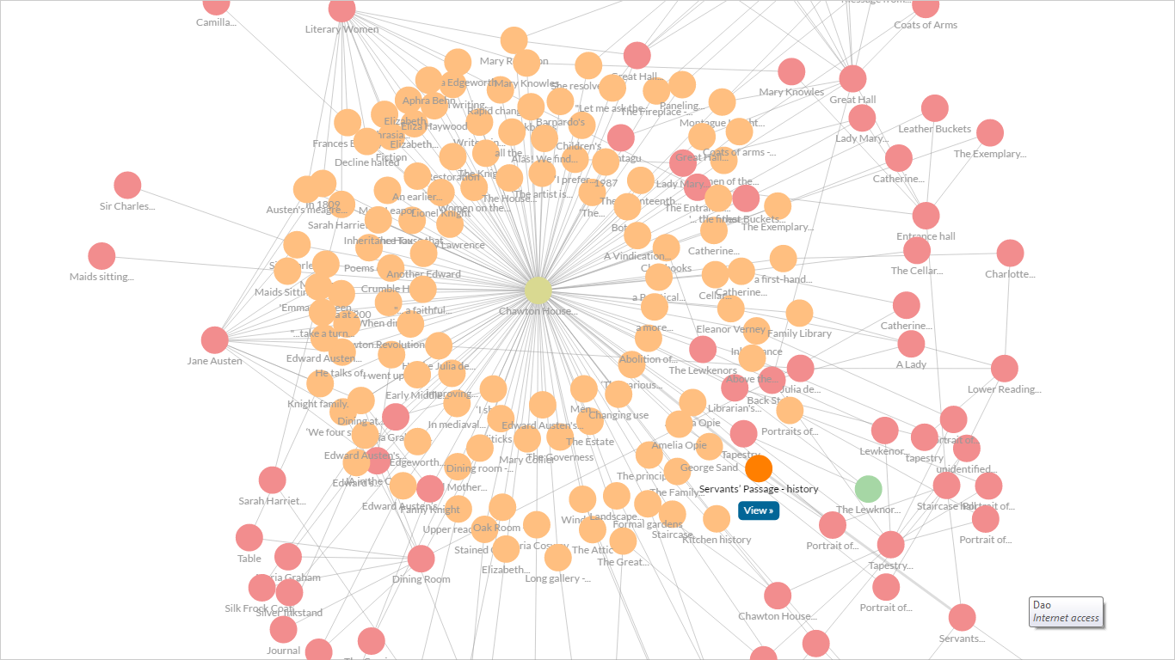

Slide 12
Thank you
Matthew Tyler-Jones
University of Southampton
mtj1v12@soton.ac.uk
matthew.tyler-jones@nationaltrust.org.uk
www.memetechnology.org
@MTylerJones

