Slide 1
Equality, Diversity and Inclusion Strategic Delivery Plan Summary Presentation
For use by colleagues without digital access
Notes:
Sort logos out

Slide 2
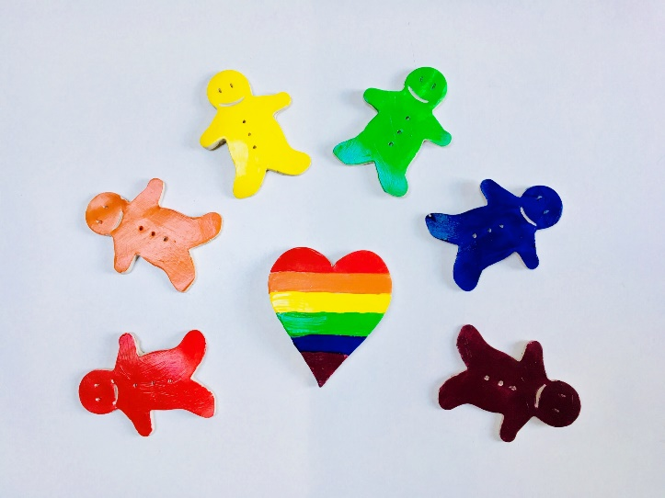
Why Equality, Diversity and Inclusion Matters
Ensure that all students and staff feel safe and supported in all that they do
Include a wider range of voices in decision making across the University
Increase the diversity & experience of our student population
Ensure that all staff and students are able to achieve their best
Enable everyone an equal opportunity to progress in their studies and careers
Support the University to grow and thrive
Deliver a happier, more effective institution
Values
Excellence
Effective Delivery

Slide 3
How EDI helps us to achieve University Objectives
The EDI Strategic Deliver Plan will support a number of University targets, including:
Positive media coverage & reputation
Student experience
Teaching Excellence Framework (TEF) Gold
Research income & outputs
Staff engagement
Athena Swan and Race Equality Charter mark awards
Institutional EDI objectives

Slide 4
Some of our challenges at the University of Nottingham
BME attainment gap – the number of students from a BME background that attain a high level degree is lower than other students
Numbers of BME academics who are women have decreased
Low number if women in senior (level 7) roles
Low disclosure of disability, especially at more senior levels
Some staff experience harassment, loss of dignity and racism / sexism
Concerns about the fairness in external distributions of research funding
Health and wellbeing of our staff and students
Seeing EDI as being everyone’s business

Slide 5
Proposed approach of the EDI strategic delivery plan
Marriage and Civil Partnership
Sex
Gender reassignment
Race
Temporary disability
Disability
Care responsibilities
Socio-Economic background
Religion or Belief
Pregnancy and Maternity
Age
Intersectionality
Sexual Orientation

Slide 6
Theme 1: Demonstrable equality in experience for all of our staff and students
We will…
Collate, analyse and use data to understand our progress against EDI objectives
Support people to take appropriate action when the see or experience
Work to ensure that all staff and students are safe, and that they have been treated fairly and equitably
Listen to and share stories of EDI experiences to improve our understanding & awareness
Address both individual characteristics and the impact of intersectionality

Slide 7
Theme 2: Transform diversity & inclusive practice in our staff and student bodies
We will…
Be ambitious in developing a more diverse population of staff & students
Develop policy, governance and culture to support inclusivity
Share challenges and best practice
Support all staff and students to achieve their very best at the University and beyond

Slide 8
Theme 3: Excellence and Ambition in delivery of Embedded EDI
We will…
Develop a process to ensure issues can be raised, owned and acted upon
Support people to challenge positively and appropriately when required
Agree when and how action to address an EDI issue is needed
Provide information and resources to support staff and students to challenge EDI issues
Undertake research to develop new approaches to EDI
Ensure all significant programmes, projects and business developments have published Equality Impact Assessments in place
Evaluate the success of our work through review of data, monitoring of objectives and analysis.

Slide 9
Theme 4: The University, Nottingham, and our Global Community
We will…
Work with our external partners, the local community, and our alumni
Ensure our impact partners and industrial stakeholders are influenced by our excellence in EDI, and that they influence us in return
Work with all Schools, Professional Service teams and student groups to deliver EDI activities with appropriate support
Work with and learn from local and national specialist groups
Empower leaders and managers to support all staff and students
Recognise and celebrate staff and students who are leading and inspiring others

Slide 10
Ensuring we are considering everything!
We need to think about the……
design of buildings & campuses
images we have images around our campus and in digital media
technology we are developing to ensure it is accessible to all
food we serve at meetings & within student areas
language we use in job advertising and where we advertise
behaviours of all our staff and students
“Looking at the world through an EDI lens”

Slide 11
Celebrating Staff and Students
Three new projects to celebrate the diversity of our staff and students.
International Women’s Day
Any female student or staff member based in the UK, China or Malaysia can be nominated, by any student or staff member, to appear in a digital photo campaign to support this year’s #balanceforbetter theme.
International Colleagues
The University’s Portrait Diversification project is being extended to open to nominations of international staff working in the UK, by any member of staff or student in the UK, China or Malaysia.
Colleagues from the European Union
EU staff working in the UK, are sought for case studies to be showcased at a staff celebration event on March 19 and can be nominated by any member of staff or student working in the UK.
Full details and nomination forms for all three projects can be found on Campus News.
Notes:
•Acres of space – print and online
•Hours of airtime
Media want expert comment and analysis on stories - often from an independent source.
Expert opinion - adds weight and is an essential element of many news reports and features
An expert opinion is a way of media finding a new angle on a news story as well as offering balance and credibility
Can also give a local angle to a national story (local media)

