Slide 1


The Course

Slide 2
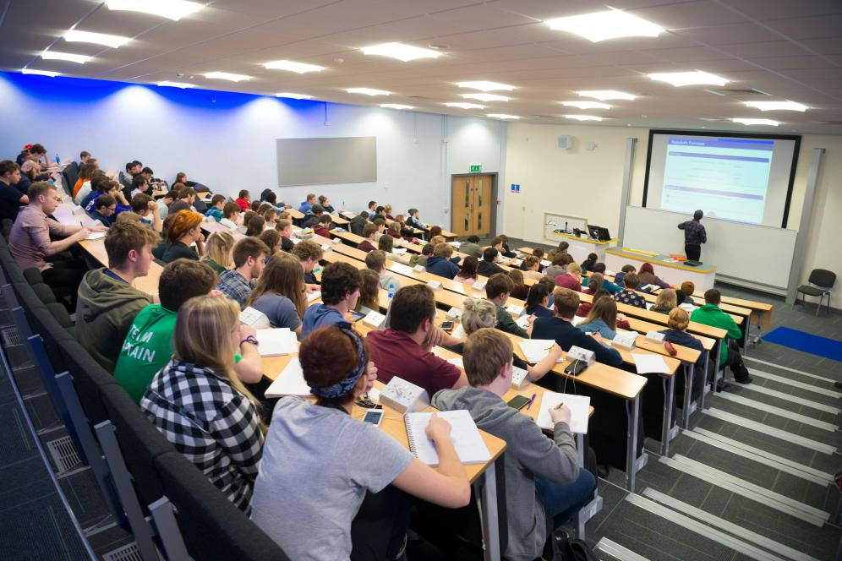
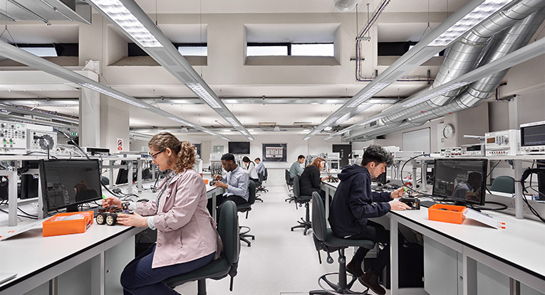

How will you study?
All UK universities have 120 credits of study per year.
FEPS is taught using:
Lectures
Laboratories
Problem workshops/seminars and tutorials

Slide 3
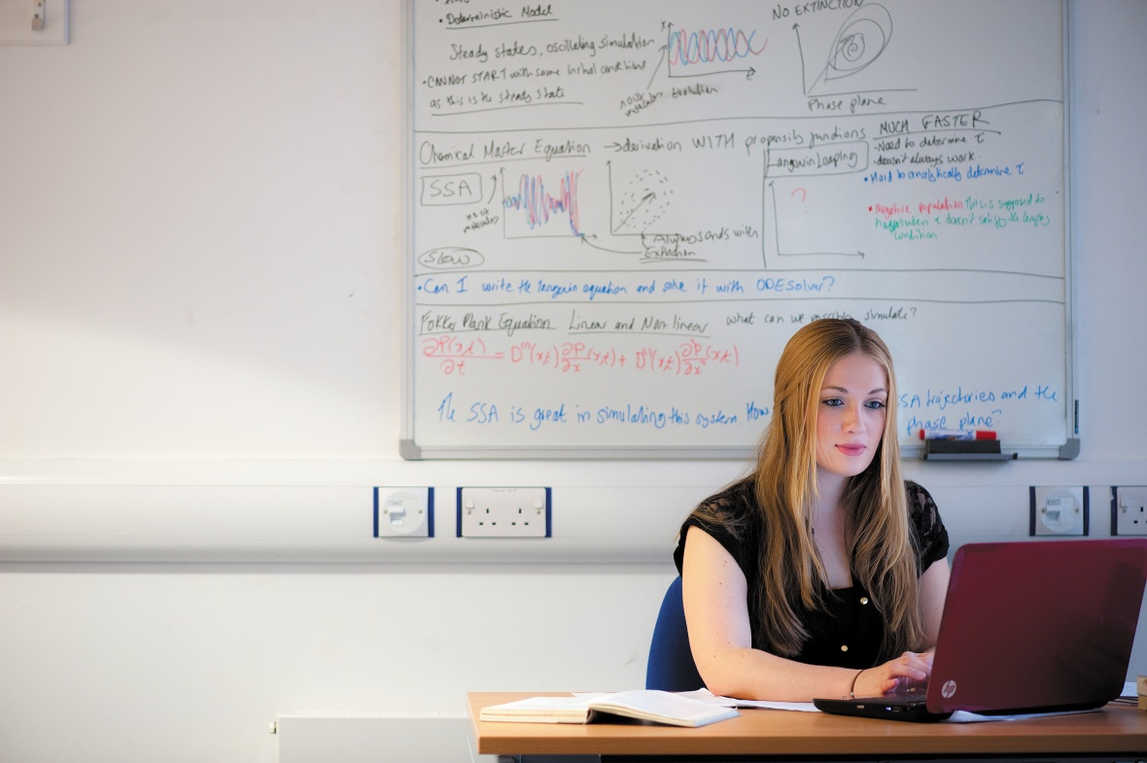
What will you study?
One third of our course is Mathematics.
This is roughly equivalent to A-Level, however the focus is narrower and deeper on topics tailored for Engineering and Physical Science degree courses.

Slide 4
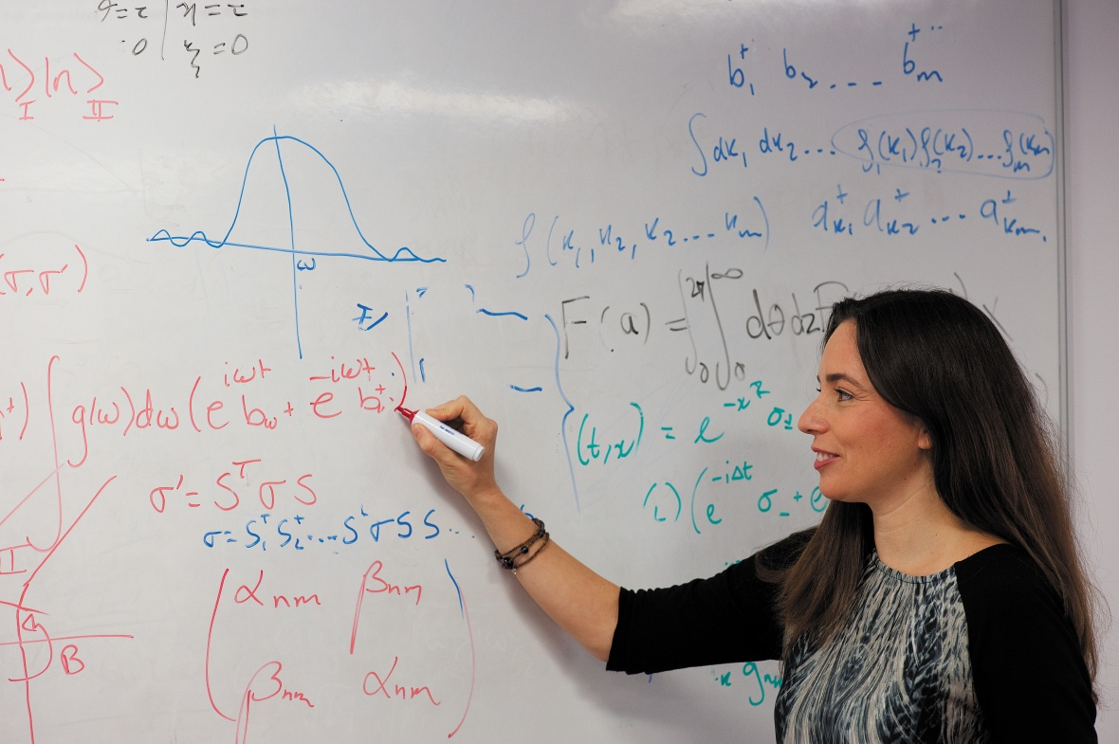
What will you study?
The remaining two thirds of the course covers some topics similar to A-Level Physics, but narrower and deeper on topics tailored for Engineering and Science degree courses. We also cover content not within the A-Level syllabus which is valuable to our students.
We incorporate computer modelling, practicals and engineering case studies throughout the course. We also focus on university standard practical work and presentation.

Slide 5
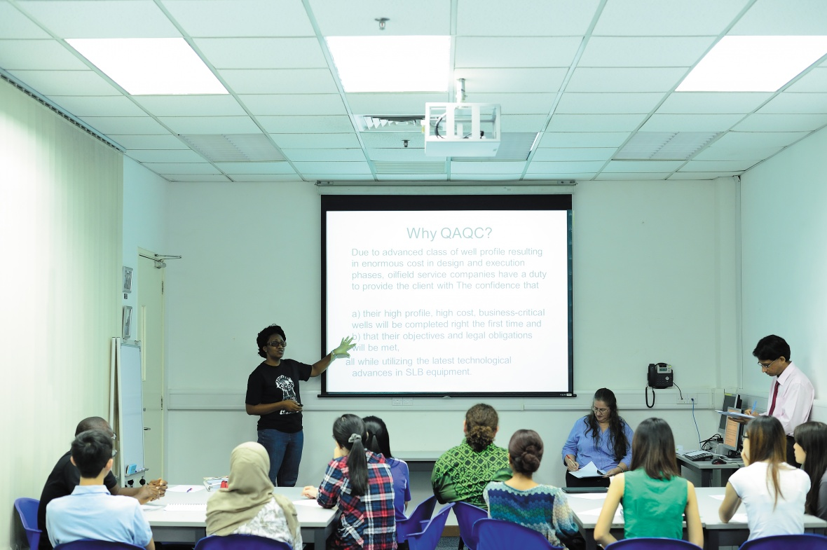
What will you study?
Semester 1
Semester 2
Foundation Mathematics 1
Foundation Mathematics 2
Foundation Maths 1
Foundation Maths 1
Professional, Experimental and Academic Competencies – laboratory, study and research skills.
Computer Methods (MATLAB)
Applied Engineering and Science – including Further Mechanics and Electromagnetism
Further Applied Engineering and Science – including Project Work
-------------
Physics at the Extremes
Engineering and Science – including Mechanics and Electromagnetism

Slide 6

Typical Workload
FEPS students have around 20 compulsory contact hours per week
In addition to this we provide additional small group tutorials and drop in sessions which students are encouraged to attend to seek help where needed.
Plus we recommend:
6 hours coursework / directed study / further reading
7 hours revision / notes write up
To succeed on our programme we expect our students to work hard but we will support them every step of the way.

Slide 7
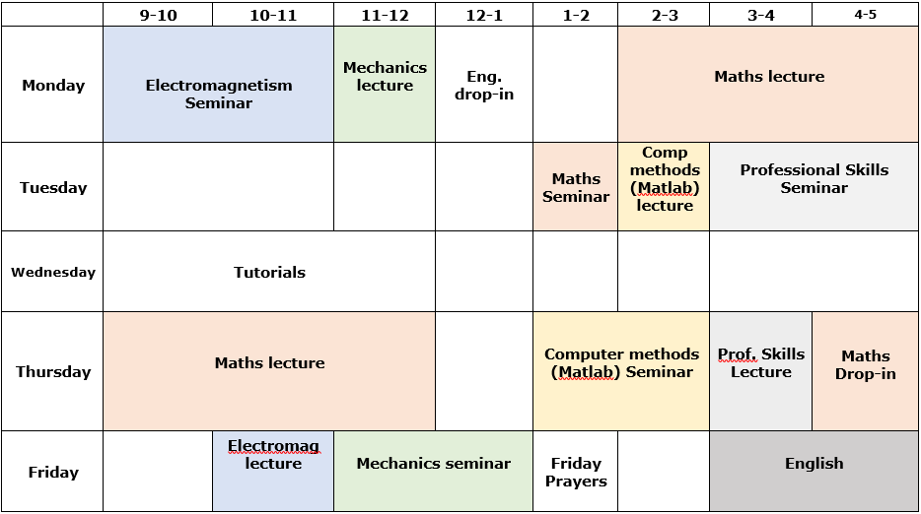
Example Timetable

Slide 8
Why us?
Why are we different?

Slide 9

Why FEPS at the University of Nottingham?
The course is run by dedicated staff who are part of the University of Nottingham academic community.
We are passionate about the course and about offering a great experience and opportunity for our students.
We care and take the time to get to know the students we are teaching!

Slide 10

Why FEPS at the University of Nottingham?
You will be taught at the University of Nottingham within the Faculty of Engineering.
You will be on year zero of your degree programme.
You will be a University undergraduate student.
You are part of the University community from day one with the same access to resources and facilities as all other undergraduate students.

Slide 11

Why FEPS at the University of Nottingham?
We have a typical progression rate of around 80% in terms of students who successfully complete their course and continue to their chosen degree.
Our course offers the guarantee of automatic progression (subject to successful performance), as well as the opportunity to be flexible about your choice of destination degree.
After leaving the Foundation course, our students typically gain a very high quality degree at the end of their studies.

Slide 12
Any Questions about our Foundation Course?

