Slide 1


A Brief Introduction to the Destination Departments

Slide 2


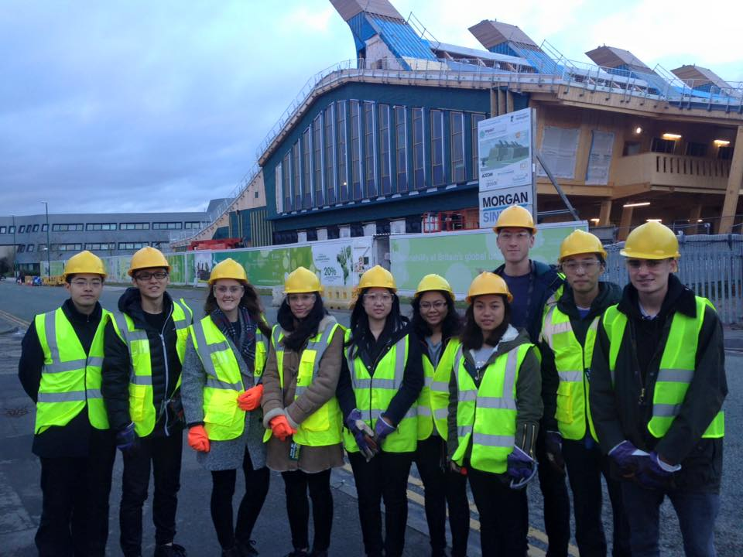

Architectural Environment Engineering

Slide 3
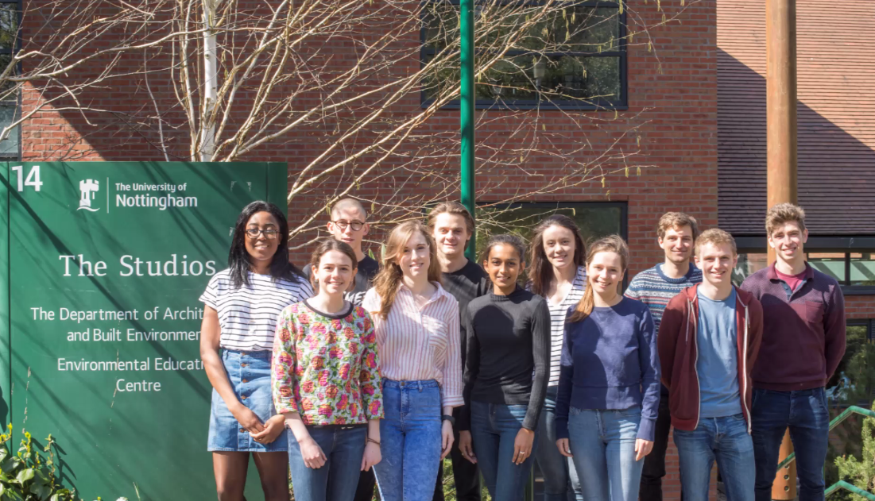

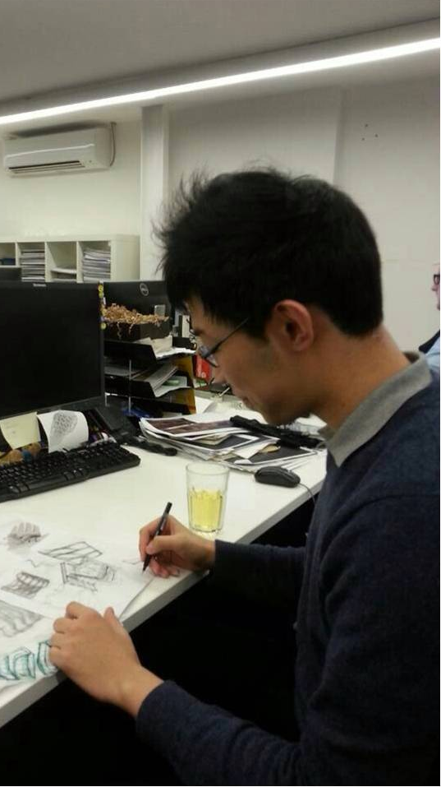
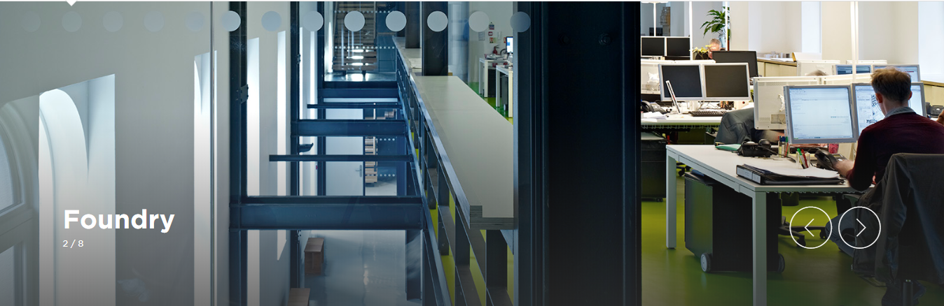
Architecture

Slide 4
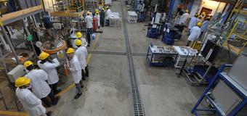

Chemical Engineering

Slide 5

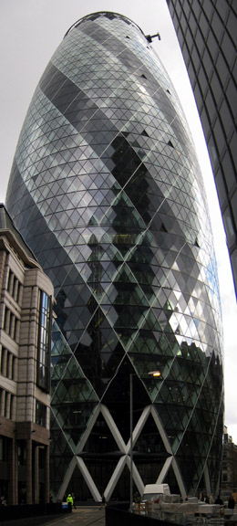


Civil Engineering

Slide 6
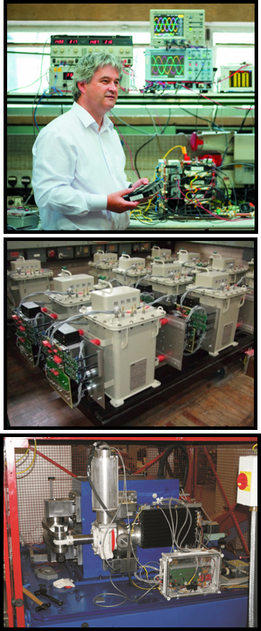
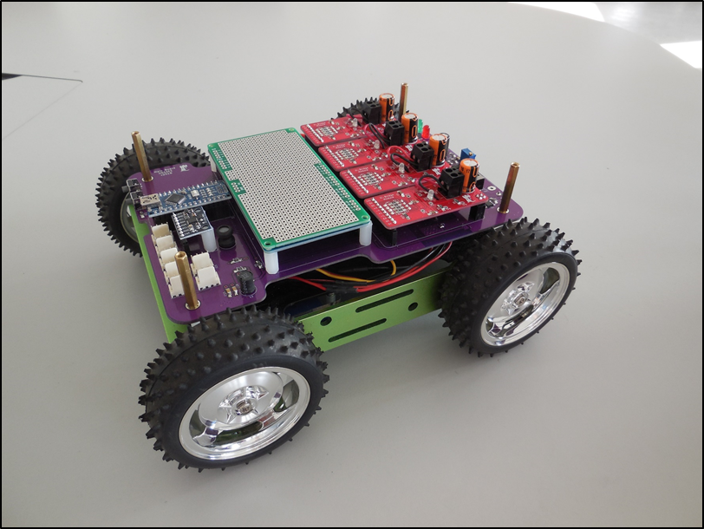

Electrical & Electronic Engineering

Slide 7


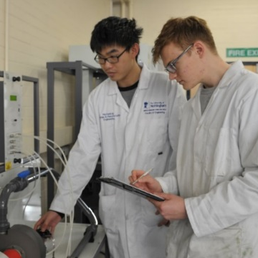


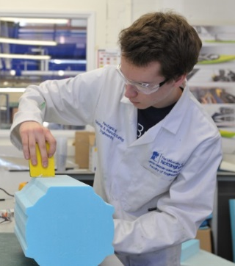
Mechanical, Materials and Manufacturing Engineering
Mechanical, Materials and Manufacturing Engineering

Slide 8
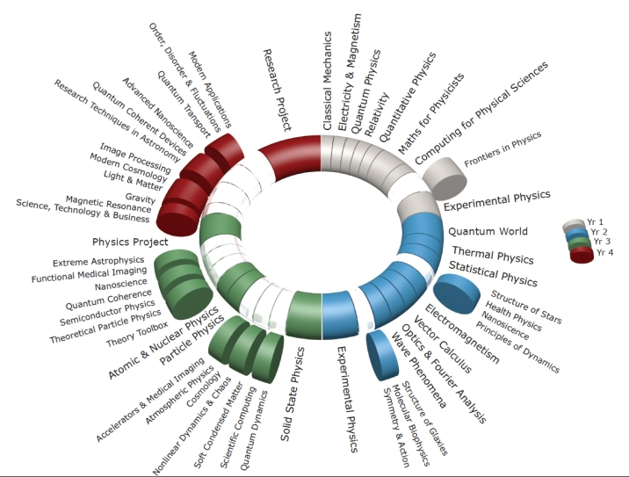
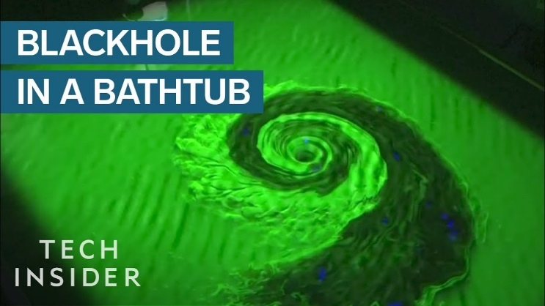




Physics and Astronomy

Slide 9


Mathematical Sciences

Slide 10



Computer Sciences

Slide 11




Questions?
Please feel free to ask any general questions now or talk to us afterwards if you would like to ask on an individual basis.
The University of Nottingham:
youtube.com/NottmUniversity
@UoNapplicants
The University of Nottingham
UoNapplicants
Admissions Queries: email tom.westby@nottingham.ac.uk
Or: Engineering Support email (engineeringsupport@nottingham.ac.uk)

