Slide 1
Leverhulme Centre Schools Conference 2011
Trade and the Environment
Dr. Tim Lloyd
Associate Professor
School of Economics

Slide 2
Introduction
We are in a critical time in history
Global financial crisis, food crises, volatile oil prices, accelerating ecosystem degradation and climate-induced extreme weather events.
These multiple and inter-related crises call into question the ability of a growing human population to live peacefully and sustainably on this planet.

Slide 3
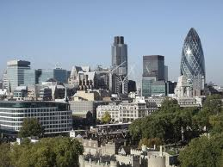
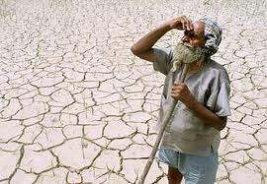
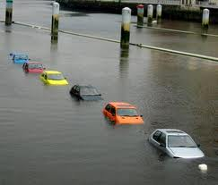
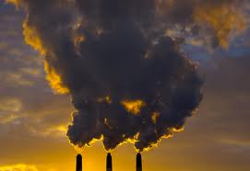
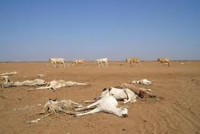
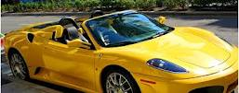
Life is about choices . . .
Economic Prosperity
Environment

Slide 4
Growth versus the environment
Rio+20 Earth Summit 2012
Growth versus Environment?
No! we must (and can) have both
Far from being ‘agent of disaster’, international trade holds the key

Slide 5
In today’s lecture . . .
The Growth vs Environment debate
Economics & trade is a powerful force
The scenarios : Growth & Environment
Global Warming
The problem is an economic one so economics can play a role . . . in rescuing the planet from catastrophe.

Slide 6
In today’s lecture . . .
Audience Response technology
You press buttons on keepad
It graphs results in real time
It’s your last response that counts

Slide 7
Are you . . . .
5
Male
Female

Slide 8
What School are you representing?
5
Countdown
QE Derbyshire
Oakham School Rutland
Our Ladies Convent School Loughborough
Rushcliffe School
Nottingham High School for Boys
Ockbrook School
Bilborough College
Bedford Modern
Framwellgate & Johnston School Durham

Slide 9
Is this your first visit to a university?
5
Yes
No

Slide 10
Are you considering studying economics at University?
Yes
No (way!)

Slide 11
Trade & Economic Growth
Most economists agree . . .
trade is ‘good’ and free trade is better.
Consumption higher than without trade
Both trading parties benefit

Slide 12
Trade & Economic Growth
Some environmentalists retort . . .
trade is bad for the environment and free trade is even worse.
Trade encourages greater pollution
Resource exploitation
Destruction of wildlife & habitats

Slide 13
Trade & Economic Growth
The debate is one of the most contentious issues of our time
Polarisation of views
If resolution possible we need to understand the problem
The problem is an economic one

Slide 14
Economists can play a role
We understand the ‘trade-offs’
Growth vs environment
We understand Markets
Market failure
We understand property rights
Consequences of lack of ownership

Slide 15
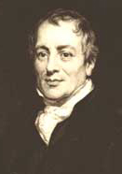
Why does trade make us richer?
‘Comparative advantage’
‘Engine of trade’
Logic underlying all exchange
Individuals . . firms . . Countries
David Ricardo (1772)
England (wool) Portugal (wine)
Forces are everywhere and awesome
. . . even in some unexpected places

Slide 16
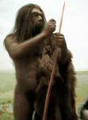
Where did all the Neanderthals go?
Neanderthal
Existed for 250,000 years
Became extinct ~35,000 BC
Wars/disease not responsible
Perpetrator none other than . . .

Slide 17
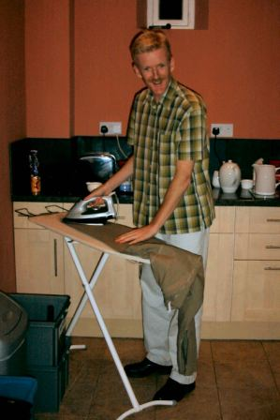
Where did all the Neanderthals go?
Neanderthal
Modern Man
Grrrrrr!

Slide 18
Where did all the Neanderthals go?
Homo Sapiens had a special weapon . . .
social interaction
This gave them the evolutionary edge
Homo Sapiens were weaker but by specialisation and trade their calorific intake & fertility was higher
Survival of smartest
Modern Man

Slide 19
What of Homo Sapiens (us) today?
Will our behaviour lead to:
Resource exploitation
Environmental degradation
Eventual ecological catastrophe
Is the ‘Doomsday scenario’ inevitable ?

Slide 20
The Doomsday Scenario
End of the World
Pollution
Per capita
Economic growth causes
environmental degradation
Economic Activity per capita

Slide 21
Why do we go on polluting ?
No one owns the environment
No one has ‘property rights’ over it
It is ‘free’ to everyone
Thus used as if it’s price is zero
This leads to over-use/degradation of environment
Fish in the sea . . . air we breath . . . water we drink . . . wildlife . . . bio-diversity . . .
Is there anything we can do?

Slide 22
An Alternative Scenario . . .
Pollution
Per capita
End of
the World
Industrialisation
Services
Demand for
environmental quality
Poverty
alleviation
Tougher standards
Green technologies
Economic Activity per capita

Slide 23
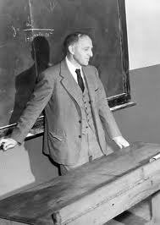
Environmental Kuznets Curve
EKC Hypothesis:
“as per capita incomes rise ,
pollution will initially rise,
reach a turning point and
then fall”
‘n’ shaped (‘Kuznets’) relationship
So-called after the Nobel Prize winning economist who found same ‘n’ shaped relationship between income and income inequality

Slide 24
Empirical Evidence of EKC?
Turning point varies by pollutant
Air quality ~$11,000/capita
Water quality ~$15,000/capita
Government intervention required
to assign ownership (property rights) via laws and regulations
To create markets

Slide 25
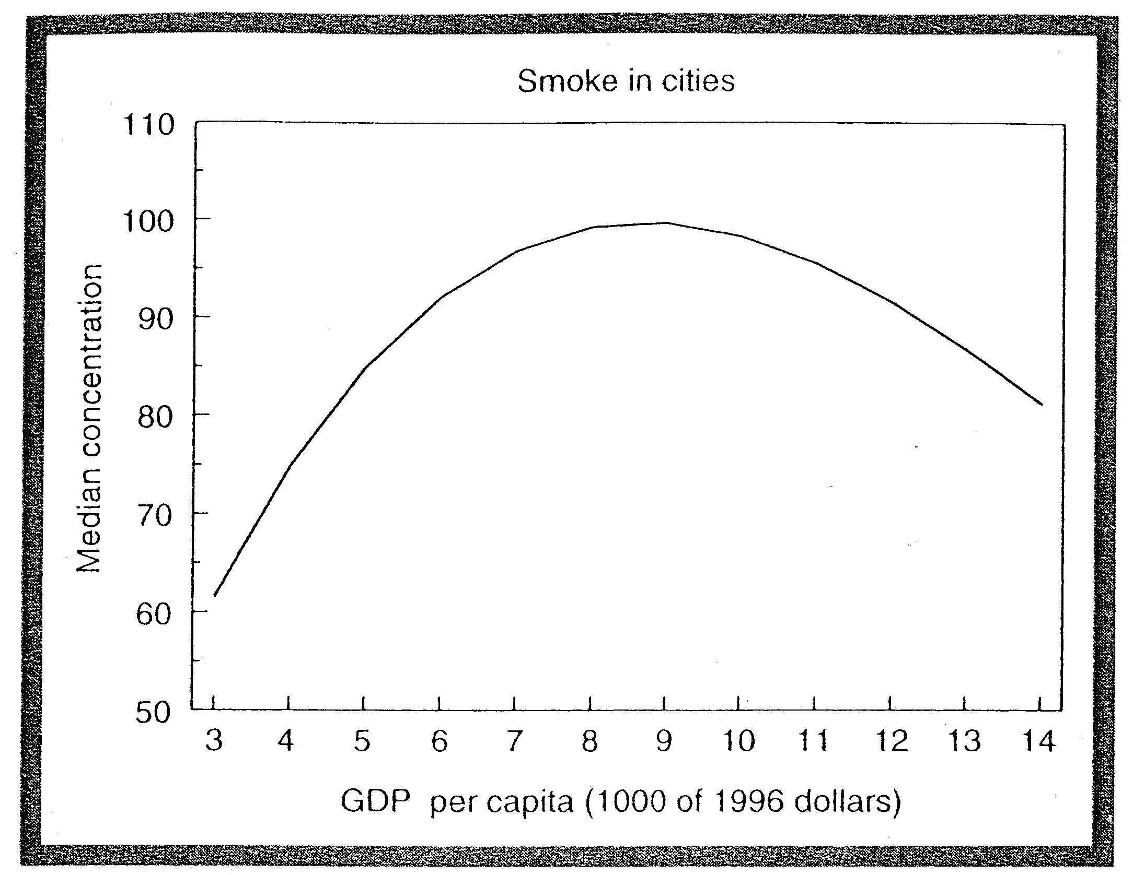
The EKC for US Air Quality
Turning point
$9,000

Slide 26
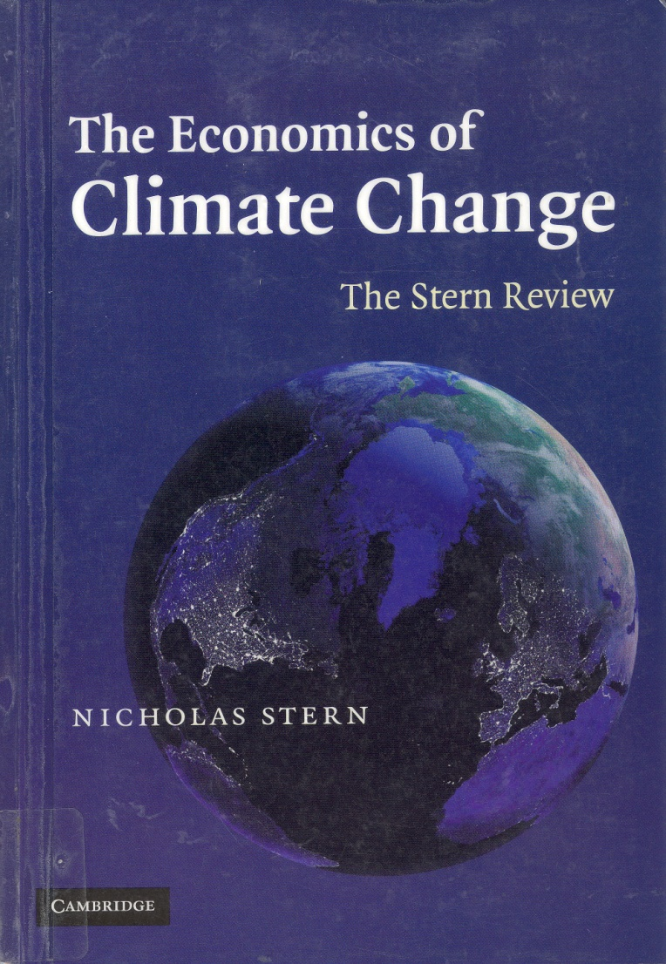
And what of Climate Change?
Stern Review (2006) stark warning
Carbon dioxide (CO₂) created by economic activity
CO₂ principal cause of climate change
EKC identified here too
But the trouble is . . . .

Slide 27
And what of Climate Change?
Stern Review (2006) stark warning
CO₂ turning point ~$50,000/capita
Turning point will not be reached until the average nation has income level of the richest today
Turning point will not be reached until 2050

Slide 28
An Invisible Threat
Current trends: 2-3ºc rise by 2050
200m people displaced
Rising sea levels
Aridity
Threat of ‘resource wars’ primarily over water
Malnutrition, disease
<40% species extinction
Catastrophe
If not climate change itself then its consequences (war)

Slide 29
Sleep walking in to Catastrophe
Given the consequences why aren’t we abating carbon dioxide (CO₂) more?
The reasons . . .. . . .
CO₂ only recognised as a ‘pollutant’ in 1980s
Long lag between cause & effect
‘Non-point pollutant’
Initial uncertainty about human cause
Nobody ‘owns’ the environment
It’s the old problem of lack of ‘property rights’
Market for ‘the environment’ fails to emerge

Slide 30
How can we stop it?
Not easy to assign ‘ownership’ of environment (to who?)
But we can create markets
Pollution permits are traded
Carbon taxes are levied
Raises the price of ‘using’ environment
To reflect its value to us and future generations

Slide 31
How can we stop it?
Who could do perform this role?
Who better to do this than . . .
World Trade Organisation (WTO)
WTO already monitors and polices international trade in agricultural commodities and manufactured goods
The environment would a natural albeit significant step

Slide 32
Four Important Messages
Economic prosperity has come at a high cost and climate change is no different
However, this need not be case in future
Trade & its governance offer mechanism for sustainable growth
Co-ordinated action required (carbon taxes, pollution permits)
World Trade Organisation (WTO)
Economists have a role to play . . . and can make a difference

Slide 33
So let’s play . . . .
The GEP Schools Challenge
Battle of the Schools
2012

Slide 34
What shape is the Environmental Kuznets Curve?
5
‘s’ shaped
‘L’ Shaped
‘n’ shaped

Slide 35
Which does not make the EKC turn down?
5
Industrialisation
Green technologies
Tougher standards

Slide 36
When Was David Ricardo born?
5
1772
1790
1823

Slide 37
When did Neanderthals become extinct?
5
250,000 BC
50,000 BC
35,000 BC

Slide 38
And finally . . .
Thanks for taking part!

Slide 39
Further reading
Horan, R., E. Bulte and J. Shrogen (2005) ‘How Trade Saved Humanity from Biological Exclusion: An Economic Theory of Neanderthal Extinction’ Journal of Economic Behaviour and Organisation, 58:1-29.
Copeland, B.R. and S.M. Taylor (2003) Trade, Growth and the Environment: Theory and Evidence. Princeton, NJ, Princeton University Press.
Grossman, G. and A. Krueger (1995) ‘Economic Growth and the Environment’, Quarterly Journal of Economics, 110: 353-377.

