Slide 1
Introduction to Anatomy NMS Week 2
Catherine Moore

Slide 2
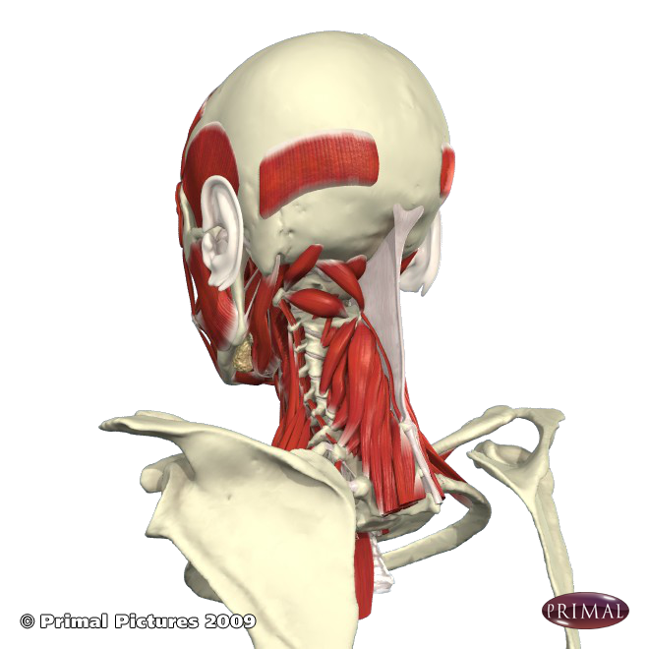
Session outcomes
By the end of the session students will be able to describe basic anatomical terms
By the end of the session students will be able to use these terms to describe normal movement

Slide 3
Outcomes
Module: Bi. Discuss basic, core rehabilitation & therapy principles and concepts
CSP: 3.5 – Demonstrate a capacity for effective communication and interpersonal skills
HCPC: 8.4 select, move between and use appropriate forms of verbal communication with service users and others
BASRaT: B2g. Demonstrate skill in analysis of normal movement patterns
C1b. Subjective Evaluation - demonstrate knowledge of standard nomenclature and terminology.

Slide 4
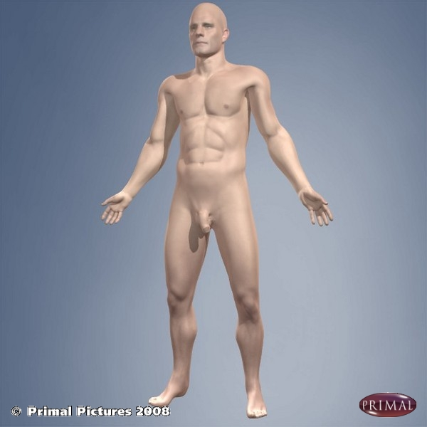
Anatomical position
Standing
Feet parallel
Facing Forwards
Arms by side
Palms facing forwards http://anatomy.tv

Slide 5
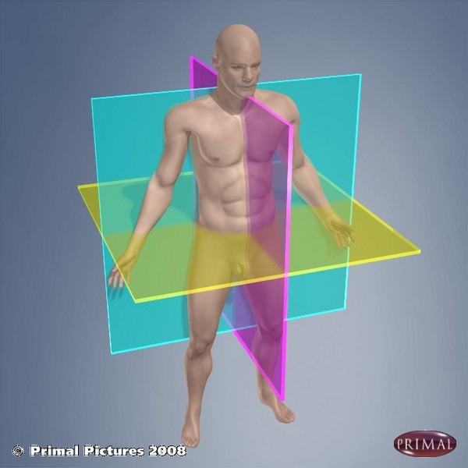
Planes
Coronal plane (frontal)
Transverse plane (horizontal)
Sagittal plane

Slide 6
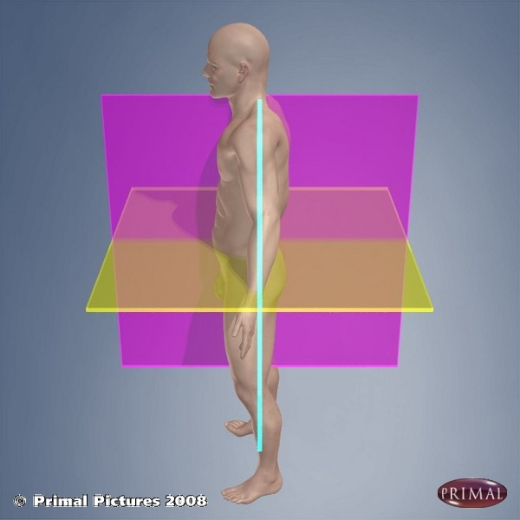
Sagittal plane
Divides the body into right and left halves
Movement of a body part FORWARDS is generally called FLEXION
Movement of a body part BACKWARDS is generally called EXTENSION

Slide 7
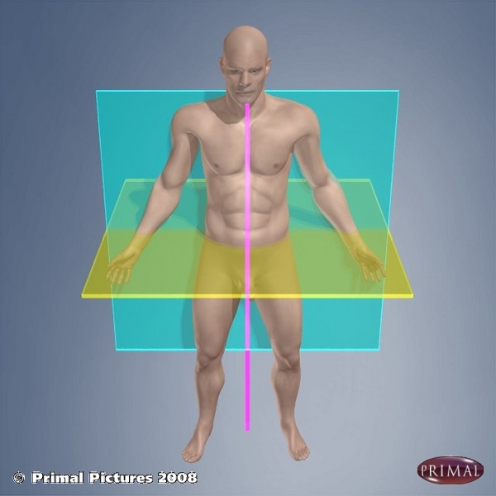
Coronal (frontal) plane
Divides the body into front and back parts
Movement of a body part away from the mid-line is generally called ABDUCTION
Movement of a body part towards the mid-line is generally called ADDUCTION

Slide 8
Transverse (horizontal) plane
Divides the body into upper and lower parts
Rotation of a body part outwards is generally called LATERAL (external) ROTATION
Rotation of a body part inwards is generally called MEDIAL (internal) ROTATION

Slide 9
Axis
Coronal plane moves around a sagittal axis
Transverse plane moves around a vertical axis
Sagittal plane moves around a coronal axis

Slide 10
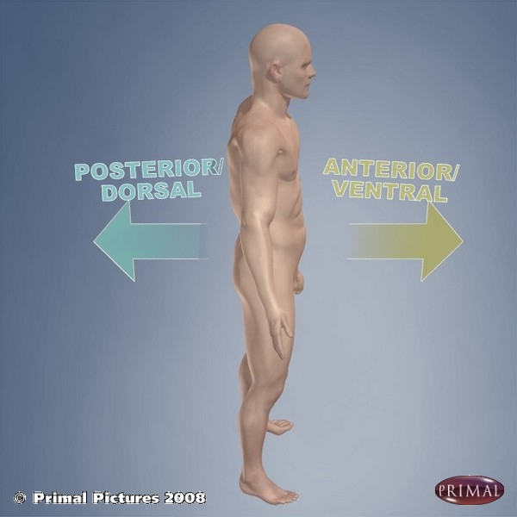
Anterior and posterior
Anterior – towards the front / in front of
Posterior – towards the back / behind

Slide 11
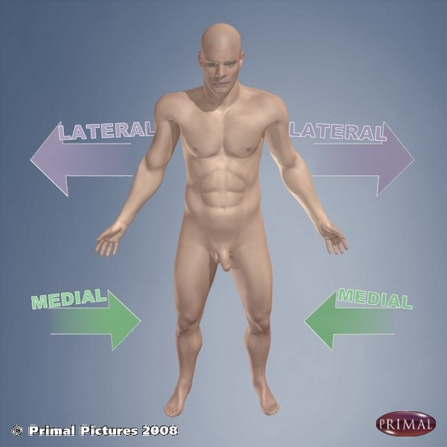
Medial and lateral
Medial – closer to the midline
Lateral – further away from the midline

Slide 12
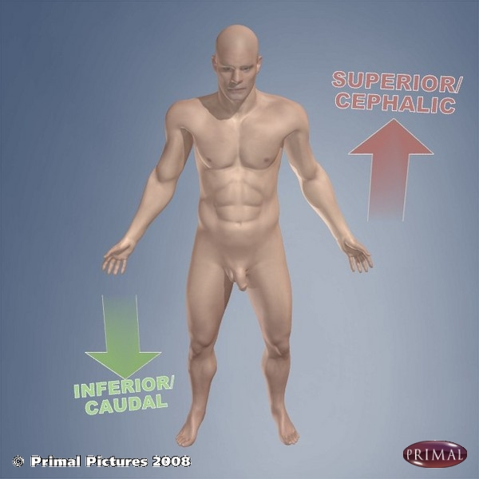
Superior and inferior
Superior – Above / on top of
Inferior – Below / underneath

Slide 13
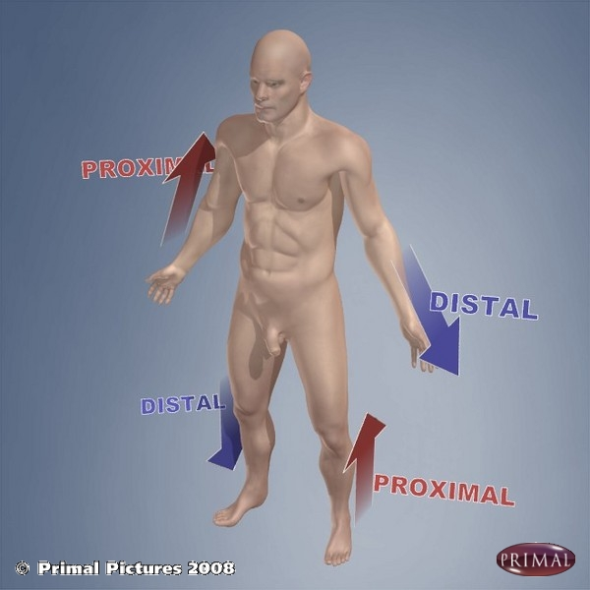
Proximal and distal
Proximal – nearer to the trunk
Distal – further from the trunk

Slide 14
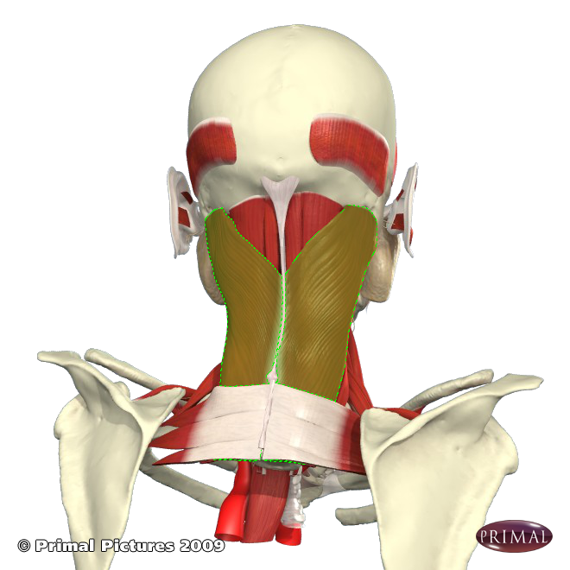
Superficial and deep
Superficial – closer to the surface
Deep – further from the surface
Splenius capitus is superficial to erector spinae

Slide 15
Bones
Function of bone
Protection
Mobility
Stability
Leverage
Nutrition

Slide 16
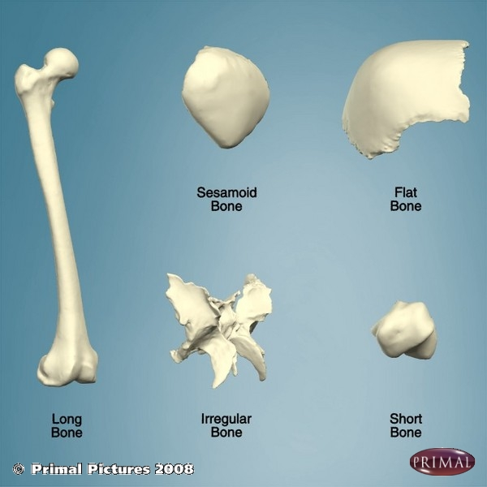
Bones
5 main types of bone:
Long
Short
Flat
Sesamoid
Irregular

Slide 17
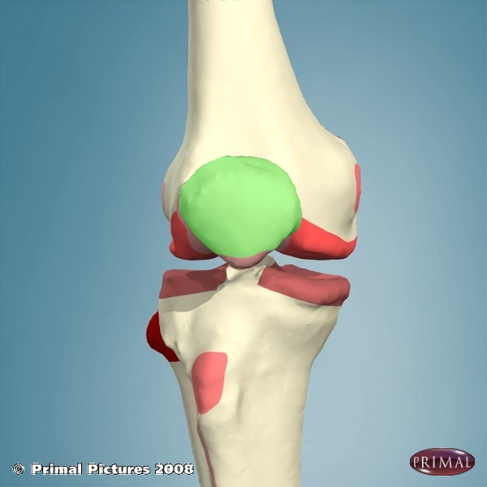
?

Slide 18
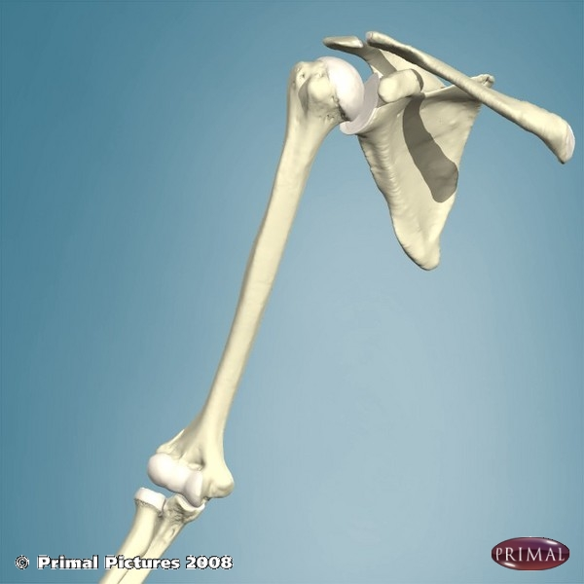
?

Slide 19
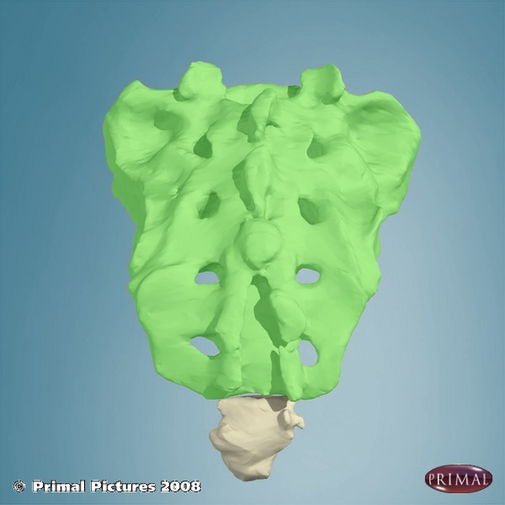
?

Slide 20
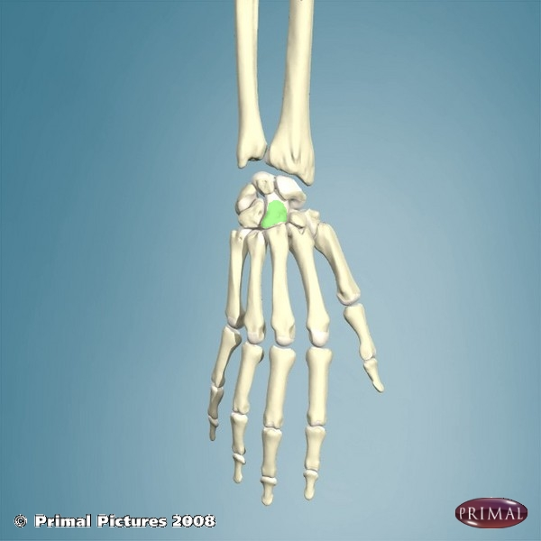
?

Slide 21
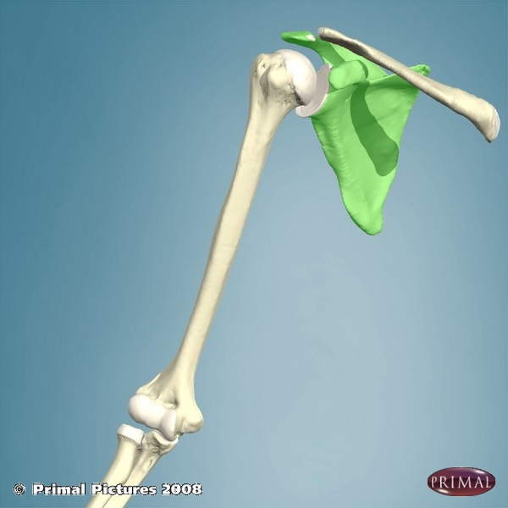
?

Slide 22
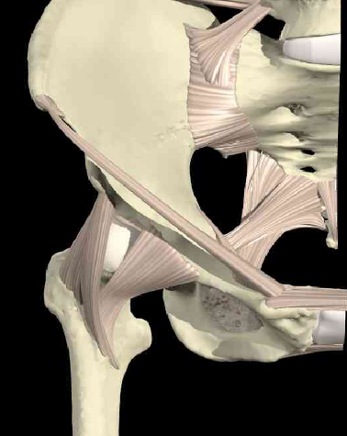
Joints
Areas where bones are linked together
Some joints are linked by fibrous or cartilaginous tissue and allow little movement
Most joints in the body are SYNOVIAL JOINTS and are freely moveable

Slide 23
Joints (3 types)
Synovial
Cartilaginous - Primary - Secondary
Fibrous - Gomphosis - Suture - Syndesmosis

Slide 24
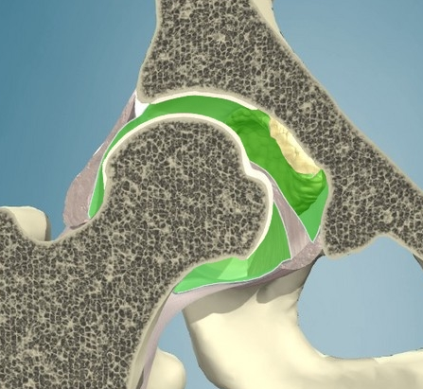
Features of a synovial joint
Fibrous capsule
Articular cartilage
Synovial cavity and fluid
Synovial membrane

Slide 25
Synovial joint types
Ball and socket
Hinge
Pivot
Saddle
Ellipsoid/condylar
Gliding/plane
Useful revision section and quiz on Anatomy TV

Slide 26
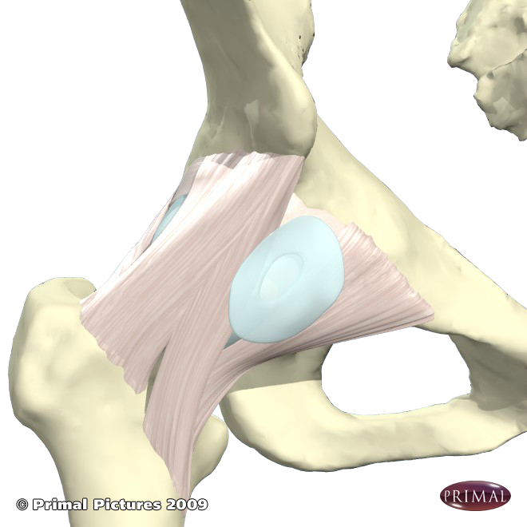
What are these?
Ligaments
Connect bones
Collagen
Provide stability

Slide 27
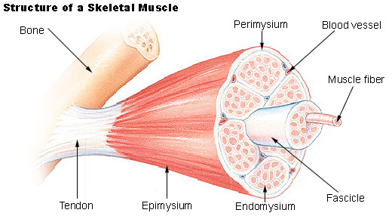
Muscle
Composed of bundles of individual fibres.
Muscles which attach to bones are called skeletal muscles.
http://training.seer.cancer.gov/anatomy/muscular/structure.html

Slide 28
Muscle
Muscle can attach directly to bone or via a tendon
The shape and arrangement of the muscle will effect its function

Slide 29
Summary
A joint is where 2 or more bones meet and is usually where movement occurs
Synovial joints contain synovial fluid and the joint surfaces are lined by hyaline cartilage
Bones are held together at joints by ligaments
Movement of bones at a joint is produced by the contraction of muscles

Slide 30
Quiz
With a partner stand in the anatomical position
Point to which of these is most proximal – shoulder, elbow, wrist?
Which is most distal – hip, knee, foot?
Point to the medial side of the arm
Point to the lateral aspect of the leg

Slide 31
Quiz
Point to the anterior aspect of the trunk
Which of these is most superficial – skin, fat, muscle?
Perform a movement in the sagittal plane
Perform a movement in the frontal plane
Name the 3 main types of joint

Slide 32
Session outcomes
By the end of the session students will be able to describe basic anatomical terms
By the end of the session students will be able to use these terms to describe normal movement

Slide 33
Thank you!

