Slide 1
Introduction to joints and muscles NMS Week 1 PHRS1002
Catherine Moore

Slide 2
Learning outcomes
By the end of the session students will be able to:
Discuss anatomical terms
Discuss planes and axis
Discuss joint types and features
Discuss muscular attachments and actions

Slide 3
Anatomical terms
Anatomical position
Anterior
Posterior
Medial
Lateral
Superior
Inferior
Proximal
Distal
Superficial
Deep

Slide 4
Task
Place yourself in the anatomical position
Answer the following:
The head is …………… to the feet
The hand is ………….. to the elbow
The shoulder is …………. to the elbow
The feet are ……… to the head
The upper trapezius is…….. to the levator scapulae
The scalenes are …… to the sternocleidomastoid

Slide 5
Task
Place yourself in the anatomical position
Answer the following:
The head is superior to the feet
The hand is distal to the elbow
The shoulder is proximal to the elbow
The feet are inferior to the head
The upper trapezius is superficial to the levator scapulae
The scalenes are deep to the sternocleidomastoid

Slide 6
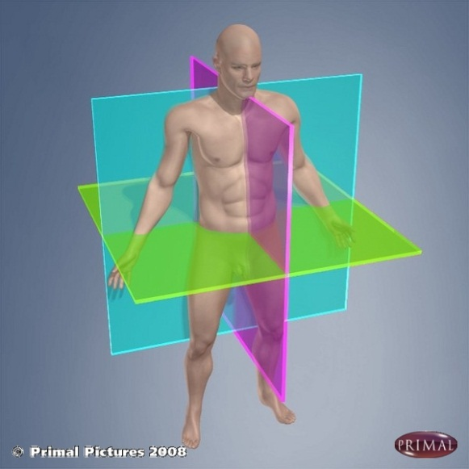
Joint movement
Planes:
Coronal (frontal)
Sagittal
Transverse
Axes:
Sagittal
Coronal
Vertical

Slide 7
Task
Show the head moving in the sagittal plane around a coronal axis – These movements are………….. and…………………
Show the head moving in the coronal plane around a sagittal axis. These movements are …….. and ……....................
Show the head moving in the transverse plane around a vertical axis. These movements ….. and……….. ……………………….

Slide 8
Task
Show the head moving in the sagittal plane around a coronal axis – These movements are flexion (looking down to the floor) and extending (looking up at the ceiling)
Show the head moving in the coronal plane around a sagittal axis. These movements are right and left side flexion (tilting from side to side)
Show the head moving in the transverse plane around a vertical axis. These movements right and left rotation (turning head to look over your shoulder)

Slide 9
Joints
Cartilaginous
Primary - Synchondroses
e.g. sternocostal/costal cartilages
Secondary –Symphyses (with pad of fibrocartilage)
e.g. pubic symphysis, IV joint
Fibrous
Sutures (skull)
Gomphoses (teeth)
Syndesmosis
Interosseous ligament
e.g. radius/ulna
Synovial
Multiaxial
Ball & Socket
e.g. hip
Biaxial
Saddle
e.g. 1st carpometacarpal (CMC) joint
Condyloid
e.g. Metacarpalphalangeal (MCP) joints
Ellipsoid
e.g. radiocarpal joint
Uniaxial
Hinge
e.g. elbow
Pivot
e.g. radio-ulna joint
Gliding (plane)
e.g. intercarpal bones
Notes:
Fibrous – very strong – in skull and teeth
In long bones – interosseous ligaments between bones to hold together, e.g. tibia/fibula; radius & ulna
Cartilaginous – primary - hyaline cartilage unites two bones – continuous pad, symphyses usually have a disc surrounded by ligaments, v little movement often fuse/ossify in adult secondary- tend to be midline
Synovial – fibrous capsule, articular (hyaline) cartilage, synovial cavity & fluid. Synovial membrane Often have bursae
Three types – axes
Multiaxial = most flexible
Uniaxial = pivot e.g. radioulnar joint = bony projection in osteoligamentous ring, also atlanto axial joint Plane e.g AC joint
Biaxial = two directions of movement saddle concavoconvex – like a rider on a saddle, Condyloid is modified ball & socket

Slide 10
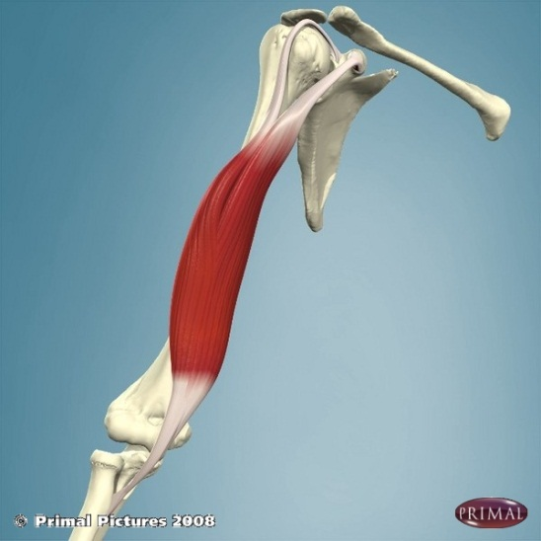
Attachment
Origin – attachment with the least movement – usually proximal
Insertion – attachment to bone showing freest movement
Usually distal
Notes:
It is safest to describe origins and insertions as proximal or distal attachment as this never changes, whereas the origin and insertion can change depending on the movement being produced e.g. lev scap

Slide 11
Attachment
Isotonic Contraction
length change
Isometric Contraction
- length stays same
Concentric Contraction
- Muscle shortens
Eccentric Contraction - Muscle lengthens - controls movement against force
Agonist/Prime Mover
“Producing action” – contracting muscle
Antagonist
Muscles that oppose the action of the agonist
Synergist
Prevent unwanted movements associated with the agonist, aids another by promoting the same movement

Slide 12
Task
Complete as many actions as possible showing muscles working:
- Concentrically
- Eccentrically
- Isometrically

Slide 13
Muscle range
Outer range –
muscle working
in its most lengthened
position
Mid range –
muscle working
in its mid length
Inner range –
muscle working in
its most shortened position

Slide 14
Task
Show the neck flexors working concentrically from outer to mid range
Show the neck extensors working eccentrically mid to outer range
Show the neck extensors working isometrically in mid range
Show the neck right side flexors working concentrically from outer to mid range
Show the left neck rotators working concentrically from mid to inner range

Slide 15
Task
Show the neck flexors working concentrically from outer to mid range
- Returning the head to neutral after looking up at the ceiling
Show the neck extensors working eccentrically mid to outer range
- Looking down towards the ground
Show the neck extensors working isometrically in mid range
- Sitting still
Show the neck right side flexors working concentrically from outer to mid range
- Returning the head to neutral from left side flexion
Show the left neck rotators working concentrically from mid to inner range
- Turning head from neutral to look over the left shoulder

Slide 16
Learning outcomes
By the end of the seminar students will be able to:
Discuss anatomical terms
Discuss planes and axis
Discuss joint types and features
Discuss muscular attachments and actions
Please sit with the other members of your learning set

Slide 17
Thank you!

