Slide 1
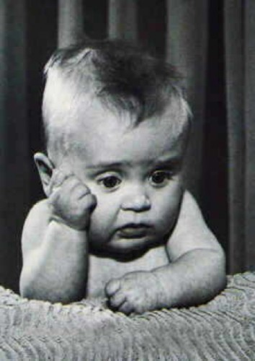






Welcome!
How are you feeling?
Notes:
Welcome to course, the University, to Nottingham for some. Congratulations on gaining a place on the course. Here because tutors have seen you as people with potential- to learn to become a teacher who can make a tangible difference to the lives of young people. Hope you have had a good morning in subject teams, getting to know tutors and peers. I hope it has settled a few nerves, answered a few questions, may have raised all sorts of emotions.
The start of things can be hard though. Talk to your partner and say how you are feeling right now in no more than three words.
As you start, I want to provide some reassurance. Whatever you are feeling today, whether it is nerves, excitement, worry, confusion, as tutors we know that all of this is normal. One of the strongest features of our course in my opinion is the tutor team. Not only are they outstanding teachers who are knowledgeable and full of enthusiasm about their subject, they are also experts in understanding the journey you are about to take and our students always rate very highly the support and guidance that they give. You will get to know them really well they will get to know you very well and they will be your biggest cheerleaders on the course
Purpose of gap between registration and start of teaching. Many of you will be managing change- moving location and setting in, leaving jobs etc. There are pre-course tasks to complete to help engage you and prepare you for the start of the course. Some of you will be doing SKE courses, primary experience etc.

Slide 2
Overview
What will the Strands and Phases look like in practice?
What to expect and ways to prepare for working with tutors, mentors and peers
Advice from previous PGCE students
  Being a professional
  What they wish they had known at the start…
Campus trail
Equality, diversity and inclusion
Library support

Slide 3
The teaching manual
The Ultimate Teaching Manual
The only thing you need to be successful!
Notes:
As we start the PGCE course, there is one thing we need to make clear- there is no such thing as a teaching manual- although some may claim otherwise. If teaching was simple, there would be a manual and no need for a course like this.
Teaching is incredible complex, nuanced, context dependent. Our course has a clear structure designed to guide you on your journey this year and to support the development of ways of thinking and working that will extend beyond the course and equip you to enjoy your role as a teacher in school, but it does not all sit neatly within a manual

Slide 4
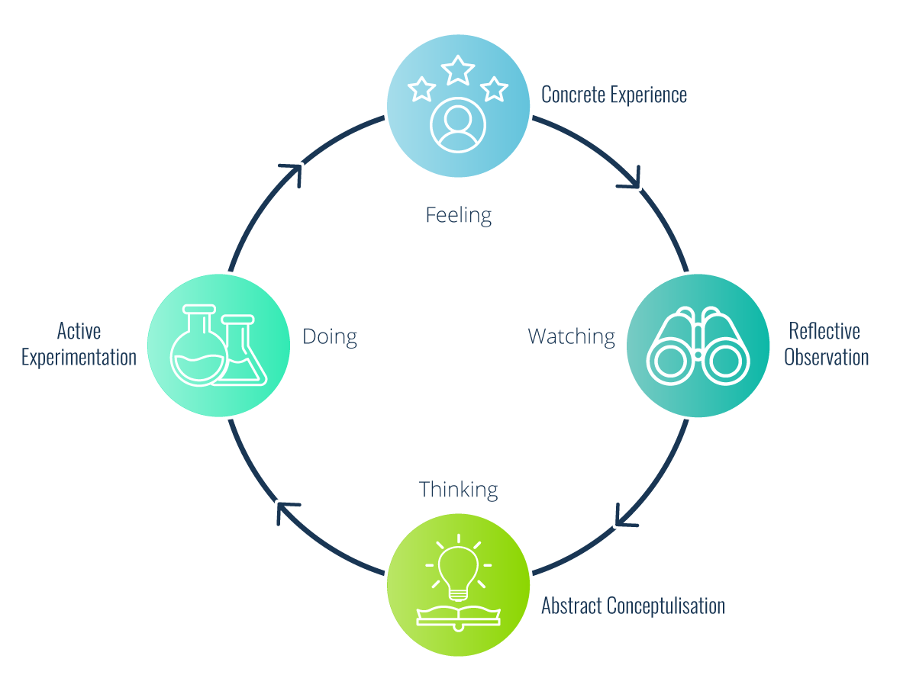
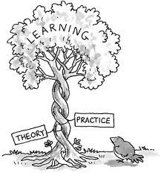
Theory and Practice
Kolb’s experiential learning cycle
Notes:
There are many ways that teaching and learning can take place. Just take a moment to reflect on all your life experiences and how they have influenced to way your see yourself and the world. If you then consider that in each classroom there will be nearly 30 people all with unique life experiences that will influence them as learners. That is what makes education so interesting and exciting but also what can make it so challenging. Whilst practice in a classroom is an important part of your development, practice alone will not support your development into a great teacher. Great teachers use theory to help illuminate their practice, to problematize and look at new possibilities. Whilst it may not always seem relevant in the here and now, I can promise you it will become useful to you at some point in the future (we only have such a short time with you). Theory will help you make sense of things and lead you to new ideas and thoughts and throughout your time on the course, we will introduce you to a wide range of theories about education to challenge and support you as you develop as a teacher.

Slide 5
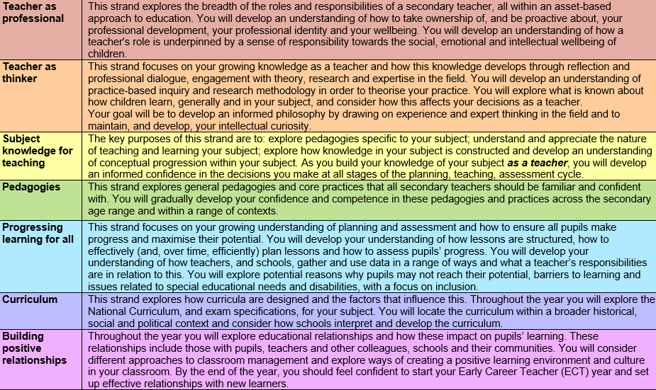
Notes:
I would encourage you to read the S&P document which you can find on the pre-course website. These 7 strands of knowledge underpin the structure of our course and help guided tutors, students and mentors to set realistic expectations throughout the year.

Slide 6



Modules
and
Schools and Society
Learning and teaching
Notes:
So how will we try to achieve that. On the PGCE course, there are two modules – each worth 30 M level credits. S&S and L&T. Both important for your development as a subject specialist and in your wider role as a teacher. They are both taught across the year, and have been planned together to support your development as a teacher
The S&S module will be taught in cross subject groups, with the opportunity to understand the perspectives of others. You will explore wider aspects of a teacher’s role in developing a more equitable society. Become a sensitive and responsive teacher. Examine issues around inclusion and equality in society to promote education for social justice in all that we do. We will challenge you to consider some really difficult questions.
L&T will take place within subjects, exploring what is known about how children learn and how best to teach within the context in of your subject.
Just like Theory and practice, the two are inextricably linked and the learning should be transferable between the modules.
Tutors teach across both modules and will develops links between the modules during subject and S&S sessions and through discussions on tasks you will complete in school.

Slide 7

Personal Learning Record Teaching Practice 1
Notes:
Today you will be given a Personal Learning Record. This is a set of tasks that you will complete across your first placement.

Slide 8
Personal Learning Record Teaching Practice 1
What is it
Purpose
Tasks designed to support your early development as a teacher
Includes readings, videos to watch, observations to complete, questions to reflect upon
Tasks cover Learning & Teaching and Schools & Society modules
Co-created by university tutors and school colleagues
Provides direction, support and structure
Provides a clear focus on different areas of a teacher’s role and practice
Facilitates conversations with mentors, teachers and university tutors about what it means to be a teacher: of your subject and more widely
Provides coherence- tasks followed up and discussed within university sessions
Notes:
PLR and its purpose this term. May look overwhelming but you have been given a whole term’s resources at once. These tasks have been co-created by university tutors and school colleagues working together to develop tasks that will enable you to get the most from experiences in school. These will also be used in subject teaching sessions, allowing you to share experiences and learn from the contexts that other students are working in and the insights they develop.

Slide 9



Assessment
What is your experience of being assessed?
How did it make you feel?
Notes:
Throughout the year, we will want to ensure that you are making learning and developing as a teacher and that will involve assessment in different ways.
I wonder how assessment has made you feel in the past- excited, enjoy pressure and performance of exams? Positive rewards for your hard work. Or perhaps, demoralised, working hard and not doing well? Navigated the challenges of both.
This course will award QTS and PGCE. Two different assessment frameworks- Teachers Standards and CCF underpinning our PGCE course- closely interlinked- you can’t have one without the other (no QTS only route).

Slide 10
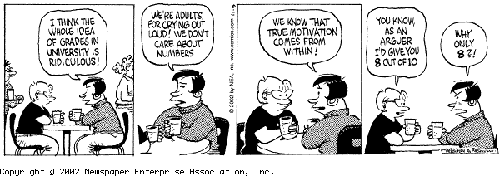
Assessment
PGCE with QTS
  Professionalism and practical teaching
  Academic assignments
Professionalism and practical teaching
  Regular assessment points throughout the year
  Involves mentor, tutor and you
Academic assignments
  Designed to support your development and draw on your experiences as a teacher
  Deadlines placed sensitively
  Support for academic writing
Notes:
To achieve QTS and PGCE, our two modules encompass a programme of reflection, research, academic writing and practical teaching to support your professional development. The academic work will support and develop your classroom practice and vice versa. There will be clear assessment points throughout the year for practical teaching and academic work and it is important you take ownership of these processes.
Assessment of practical teaching will take place during your placements and will involve you, your mentor and tutor. We do not believe in students having to produce pieces of evidence for each of the teachers’ standards but rather view any assessment holistically.
The PGCE assignments are assessed by your tutor and the nature of the assessment and associated criteria will be explained in detail by tutors. As a tutor team, we think very carefully where assignment deadlines fall, to enable you to complete them successfully. All of your M level assignments are designed to support your development as a teacher and as such, will draw on experiences working with pupils in schools, so the nature of these assignments and the style of writing might be different from previous academic work, but there will be plenty of support with this.
This is an M level course and a professional one, and as such you will be being assessed all the time – lectures, sessions, in school etc. importance of taking and full and active role.
Not everything will be assessed but doesn’t mean it isn’t important and worthwhile!
Challenging times as many of you will be a product of an education system that grades anything that moves and have been led to believe that if it is important, you will get a mark for it! We will explore this in our sessions and examine the impact of this on learning.
For example, today you will be given a PLR- a set of tasks to help guide your learning through this first term. You will complete these tasks in school with your mentor and share your learning in subject sessions with your peers. You will learn from your experiences and the experiences of others. You will draw on this learning in assignments, but we will not mark individual tasks as you complete them.
Instead, we will support you to get the most out of your learning- encouraging you to be pro-active and make the most of the experiences available to you but we cannot do the learning for you.

Slide 11
Attendance on the PGCE course
University and school-based days
Professional expectations
High attendance during university and school-based days more likely to lead to success
If you need to be absent, clear communication essential
  Always let your tutor know of any absence, for school-based days as well as university ones
  Follow school procedures for absence when in school
Notes:
We know from many years’ experience that those who have poor attendance are the ones who will find the going tough!
It is important that you are here or in school every day as far as is possible. This may be different from your time as an undergraduate when others did not rely on you.
However, we do know that sometimes you may need to be absent. And in these circumstances, then communicating in a professional way is important- following procedures, giving as much warning as possible, letting someone know why you will not be there.
Tutors will remind you of processes when we start, but it is not ok just to not turn up- others will be relying on you- in sessions or at school, so do make sure you know what you need to do if you are absent and follow the guidance given. And if you are not sure, your tutor will always be able to help.

Slide 12
Phases of the PGCE course
Phase One
Phase 2
How are you preparing for your teacher education year?
In what ways can you develop an understanding of the specialised knowledge a teacher needs?
Notes:
As well as the Strands, we also have a set of Phase Questions that provide an overarching theme for sections of the course. Since you accepted your offer on the course, you have been in Phase 1 ‘How are you preparing for your teacher education year?’ You will have had some subject related tasks to complete, some primary and/or secondary experiences, moving house, leaving jobs, finishing studies on other course.
Some of you may feel very ready to start on 9th, others know there are some things still to do, and the time before we meet again provides an opportunity to ensure you are well-prepared for the start of in person teaching.
Today marks the start of Phase 2 ‘ In what ways can you develop as understanding of the specialised knowledge a teacher needs?’. This focus runs up to October half term. So, if you consider the phase question, this part of the course will about understanding what it is you need to learn and developing ways of doing so. We will not be testing you at the end of it…

Slide 13





What to bring every day!
An open mind
Curiosity
Enthusiasm
Responsibility
Professionalism
Notes:
What to bring every day
Open mind – to explore new ways of thinking and to have our preconceptions challenged. We all have very different experiences of learning so it is important to explore other ideas and take ourselves out of our comfort zone
Curiosity – interest in learning of others, and how you will teach, be prepared to ask questions and don’t expect quick and easy answers. Living with a little uncertainty will be needed.
Enthusiasm- you need to be enthusiastic to engage others
Responsibility – there will be many times on the course where you will be expected to work as part of a team – both in school and in university. It is important you take full responsibility for your contributions.
Professionalism- what do we mean by this?
CLICK on professionalism to show video of former students discussing this- use first 3 minutes

Slide 14










Safeguarding
Notes:
Google yourself – are you happy with what comes up? Would you be happy for your pupils to see that? The headteacher? Ask someone you aren’t associated with on social media to look you up – what can they see? MAKE SURE YOU MAKE ANY ACCOUNT PRIVATE!!! Most of you already do this but you also need to know that it is not ok to accept a pupil as a friend on social media- make sure you follow guidance you will get from school colleagues and tutors, and always ask if you are unsure about something
We will encourage you to create things like Whatsapp groups to support each other on the course. Be mindful of what you post on these spaces- keep it professional, and positive, be sensitive to others– you may have had the best day ever but be mindful that others might be going through a difficult patch.
Safeguarding in school – designated officer etc. More when you start the course at university and at school

Slide 15

Support and Wellbeing service​
Counselling Service​
Academic Support​
Financial Support​
International Office​
Disability Support​
Student Advice Centre within SU​
Personal Tutors & DLOs​
Mental Health Advisory Service​
Notes:
Explain the importance of seeking support – talk to people. Don’t leave it too late! Range of wider support on offer- see the list of different teams that exist within the university, some of which might be a great benefit to support your learning this year

Slide 16

Disability Support at University
Who are Disability Support Services?
Specialist service providing support to help disabled students flourish as independent learners.
Who are they for?
For you, if you have been diagnosed with any of the following:
  Disability
  Mental health condition
  Long-term medical condition
  Autistic spectrum condition
  Specific learning difference, including ADHD
Notes:
If you have additional learning needs, do contact disability support to ensure you have the right support in place for this course to be able to flourish as a learner.
If you had a disability support plan in place as a UG at UoN, you still need to contact the disability support team again- your plan does not automatically come to us and changes might be necessary due to the nature of this course. Many have already done this- but if you have not done so now, please prioritise doing this as soon as possible.
Also speak to tutors who will respond quickly to individual needs where possible, and will not wait until a disability plan is in place to do so.

Slide 17

Inclusion Passport
Notes:
Your school colleagues will be working closely with you throughout the year during your placement. Just as it is important to share with us how best we can support you as a learner, so it will be with them.
To ensure additional needs or particular circumstances are communicated clearly to those you are working with in school, tutors will want to work with you to find out the best way for this to happen for you.
One option is to consider completing an Inclusion passport which sets your individual needs and support needed- a short document that shares relevant information and support/accommodations that would be beneficial for you as a learner. Tutors will help you draw up the passport and with sharing this.

Slide 18
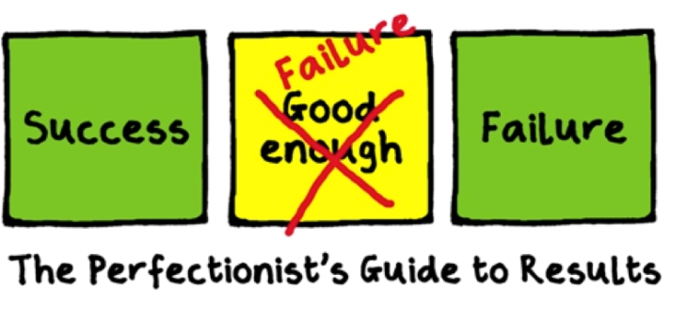




Managing the load!
Notes:
There is no doubt this year will be intense. Important to be organised and have strategies to manage your workload. Equally important is to schedule time for you to maintain contact with friends and family, keep up with sports and hobbies.
Many students come onto the course having achieved highly throughout their education and this may well be the first time they have found something hard! That can be unsettling – you need to keep communicating with us and your mentors.
Perfectionism is a noble aim but may well lead to problems. Seeking that perfect image, lesson resource, activity can take oodles of time and actually have very little impact on the learning – use your time widely, don’t always try to re-invent the wheel, sometimes it has to be good enough!
Good enough is fabulous!

Slide 19

Collaboration

Slide 20
Your first task!
Getting to know the campus
Getting to know your peers
Working as a team
Find 2 or 3 other people to work with
Take a map of campus
Take the questions for the campus trail
Notes:
Send out for treasure trail ~ 25 mins

Slide 21
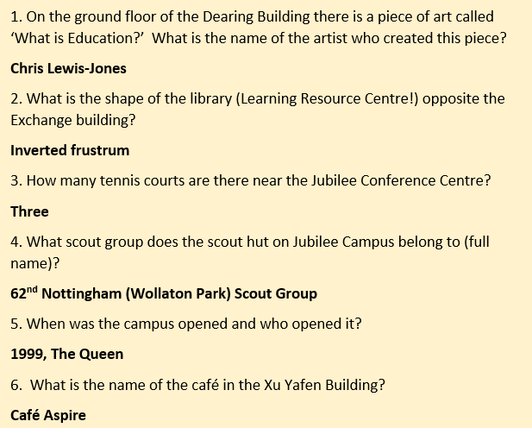

Slide 22
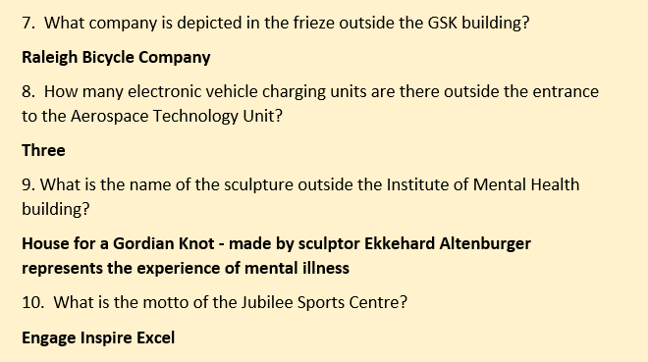

Slide 23
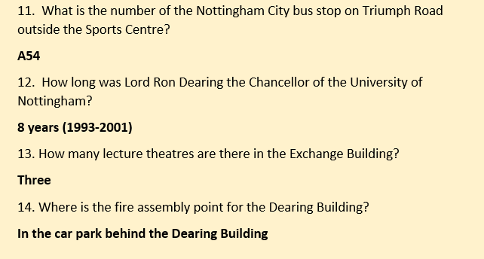

Slide 24

Equality and Diversity Pledge
Aims
To promote and celebrate a diverse and inclusive teacher workforce
To continually educate ourselves and promote the education of others
To avoid deficit models where solutions are aimed at changing individuals
To provide safe spaces for beginning teachers to share and discuss experiences
To provide spaces for us to hear all voices and use this to develop our curricula and approaches and affect change
Notes:
Pledge agreed across the region, involving different ITE providers, expressing a commitment to:
Promote and celebrate a diverse inclusive teacher workforce, to continually educate ourselves to develop our courses, to take an asset-based approach to education, recognising what individuals and communities have, not what they don’t have, to help you discuss and share experiences to inform how we continue to develop our approaches and curriculum

Slide 25
EDI:
Stronger together
Diversity
the state of being diverse
Inclusion
the action or state of including or of being included within a group or structure
Equality
the state of being equal, especially in status, rights, or opportunities

Slide 26
Be open and curious
Our instinct as humans is naturally to gravitate towards those who are most like ourselves; whose experience of the world most mirrors our own.
If you want the richest possible experience of life, make efforts to connect with people who are not the same as you.
How openly are you connecting with people who are different to you?

Slide 27

Life experiences of others
We all make assumptions until we’re shown a different perspective.
Listen to and ask questions about the experiences of others.
Create a safe, non-judgemental space to share stories and experiences.
We are all learning, all the time.

Slide 28
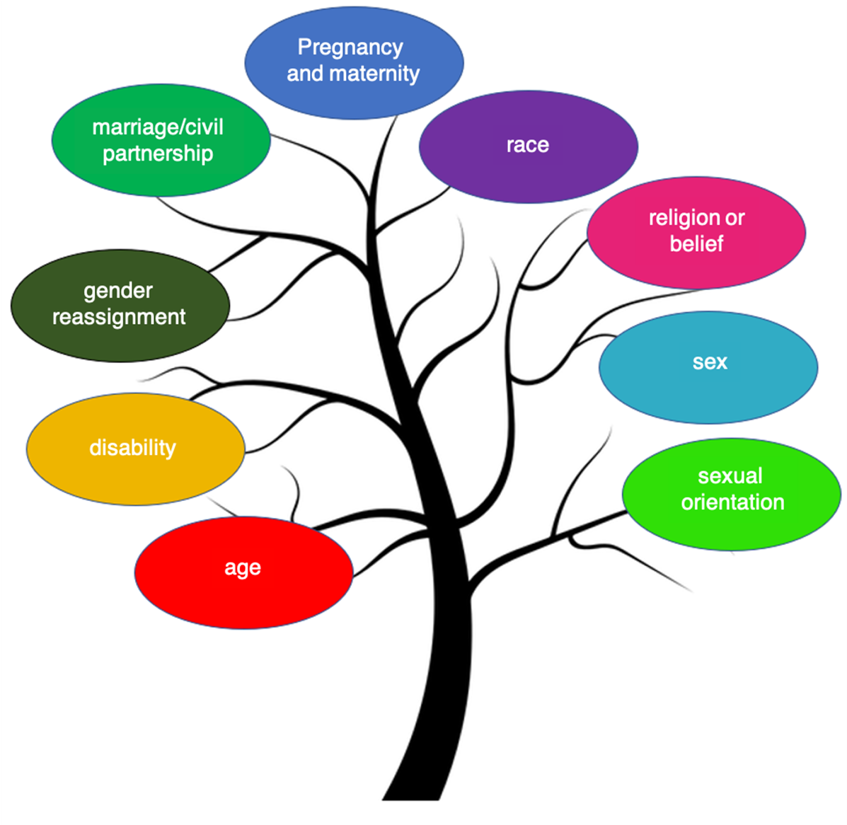
Protected characteristics
It is against the law to discriminate against someone because of the 9 protected characteristics.
The University also includes socioeconomic status, temporary impairment and caring responsibilities in planning.
It is also important to think about people who are the first in their families to attend university, and to consider refugees/asylum seekers.
Notes:
Equality Act (2010) covers protected characteristics that it is against the law to discriminate
UoN includes additional ones
Impact of life experiences on your educational progress and, as teachers, the educational experience and progress of pupils you are working with.
Throughout the course, you will work with a diverse student cohort at university and diverse pupil and school communities on placements and there will be many opportunities to learn from others- be open minded throughout and challenge yourself to consider the assumptions you might make about others

Slide 29
EDI in the School of Education
EDI forum open to staff and students meets regularly throughout the year
Key points of contact:
  All PGCE tutors
  Disability Liaison Officer: Dr Helen Smith
  Carers’ Champion: Dr Charlie Davis

Slide 30
EDI as a UoN student and teacher
UoN student and staff networks: Stronger together
School of Education EDI forum
‘EDI in practice’ SharePoint
  To connect people
  Share information events taking place
  Share news and resources
UoN PGCE student networks
Regional teacher networks

Slide 31

Life experiences of others
Stronger Together videos with students from different backgrounds talking about their experiences at Nottingham. Here’s one about mature students to illustrate what we’ve been talking about.

Slide 32
UoN PGCE student network groups
In previous years, we have run groups the following groups:
Carers and parents
Career changers
Black and global majority
Internationally educated
Neurodivergent
LGBTQ+
Mental health
…..but we can also do more!
Student led, facilitated by tutors
Time to meet, share life experiences, get to know each other
Come along on Friday 4 October 2024 at 12.45-1.15 to share experiences of the start of the course and find out more about possible network groups
OR
Get in touch with Claire Clemmet before then if you would like something to be set up sooner

Slide 33
UoN PGCE social groups
We will encourage you to get to know your peers well
We will also provide opportunities for you to connect with those who have shared interests
Look out for information about these in the first few weeks of the course
Let us know if there is anything you would like us to support with setting up at a subject or whole course level

Slide 34
Prayer and meeting rooms
These spaces are made available by the University for the benefit of all students and staff. The rooms offer designated sacred spaces for spiritual/religious activities (individual and small group), designated prayer, as well as a space for peace, quiet and reflection.
Christian and Multi Faith Spaces
XU Yafen Building (Amenities)
Jubilee Campus
Open Room B01.
Muslim Prayer Rooms
XU Yafen Building (Amenities)
Jubilee Campus
Sisters in B02 and Brothers in B05.

Slide 35

Library resources
Notes:
Click on link to see guidance and resources about using the libraries at the UoN. We know that doing academic study or writing Masters level assignments may feel daunting for some at the moment, but there will be lots of support within the course and you also have access to a range of support from across the university.
In the week ahead, you might find it helpful to explore some of the resources here from the library which provide guidance on how to use the libraries, how to find readings and resources and how the librarians can support you. There is a helpful introductory video on this link.

Slide 36

Hang on tight!
Advice from previous PGCE students from University of Nottingham
Notes:
I realise that today will have given you a lot to think about and take in! Don’t worry- you are not expected to remember everything, but you are expected to ask when things are not clear. There is an exciting and busy year ahead, and we are looking forward to working with you to help you become the teacher you want to be and to make a difference to the lives of young people.
This is a video of advice from previous students on this slide- we are going to listen to their response to the prompt Things I wish I had known at the start…’

Slide 37
Things I wish I had known at the start….
Get organised- get a planner straightaway- or get something that works for you
Look after your well-being- keep doing the things you love so that you can be the best you can be
It is a hard year, but it is so rewarding. It is ok to have bad days, but you will also have fantastic ones- focus on them
Knowing when to ask for help. There are so many knowledgeable people- mentors, tutors, that are so helpful about how to find time to rest, how to plan lessons that are good enough
Notes:
I have selected a few pertinent quotes about things they wished they had known at the start- some of which you have heard, others that come from later in the discussion. The video is 12 minutes long. If you would like to listen to more, these slides, containing the link to the video, will be on the pre-course website in the next few days, should you which to revisit them before 9th.
Get organised
Be positive
Look after yourself
Know that there is lot of support- do speak up and ask

Slide 38
Next steps….
From 1-4pm you will be in Dearing Building, in subject groups and to complete your registration
Subject | Room to be at for 1pm
English | Atrium, Dearing Building then B37
History | B85, Dearing Building
Geography | A2, Dearing Building
Maths | B46, Dearing Building
Modern Languages | B19, Dearing Building
Science | A35, Dearing Building

Slide 39

See you on Monday 9th September!
Prepare well!
Complete Immersive Practice Days and QR codes
Complete subject specific tasks
Make sure you have worked through the ‘To do’ list and responded to any emails related to your university registration

