Slide 1
Top Tips!
Maths activities work best when….
…we remember that it’s not just about completing a task – it’s about understanding the mathematics.
…we work together and explain what we are doing.
…we are prepared to say that we don’t understand!

Slide 2
1a. Setting the scene

Slide 3
Buying Paint
Ali, Blair and Col work for a decorating company.
They buy 28 litres of gloss paint for to be used on wood at three different jobs.
Blair is going to paint an area twice as large as the area Ali is to paint.
Col is going to paint an area five times larger than Ali.
How many litres of paint should each person take for their job?
Ali ₋₋₋₋₋₋₋₋₋₋₋₋₋₋₋₋₋₋₋₋₋₋₋₋ Blair ₋₋₋₋₋₋₋₋₋₋₋₋₋₋₋₋₋₋₋₋₋₋₋₋
Col ₋₋₋₋₋₋₋₋₋₋₋₋₋₋₋₋₋₋₋₋₋₋₋₋

Slide 4
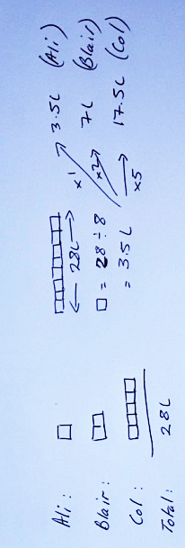
Buying Paint
Can you explain these two methods?
What is the link between the two methods?
Hint

Slide 5
Buying Paint
Can you explain these two methods?
What is the link between the two methods?

Slide 6
2a. Cards

Slide 7
Solving Problems – working in pairs
Take turns to draft the solution to problems 1 and 2 on your mini-whiteboard.
Once you are both agreed on the method write the solution and any diagrams or thinking on to the card.

Slide 8
3a. Review

Slide 9
Question 1
Hint
Answer
Next Question

Slide 10
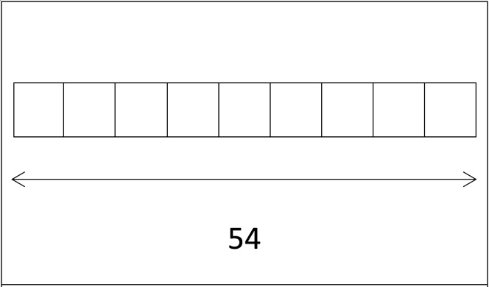
Question 1
Answer
Next Question

Slide 11
Question 1
Cola Bottles: 18
Jelly Snakes: 6
Gummy Bears: 30
Next Question

Slide 12
Question 2
Hint
Answer
Next Question

Slide 13
Question 2
Answer
Next Question

Slide 14
Question 2
Apples: 12
Bananas: 6
Oranges: 36

Slide 15
1b. Setting the scene

Slide 16
Selling Samosas
A café sells meat and vegetable samosas.
On Monday it sells four more vegetables as meat samosas.
On Tuesday it sells four times as many vegetable as meat samosas.
Each day the café sells 40 samosas.
On Tuesday, the café sells the same number of meat samosas as it did on Monday
Dek
Is Dek correct? Explain your answer.

Slide 17
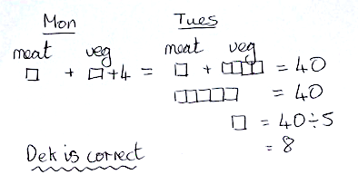
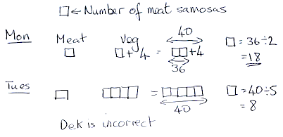
Selling samosas
What is the difference between Aabid’s and Mia’s methods?
Which conclusion is correct? How do you know?
Aabid’s conclusion
Mia’s conclusion

Slide 18
2b. Cards

Slide 19
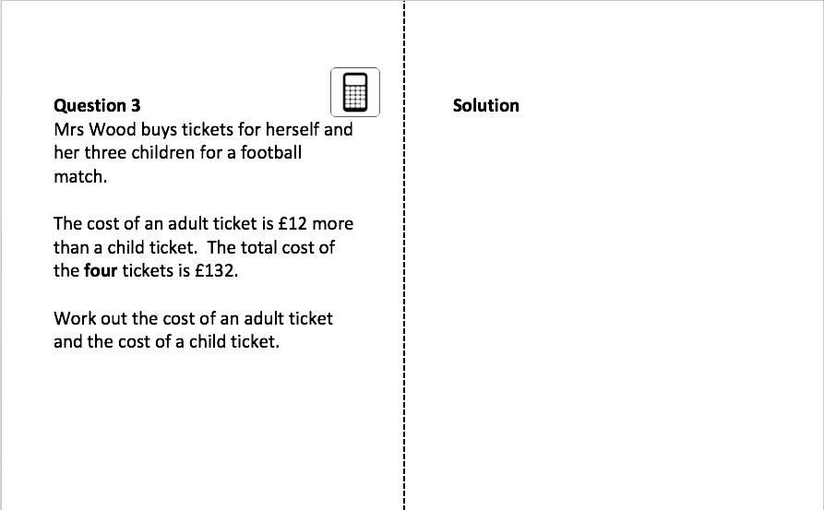
Solving Problems – working in pairs
Take turns to draft the solution to problems 3 and 4 on your mini-whiteboard.
Once you are both agreed on the method then write the solution and any diagrams or thinking on to the card.

Slide 20
3b. Review

Slide 21
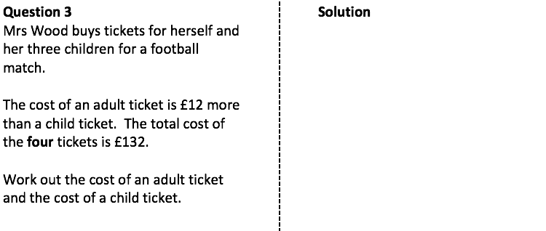
Question 3
Hint
Answer
Next Question

Slide 22
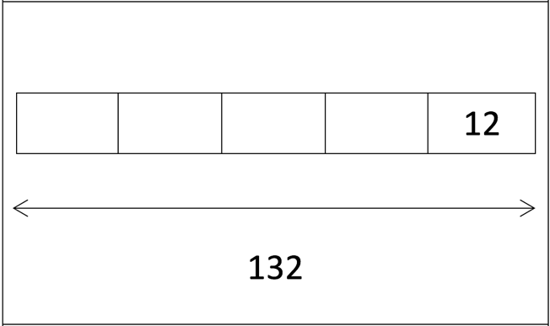
Question 3
Answer
Next Question

Slide 23
Question 3
Adult ticket: £42
Child ticket: £30
Next Question

Slide 24
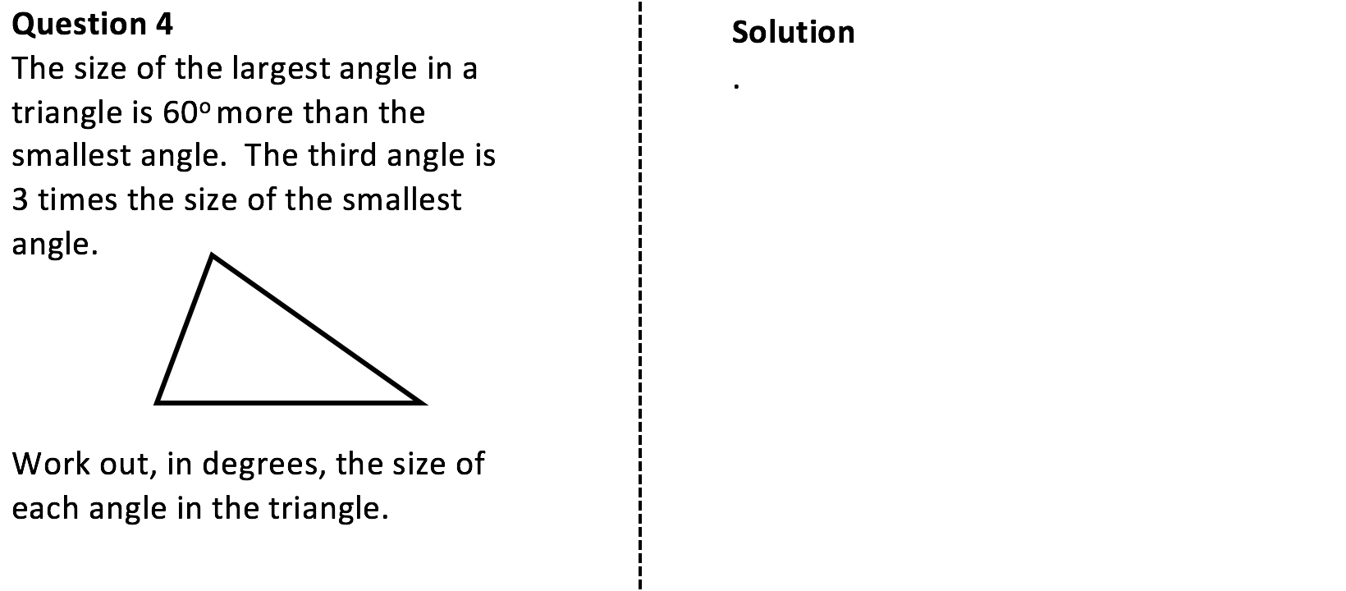
Question 4
Hint
Answer
Next Question

Slide 25
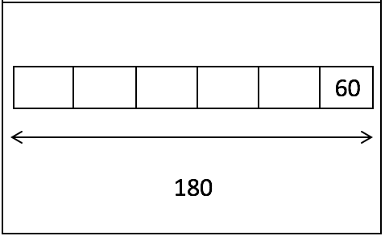
Question 4
Answer
Next Question

Slide 26
Question 4
84º
72º
24º
Next Question

Slide 27
4. Closure

Slide 28
Selling Samosas
What were the most important words/phrases that had to be noticed?
A café sells meat and vegetable samosas.
On Monday it sells four more vegetables as meat samosas.
On Tuesday it sells four times as many vegetable as meat samosas.
Each day the café sells 40 samosas.
On Tuesday, the café sells the same number of meat samosas as it did on Monday
Dek
Draw a diagram to show that Dek is incorrect.

Slide 29
Selling Samosas
What were the most important words/phrases that had to be noticed?
A café sells meat and vegetable samosas.
On Monday it sells four more vegetables as meat samosas.
On Tuesday it sells four times as many vegetable as meat samosas.
Each day the café sells 40 samosas.
On Tuesday, the café sells the same number of meat samosas as it did on Monday
Dek
Draw a diagram to show that Dek is incorrect.

Slide 30
How Old?
Kate is the youngest of three friends.
Jayne is 7 years older than Kate and Helen is twice as old as Kate. The sum of their three ages is 103.
How old are Kate, Jayne and Helen?
Kate ₋₋₋₋₋₋₋₋₋₋₋₋₋₋₋₋₋₋₋₋₋₋₋₋ Jayne ₋₋₋₋₋₋₋₋₋₋₋₋₋₋₋₋₋₋₋₋₋₋₋₋
Helen ₋₋₋₋₋₋₋₋₋₋₋₋₋₋₋₋₋₋₋₋₋₋₋₋

Slide 31
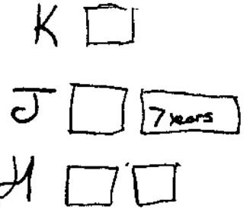
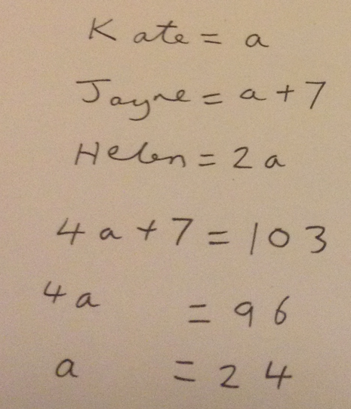
How Old?
Kate is the youngest of three friends.
Jayne is 7 years older than Kate and Helen is twice as old as Kate. The sum of their three ages is 103.
How old are Kate, Jayne and Helen?

Slide 32
Going deeper…
Fran has a friend, James, who is 4 years older than her.
Paul is three times as old as Fran.
The sum of their three ages is 89.
If x represents the age of Fran, show that 5x = 85 and hence find how old Paul, James and Fran are.
Paul ₋₋₋₋₋₋₋₋₋₋₋₋₋₋₋₋₋₋₋₋₋₋₋₋ James ₋₋₋₋₋₋₋₋₋₋₋₋₋₋₋₋₋₋₋₋₋₋₋₋
Fran ₋₋₋₋₋₋₋₋₋₋₋₋₋₋₋₋₋₋₋₋₋₋₋₋

Slide 33
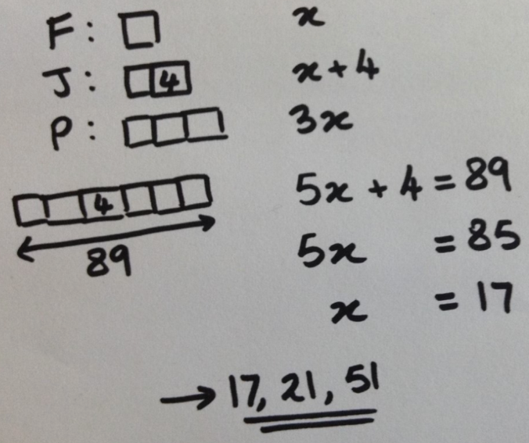
Going deeper…
Fran has a friend, James, who is 4 years older than her.
Paul is three times as old as Fran.
The sum of their three ages is 89.
If x represents the age of Fran, show that 5x = 85 and hence find how old Paul, James and Fran are.

Slide 34
Going deeper…
Fran has a friend, James, who is 4 years older than her.
Paul is three times as old as Fran.
The sum of their three ages is 89.
If x represents the age of Fran, show that 5x = 85 and hence find how old Paul, James and Fran are.

Slide 35
5. Extension

Slide 36
Extension
A straight line is made up of three angles.
Angle 2 is twice the size of angle 1.
Angle 3 is 15º smaller than angle 2.
Find the size of each angle.
Angle 2
Angle 1
Angle 3

Slide 37
Extension
A straight line is made up of three angles.
Angle 2 is twice the size of angle 1.
Angle 3 is 15º smaller than angle 2.
Find the size of each angle.
78º
39º
63º

