Slide 1
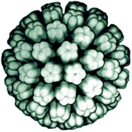
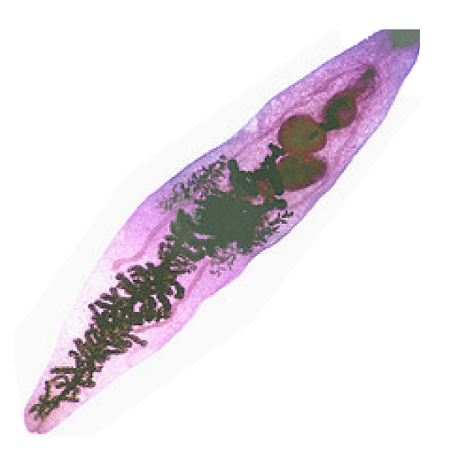
Infectious agents and cancer
Viruses
Bacteria
Parasites
Professor Kevin Gaston
Kevin.Gaston@Nottingham.ac.uk

Slide 2
Figure 1
Cancer cases attributable to infectious agents
The attributable fraction for a population is the proportion of incidents that are attributable to the risk factor.
Plummer et al Lancet Global Health (2016) 4: e609.
Notes:
Attributable fraction of cancer related to infection, 2012

Slide 3
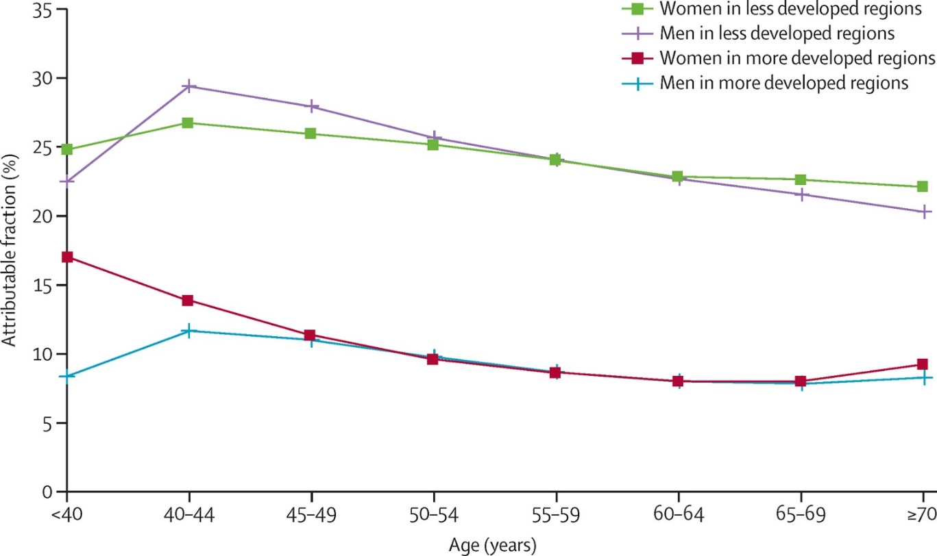
Figure 3
People in less developed regions are most at risk
In less developed regions infectious agents account for at least 25% of all cancer cases.
In more developed regions infectious agents account for at least 10% of all cancer cases.
The Lancet Global Health 2016 4, e609-e616DOI: (10.1016/S2214-109X(16)30143-7)
Notes:
Proportion of cancer cases in 2012 attributable to infection, by sex, age group, and development status

Slide 4
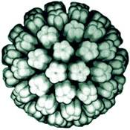
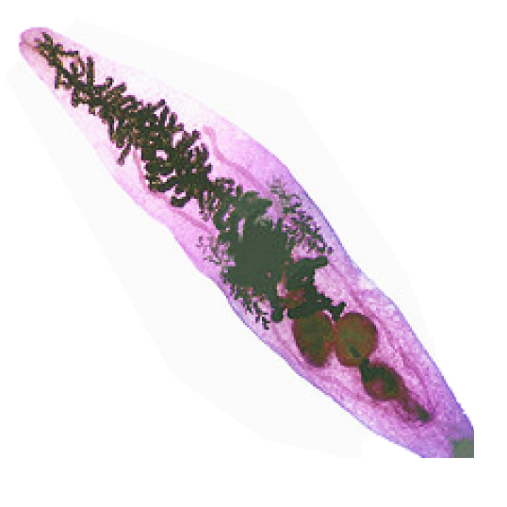
Infectious agents account for 2.2 million cases/year

Slide 5
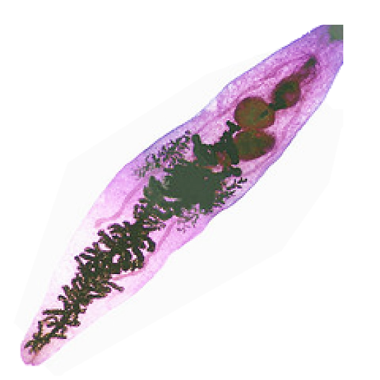
Some types of liver fluke cause bile duct cancer
Number of credits - 20. Semester 2.

Slide 6
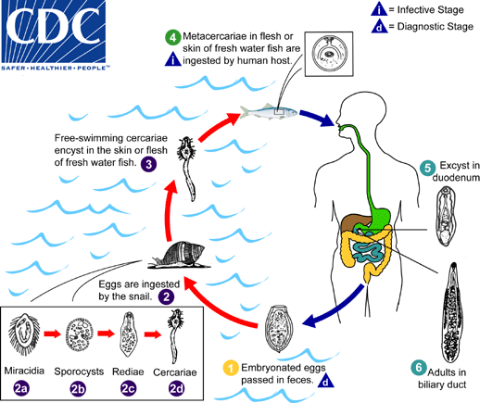

Slide 7
Chronic inflammation drives bile duct cancer
M
Chronic inflammation
Stromal Activation
Progression to invasion
Proliferation/ DNA damage
Mutations e.g. P53, KRAS, PTEN
Notes:
Wnt from macrophages is known to promote CCA
Notch2 and Jagged mutation leads to Agaille syndrome – characterised by loss of bile ducts
In cancer Notch1 2 and 3 are elevated
Notch3 is over expressed in primary CCA and in a mouse model of CCA genetic deletion of Notch 3
Inhibits the formation of tumours

Slide 8
Helicobacter pylori causes gastric cancer

Slide 9
Viruses are also a major cause of cancer

Slide 10
Human papillomaviruses
Virus Type Clinical Association
HPV 1 Plantar warts on feet
HPV 2 and 4 Common wart
HPV 16, 18 and 31 Cervical cancer
Head and neck cancer
An oral papilloma

Slide 11
The HPV life cycle
Viral
DNA
The E6 and E7 oncogenes encode viral oncoproteins

Slide 12
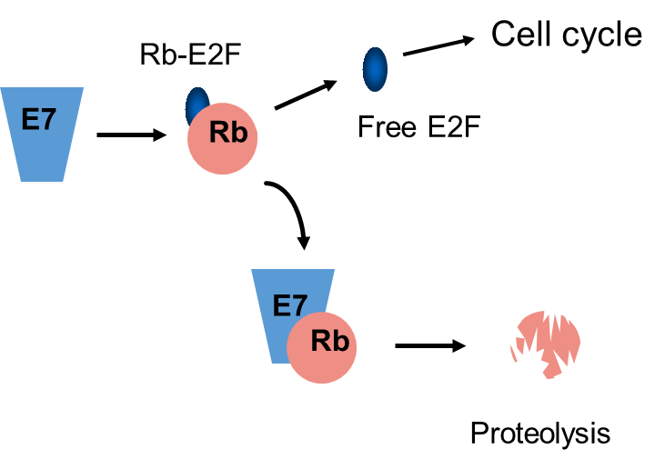
HPV E7 binds to the retinoblastoma protein
Rb is a tumour suppressor protein that controls the cell cycle
E7 targets Rb for degradation by the proteasome

Slide 13
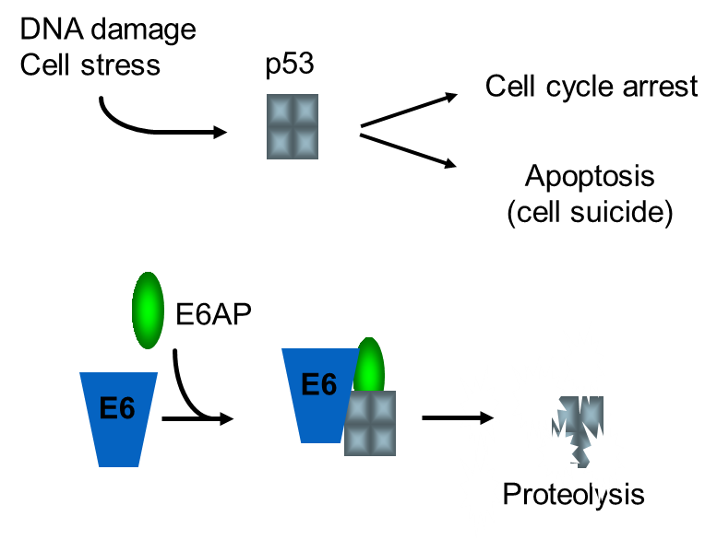
E6 binds to the p53 tumour suppressor protein
E6 targets p53 for degradation by the proteasome

Slide 14
Retroviruses also cause cancer in humans
Virus Clinical Association
HIV AIDS
(Kaposi’s sarcoma)
HTLV-I T-cell leukaemia
HTLV-II May be associated with some
T-cell leukaemias
HTLV-l is endemic in Japan and the Caribbean and parts of the United States, Italy, and Africa
Around 3% of infected people develop T-cell leukaemia

Slide 15
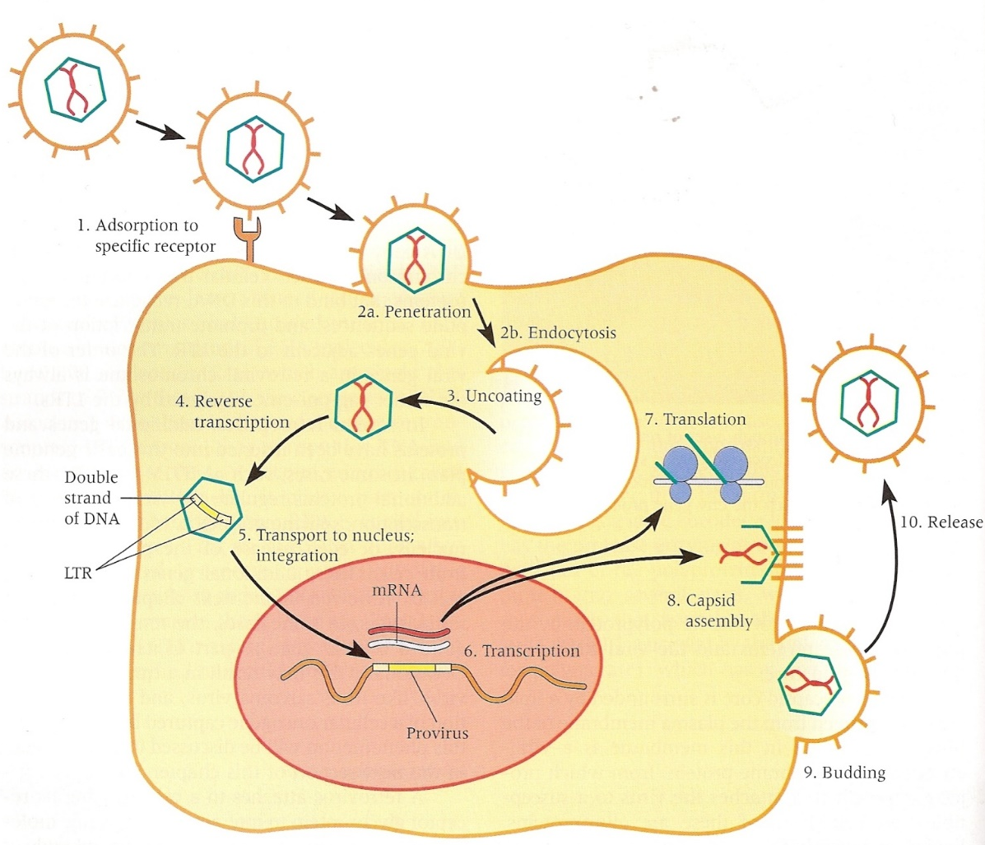
The retroviral life cycle
From “Viruses” by A. J. Levine,
W.H. Freeman and Co.

Slide 16
Summary
Infectious agents cause several types of cancer in humans
Liver flukes cause bile duct cancer in South East Asia
Helicobacter pylori causes gastric cancer
HPV causes many types of cancer including cervical cancer
HPV E7 inactivates the Rb tumour suppressor protein
HPV E6 inactivates the p53 tumour suppressor protein
Retroviruses also cause cancer in humans
Further reading: The Biology of Cancer (2nd Edition)
Robert A. Weinberg
Chapter 14

