Slide 1
xCorrelation Grid – USER GUIDE (2014 v3a)
Xcorrelogram analysis useful tool to examine correlated firing between pairs of units
Problem with CCH analysis is astronomical combination of neuronal pairs available
e.g. just with a16-electrode array: i.e. many pair combinations!
Question: How to visualise such huge data sets, to allow visual scanning / analysis selection
Resolution: Development of a grid plot which allows visualisation of the entire recording array population of unit-pairs x-correlations

Slide 2
Cross-correlation Grid/Matrix plot – Regions of Interest (ROIs 1 2 3)
high correlation
VTA
ROI 1
mPFC
ROI 3
ROI 2
low correlation
VTA
mPFC

Slide 3
Cross-correlation Grid/Matrix plot – generating selected CCHistograms
+
mouse cursor
“click” generates CCH

Slide 4
Example Cross-Correlation Histogram (CCH) or x-correlogram
half-peak width ~ value = x (ms)
confidence limits, e.g. 99%
Computed indices/parameters: Reference: Eblen-Zajjur & Sandkuhler (1996) Neurosci. 76, 39-54
+/- 1s; bin width 1ms
+/- 200ms “shoulder” specified in computation
Peak height ~ strength of correlation
Half-peak width ~ ”variance/jitter” in spike firing timing (“correlation”)
Peak Offset ~ shape & skew from centre zero (0) = lead + / lag- in firing correlation between unit pairs

Slide 5
CCH computed indices/parameter plots:
K-index / half-peak width (PW₅₀)
peak width (PW₅₀ ms)
K-index
Data plotted as mean ±s.e.m., n= N units (ROI 1 & ROI 2) / unit pairs (ROI 3) for a user-defined epoch / period within script

Slide 6
CCH computed indices/parameter plots:
ROI Peak Offset
ROI 1
ROI 2
ROI 3

Slide 8
xCorrGrid – plot interpretation (1)
Example #1 is recording from 8-channel array in VTA [sig 01-08] and 8-channel array in mPFC [sig09-16]
Grid/matrix y-axis = REFERENCE UNITS
x-axis = TARGET UNITS
Each pixel = computed correlation between pairs of units – the grid represents all neural pair combinations available from the array recording electrode(s)
Colour = magnitude of correlation for each neuronal pair
black diagonal = max (100%) correlation = auto-correlation for each unit
Reviewing example grid user can infer:
Independent correlated activity within (intra-) VTA (ROI 1) and mPFC (ROI 2)
evidence for weaker correlation between (inter-) VTA and mPFC (: ROI 3)
when reviewing peak offset histograms “clicking” on a peak reveals contributing unit-pairs

Slide 9
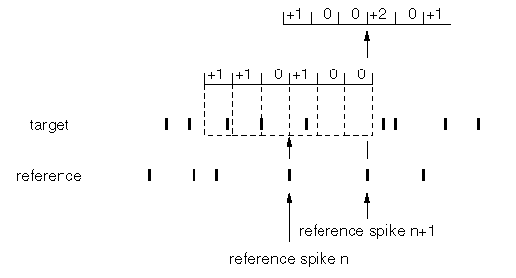
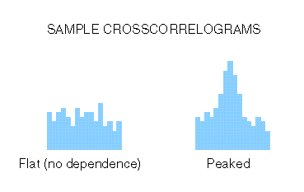
Cross-Correlation Histogram (CCH)
Timing of spike occurrence at one reference neurone compared with a target neurone
Plot provides information on absence / presence / degree of correlation neuronal pairs
spike rasters for
neuronal pair
Time (ms)
Target neurone ~
Reference neurone ~
correlation absent ~
~ correlation present
- 0 +
- 0 +
Time (ms)
lead (+ ms) or lag (- ms) ~ implication on connectivity between neurones

Slide 10
Cross-Correlation Histogram - CCH plot interpretation
Height & width of peak – gives indication of strength of any correlation
Peaks centred at 0 time ~ imply both neurones (T & R) receive common input
T
c
R
Peak to right (+ ms) of 0 ~ reference neurone leads target
R
T
Peak to left (- ms) of 0 ~ reference neurone lags target
T
R

Slide 11
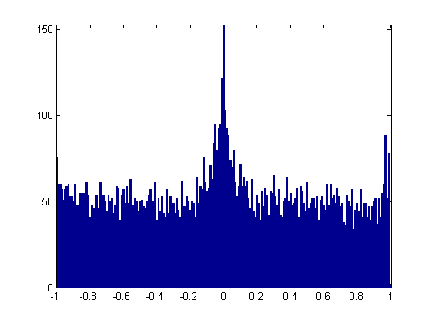
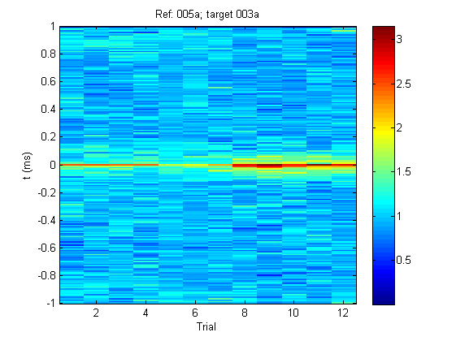
CCH activity between neuronal pairs in sequential time series
(1) CCH in single temporal recording epoch limited information
– devised Sequential time-series visualisation
CCH plot for single epoch 12
Time series CCH plot for epoch trials 1-12
CC magnitude
Correlation magnitude
Time (ms)
Time (s)
Epoch Trial #
Kainate

Slide 13
xCorrGrid – plot interpretation (2)
Example #2 is a recording from an 8-channel (4x2) array in mPFC [sig 01-08] and 8-channel array in hippocampus [sig09-16].
Sig01-04 recorded in superficial mPFC (IL) / sig05-08 recorded in deep mPFC (CG).
Grid y-axis = REFERENCE UNITS
x-axis = TARGET UNITS
Each pixel = a correlation between pairs of units – the grid represents all neural pair combinations available from the array recording electrode(s)
Colour = magnitude of correlation for each neuronal pair
black diagonal = max (100%) correlation = auto-correlation for each unit
Reviewing example grid user can infer:
Independent correlated activity within mPFC and Hpc; some evidence for difference intra-mPFC
weaker correlation between mPFC and Hpc

Slide 16
Old SLIDES

Slide 17
Xcorrelogram Grid plot (old style):
mPFC
(sig 01-08)
Reference Unit
+
Hpc
(sig 09-16)
mouse cursor
“click” generates
CCH

