Slide 1

Understanding your pension
University of Nottingham - Contributory Retirement Savings Plan (CRSP)
Chris Johnston
Client Director
1 February 2024

Slide 2




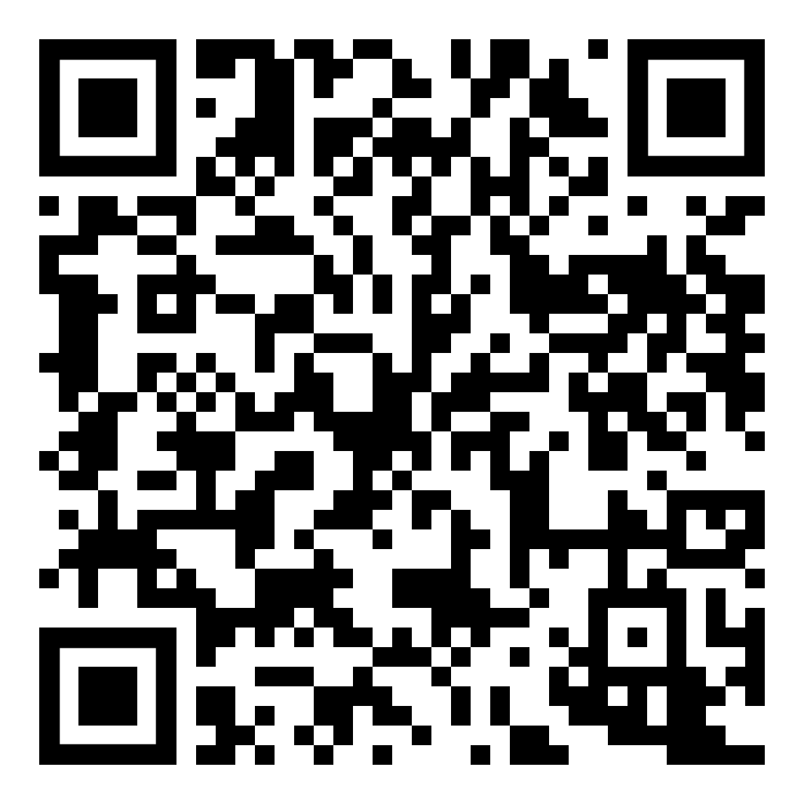
Important information
  This presentation is designed for general education purposes on the subjects covered. Please remember the presenter is unable to give any financial advice, if you need financial advice you can visit unbiased.co.uk where you can find a list of financial advisers. Please note advisers may charge for their service.
    The law, tax rates and any allowances may change in the future. These changes could affect the value of your savings, how much you can pay in, or the age at which you’re able to access your money. How tax works for you will depend on your individual circumstances.
    This presentation is based on 2023/2024 tax year and is subject to change with the HMRC rules and regulations.
    Investments will be covered in this presentation however please bear in mind that your investments may go down as well as up and the return on your investments is not guaranteed.
Managing your money in uncertain times

Slide 3
Agenda:
What are we going to cover today?
Getting started
Investing your pension
Taking money from your pension
Other important considerations

Slide 4

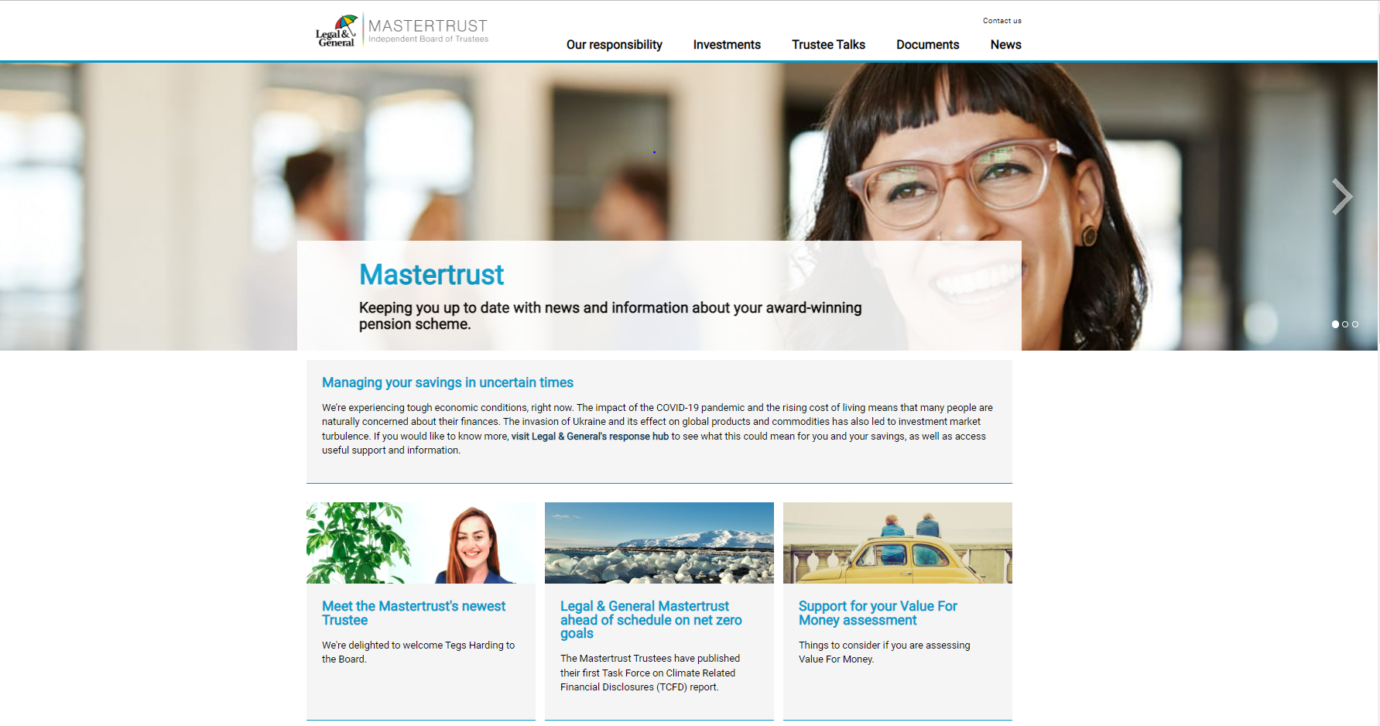
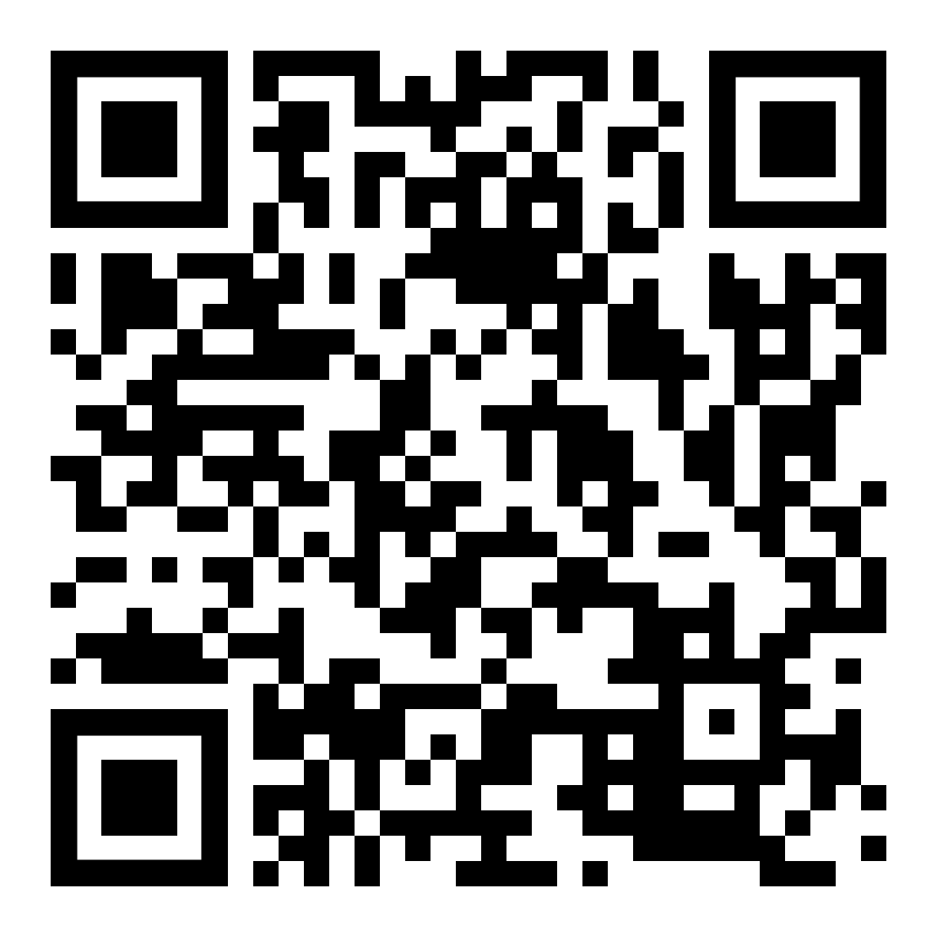
What is the Legal & General Mastertrust?
The Mastertrust is managed by an independent Board of Trustees who:
act in the interests of Scheme Members
are responsible for ensuring members receive value for money
regularly assess costs to ensure that all charges are fair and competitive
L&G Mastertrust

Slide 5

Saving for retirement
5

Slide 6
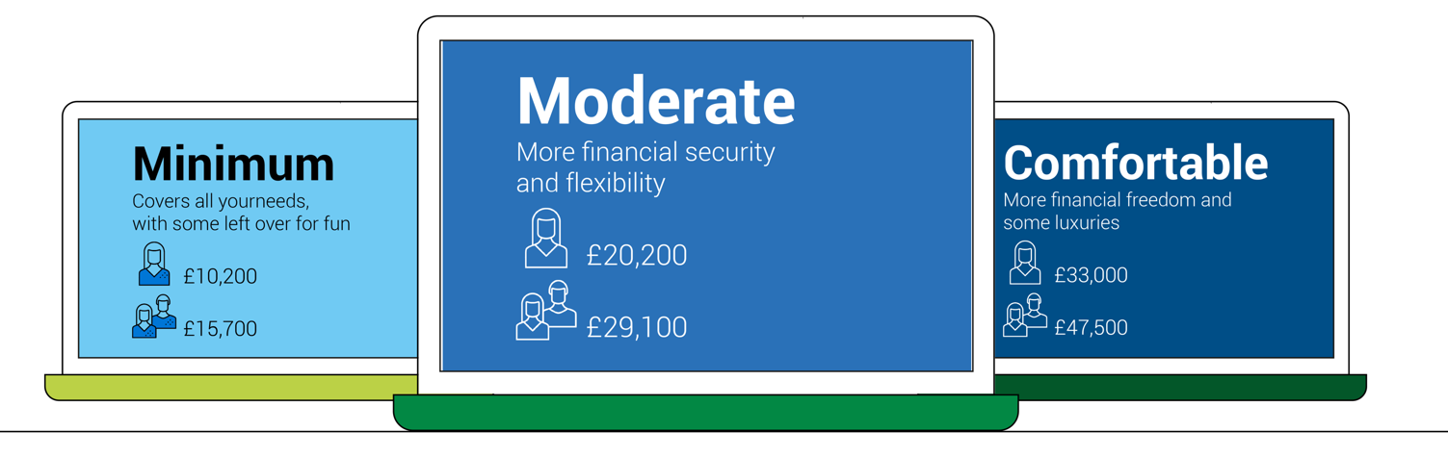





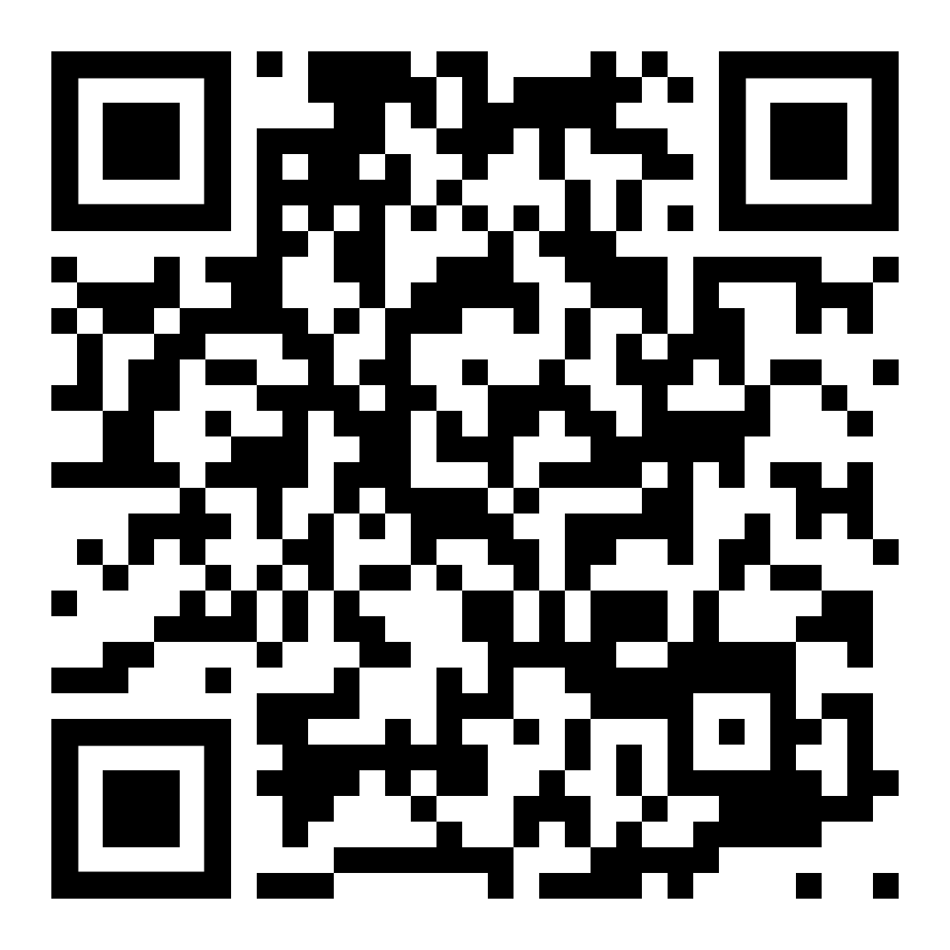
Picture your future
What standard of living would you want in retirement?
  The Pensions and Lifetime Savings Association (PLSA) has developed 3 lifestyle examples to help people visualise the cost of their retirement.
  Examples show how much annual income you’ll need from your pension (as well as other savings) to achieve the example retirement lifestyles.
Moderate
Minimum
More financial security and flexibility
Comfortable
Covers all your needs with some left over for fun
More financial freedom and some luxuries
£23,300
£12,800
£10,900
£37,300
£19,900
£34,000
£54,500
Pensions and Lifetime Savings Association

Slide 7

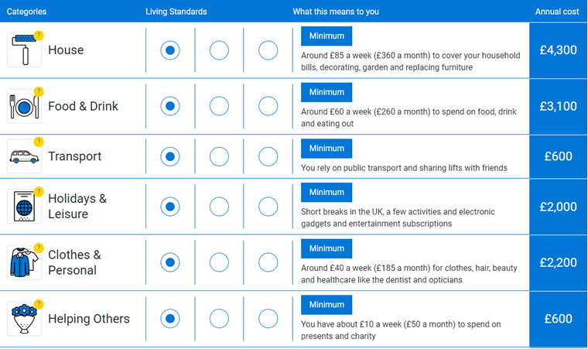
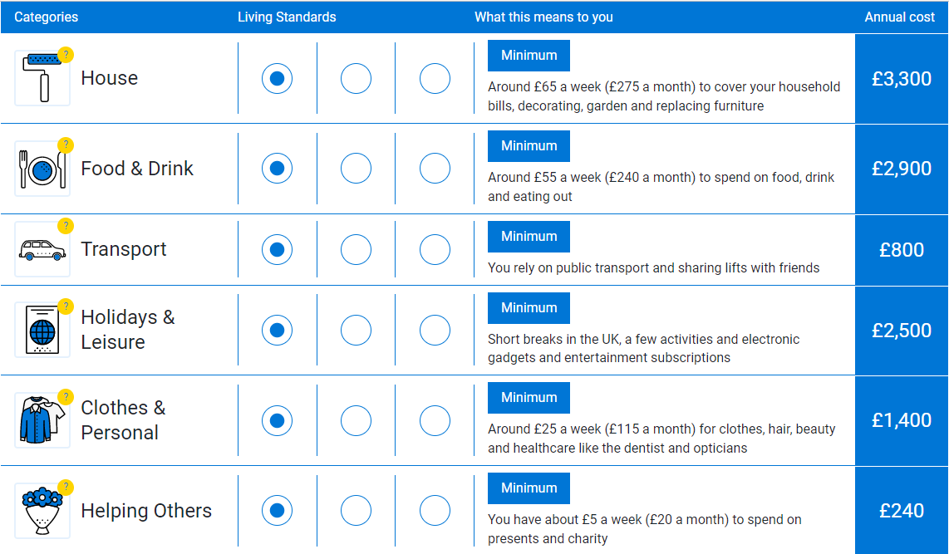
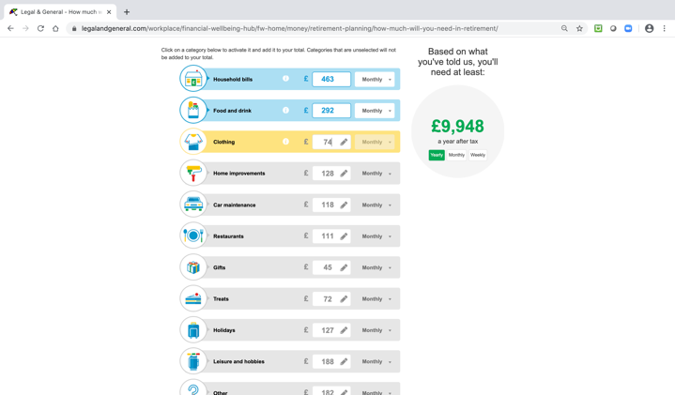
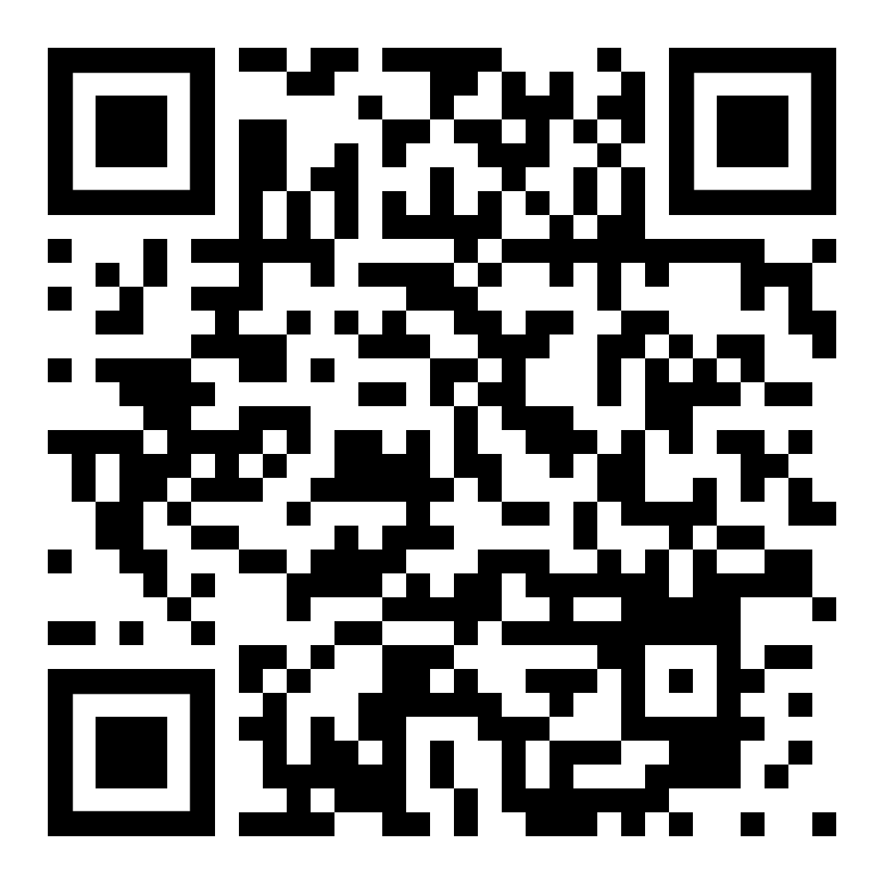
How much income will you need in retirement?
Retirement living standards tool

Slide 8

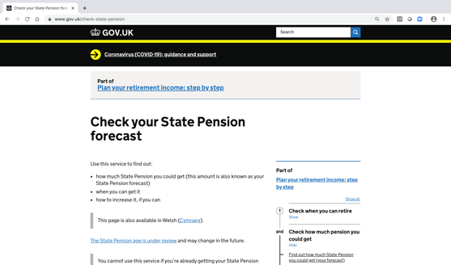
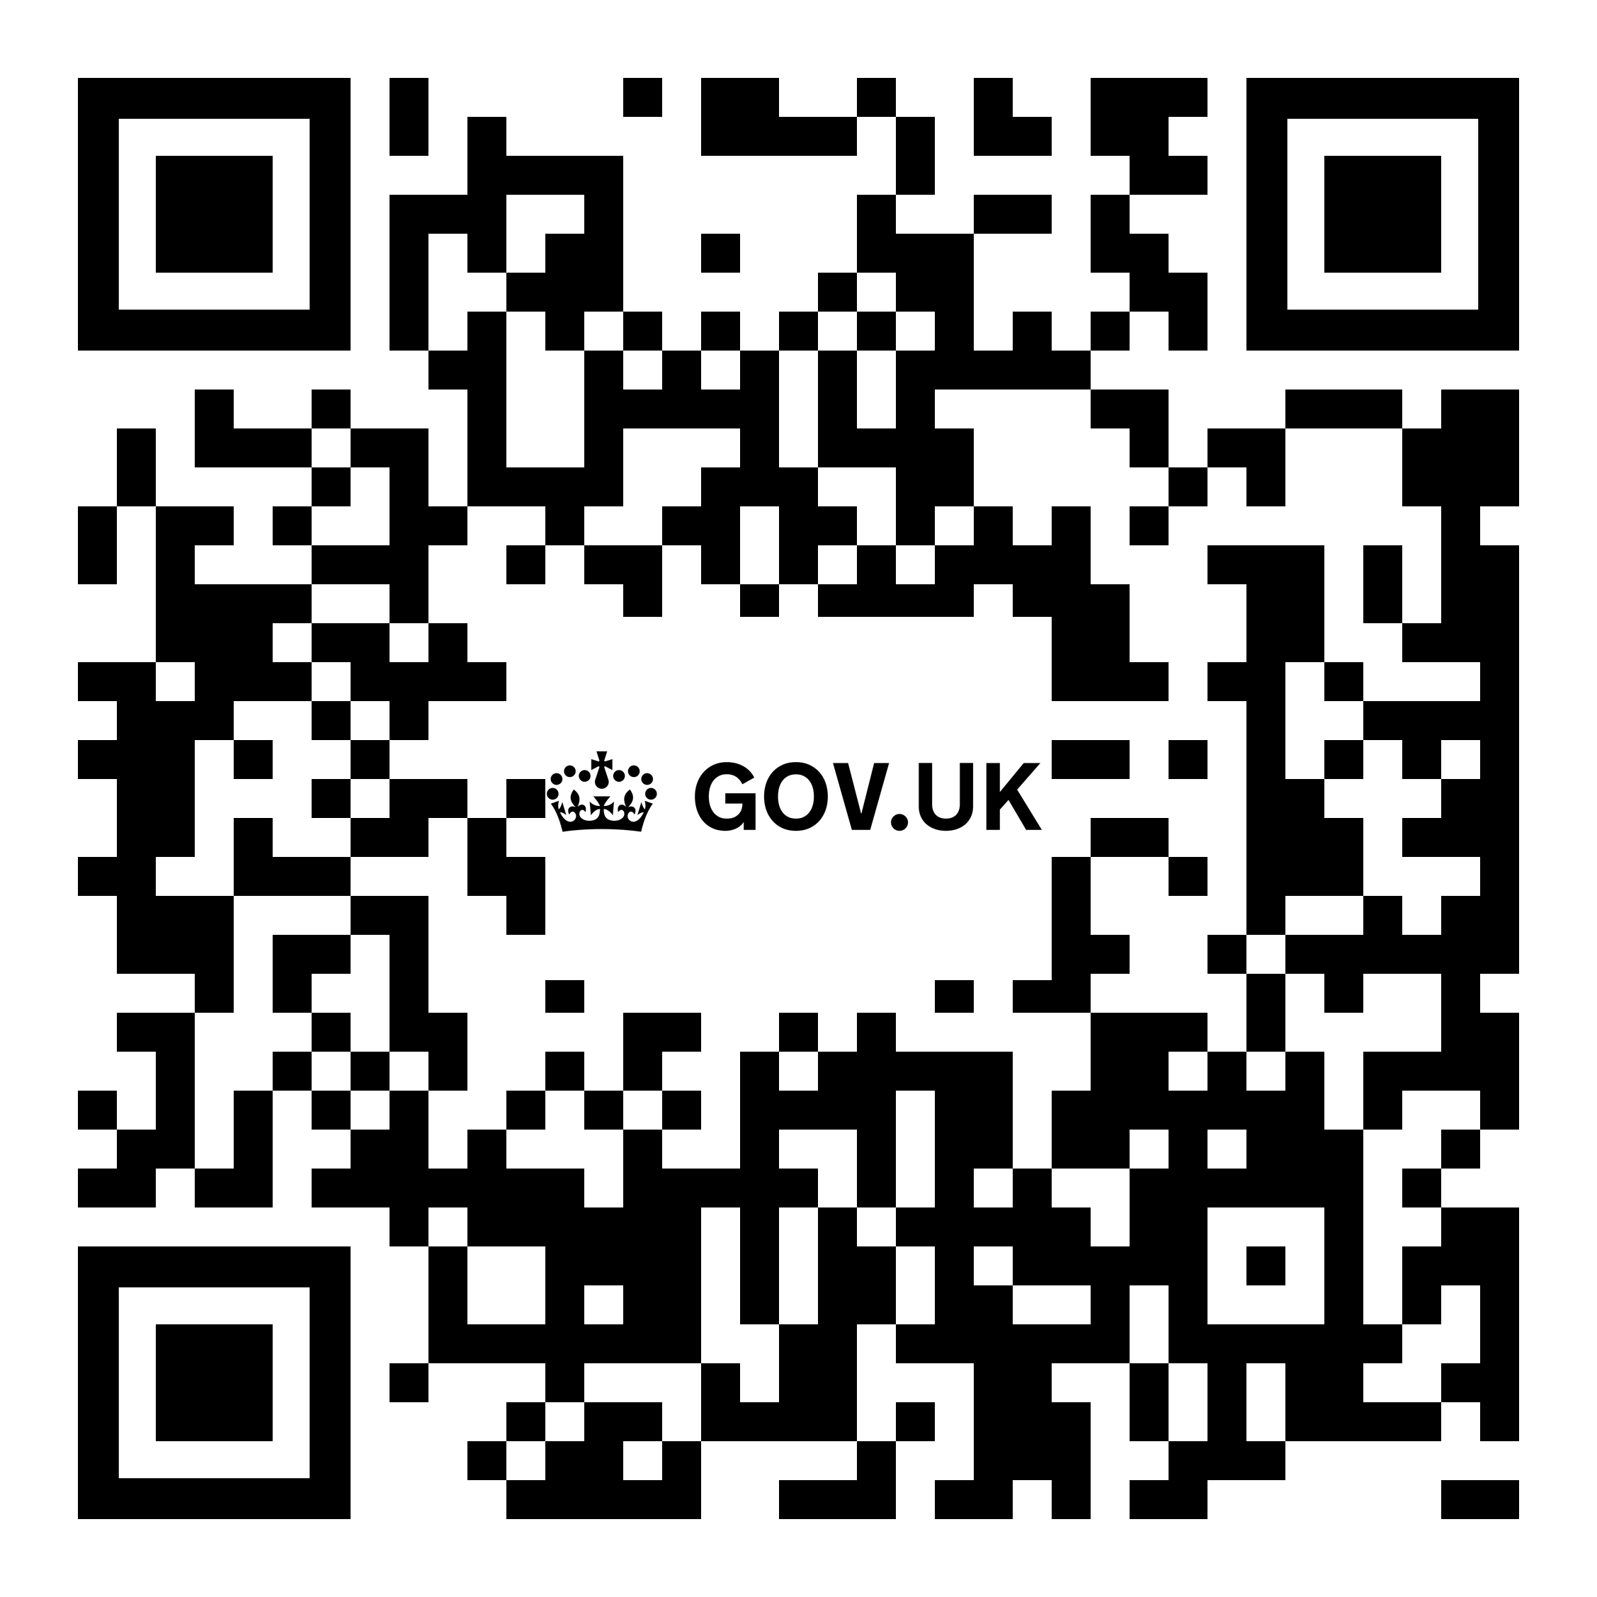
How much State Pension will you get ?
£203.85 per week for 2023/2024 tax year
35 qualifying years National Insurance contributions required for full entitlement (above)
Minimum 10 qualifying years to receive a reduced amount
gov.uk/check-state-pension

Slide 9

How does your pension work?
9

Slide 10

Why save into a workplace pension?
The benefits of saving into a workplace pension
  There are short-term and long-term benefits when it comes to saving into your workplace pension:
  You’ll get tax relief on your personal contributions (subject to limitations)
  You’ll receive contributions from your employer
  Your savings have the opportunity to grow over time
  You can take your pension pot in different ways
  The money can be passed on to your loved ones. It is therefore important to complete your nomination of beneficiaries. You will need to do this for CRSP as well as your life assurance benefit.

Slide 11



Your CRSP Defined Contribution (DC) scheme
How does your Legal & General workplace pension work?
Contributions are paid in
Your savings are invested
You access your pension pot
You and your employer pay in.
You get tax relief from the government.
The aim is to increase or protect the value of your savings but this isn’t guaranteed and they can go down in value as well.
Charges are taken for managing and investing your savings.
You can take your money in different ways.
The available options will depend on your scheme rules.

Slide 12
Saving for the future with the CRSP
Your pension contribution is provided by the University of Nottingham and is based on pensionable pay
Pensionable pay is your basic pay plus any other amount as determined by your employer.
On joining the Plan, you will initially pay 3% of your pensionable pay as an employee contribution and the University of
Nottingham will contribute 6%. After your first contribution has been deducted from your payslip you may, if you wish, elect to
increase your contribution level as per the table below.
As an active member of the CRSP, you are entitled to a life assurance benefit of 5.5 times your salary at date of death.
Employee | Employer | Total
3% | 6% | 9%
4% | 8% | 12%
5% | 10% | 15%
6% | 12% | 18%
7% | 14% | 21%
8%* | 16%* | 24%*
*This contribution structure will be available from 1 August 2023.
12

Slide 13

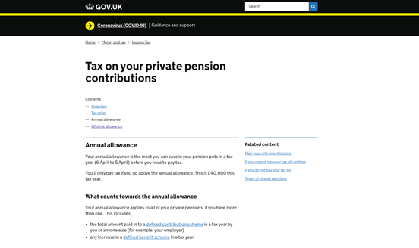
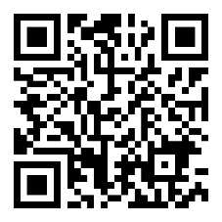
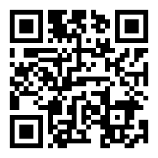
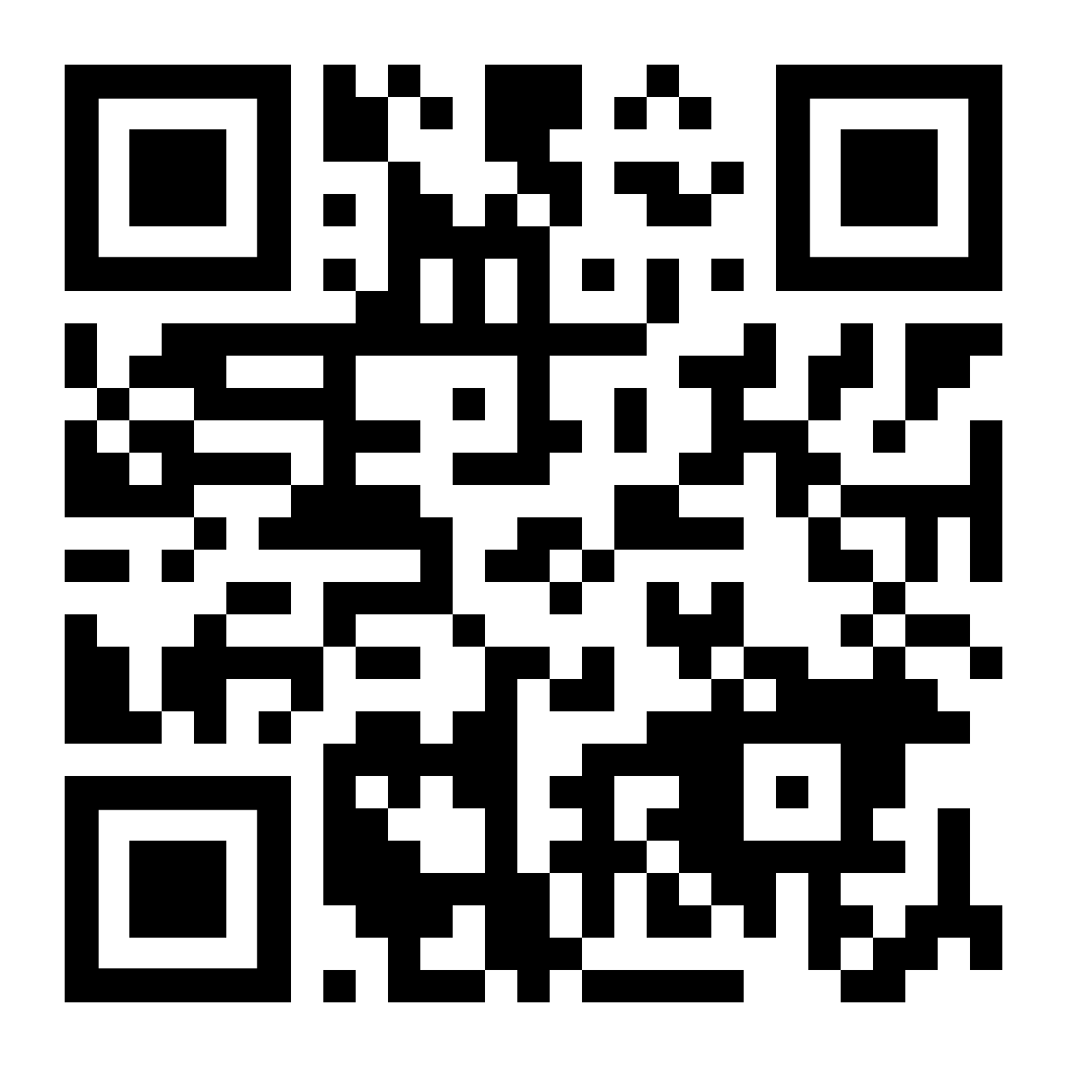
Tax limits on pension savings
Annual Allowance £60,000
Minimum Tapered Annual Allowance £10,000
Money Purchase Annual Allowance £10,000
Lifetime Allowance £1,073,100
If you need financial advice please visit unbiased.co.uk
Gov.uk
moneyhelper.org.uk
unbiased.co.uk

Slide 14

How much should I contribute to the CRSP?
Ideally, you should contribute as much as you can sensibly afford to pay, in line with your target income at retirement.
Things to consider:
Review your contributions regularly and increase the amount you pay in, if you can afford to do so
Regular increases - even small amounts - can make a real difference over time

Slide 15

Investing your savings
15

Slide 16
Understanding risk and reward
Understanding where pension funds invest and the risks and returns traditionally associated with them
  The benefit of diversification
  You can’t get rid of risk completely, so it’s important to manage it carefully.
  You can reduce risk by putting your money in different types of investment with varying levels of risk, for example, cash, bonds (or fixed interest securities), property and company shares (or equities).
Company shares
Dividends and capital increase
Higher
Property
Value increase and rent
Risk
Bonds
Interest
Risk Warning
Pension Fund Asset Classes can provide a return. However, returns are not guaranteed, and investments can go down as well as up.
Lower
Cash
Interest

Slide 17
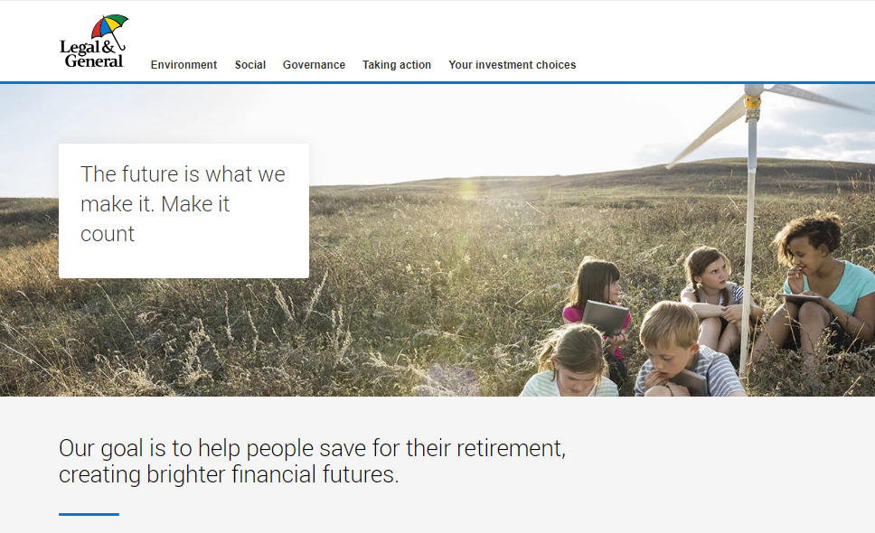
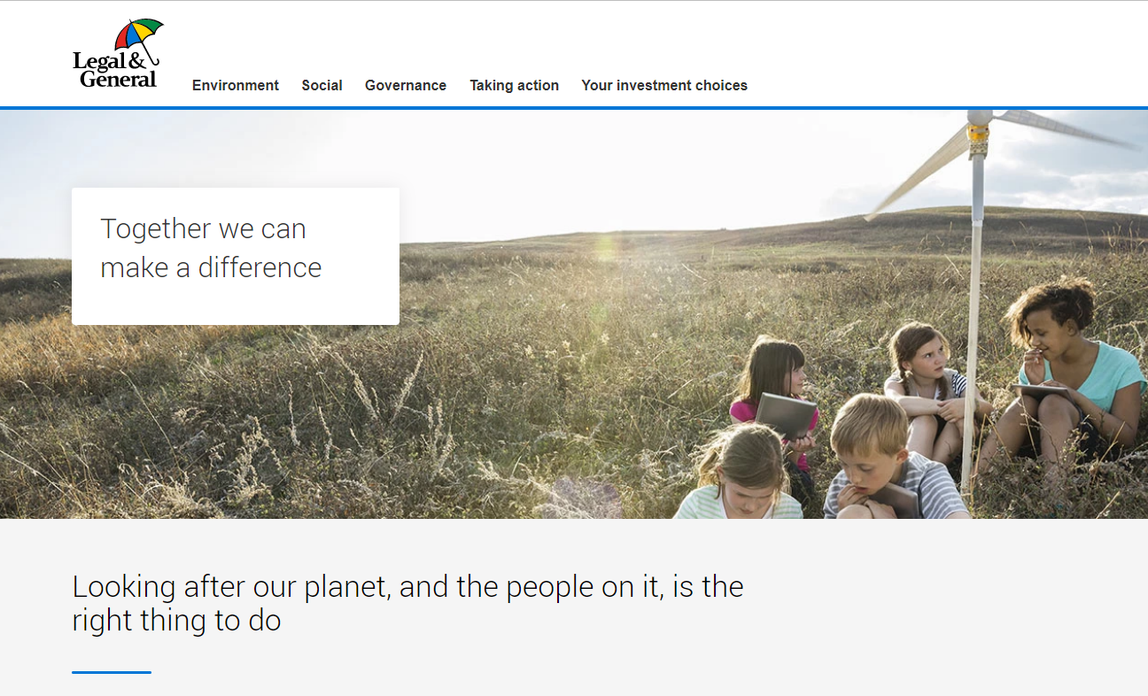
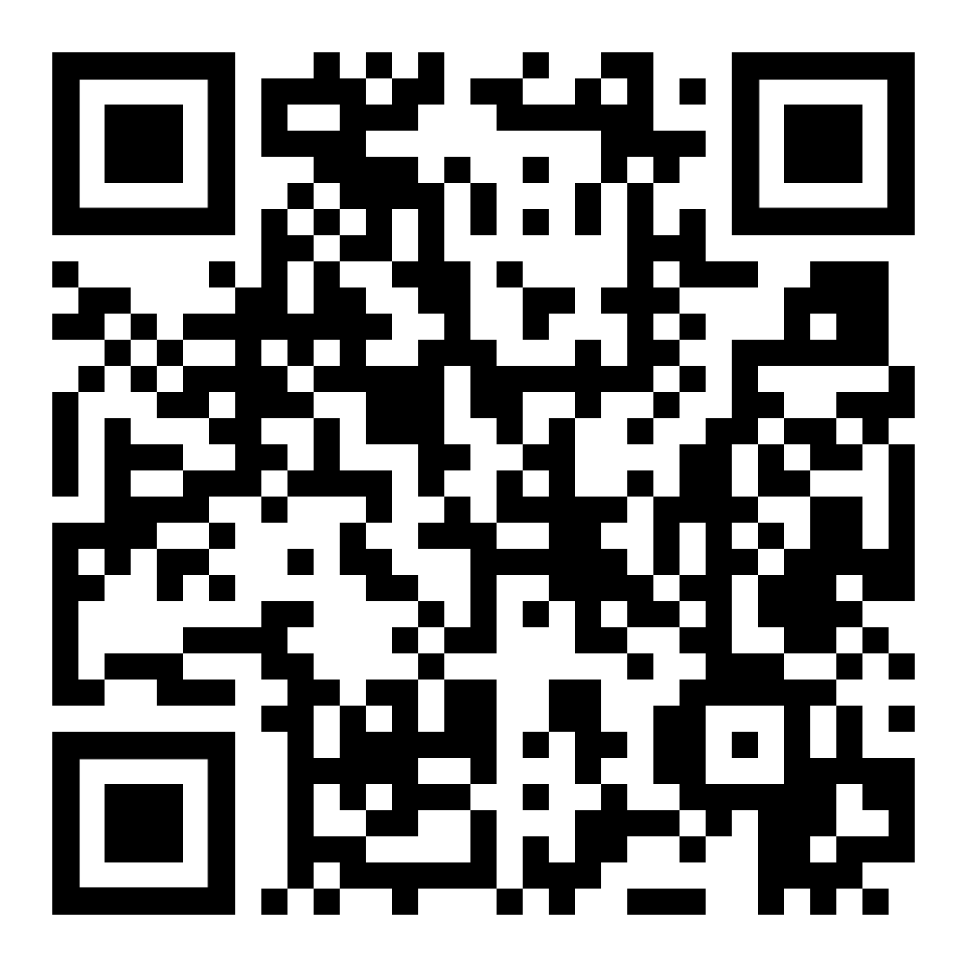
Environmental, Social & Governance (ESG) Hub
The future is what we make it. Make it count.
legalandgeneral.com/workplace/esg/

Slide 18



How are your CRSP savings invested?
Scheme Default
Self Select
Investing to suit your retirement plans

Slide 19
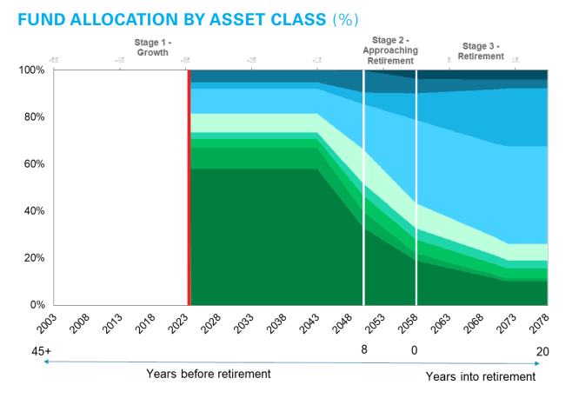
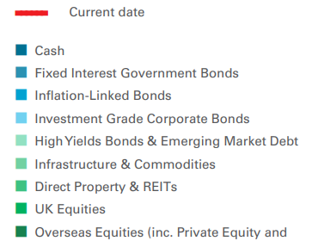

Your default investment option in the CRSP
Target Date Funds
Legal & General PMC 2055-2060 Target Date Fund 3
This diagram is for illustrative purposes only and is intended to show the types of assets in which the Target Date Funds are invested, and how the relative proportion of each changes over time.
For details of the current proportions of each asset class in each Target Date Fund, please see the individual fund factsheets at www.legalandgeneral.com/mya

Slide 20
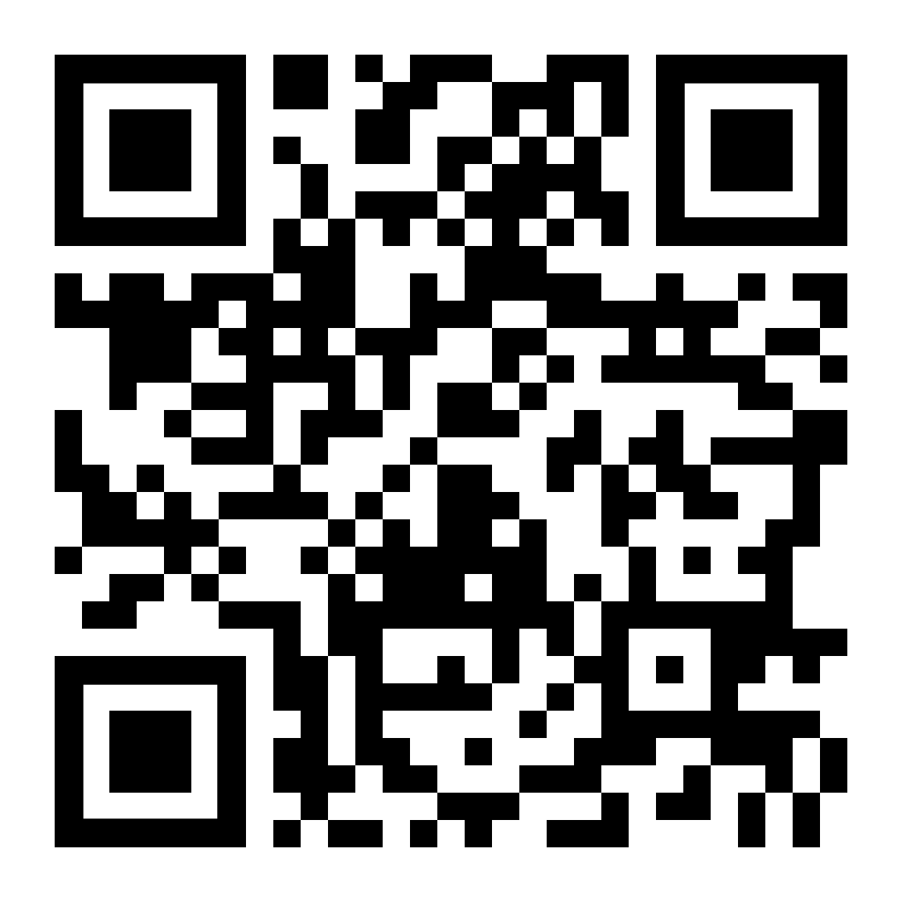
CRSP - Default Investment Option charges
Annual Management Charge
(AMC)
Fund Management Charge
(FMC)
Total
annual charge
0.25%
0.15%
0.40%
The Fund Management Charge (FMC) shown is based on the default investment option for your scheme.
This charge is likely to change if you make your own investment choices.
To find out more information on the funds available to you, including the charges, please visit www.legalandgeneral.com/mya or scan the QR code.
Manage your account

Slide 21

Taking money from the CRSP
21

Slide 22



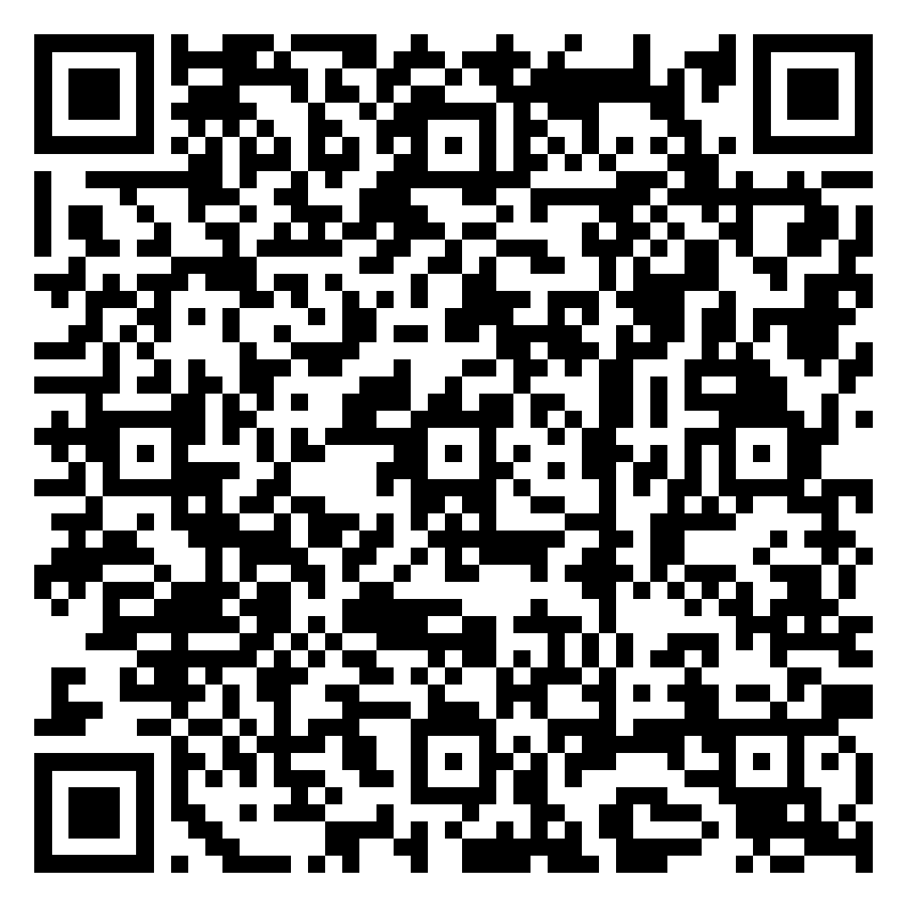
How can you take your money?
Cash
Annuity
Drawdown
Accessing your pension pot

Slide 23

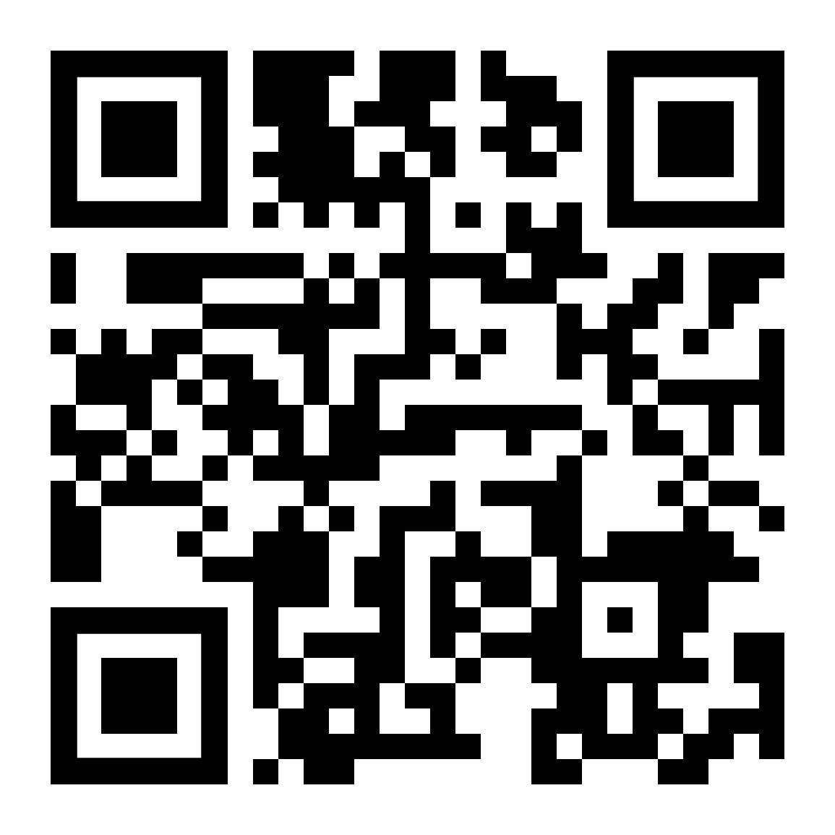
Money Purchase Annual Allowance
The MPAA limits the amount you can contribute and still get tax relief
The MPAA is only triggered once you’ve started withdrawing money from a Defined Contribution pension scheme, depending on how you access your savings.
The MPAA for the 2023/24 tax year is £10,000 a year including the contributions from your employer.
The MPAA only applies to Defined Contribution pensions (not Defined Benefit pensions).
Please see the Money Purchase Annual Allowance section on the MoneyHelper website for more information.
MoneyHelper.org.uk

Slide 24

Getting your pensions into one place
24

Slide 25
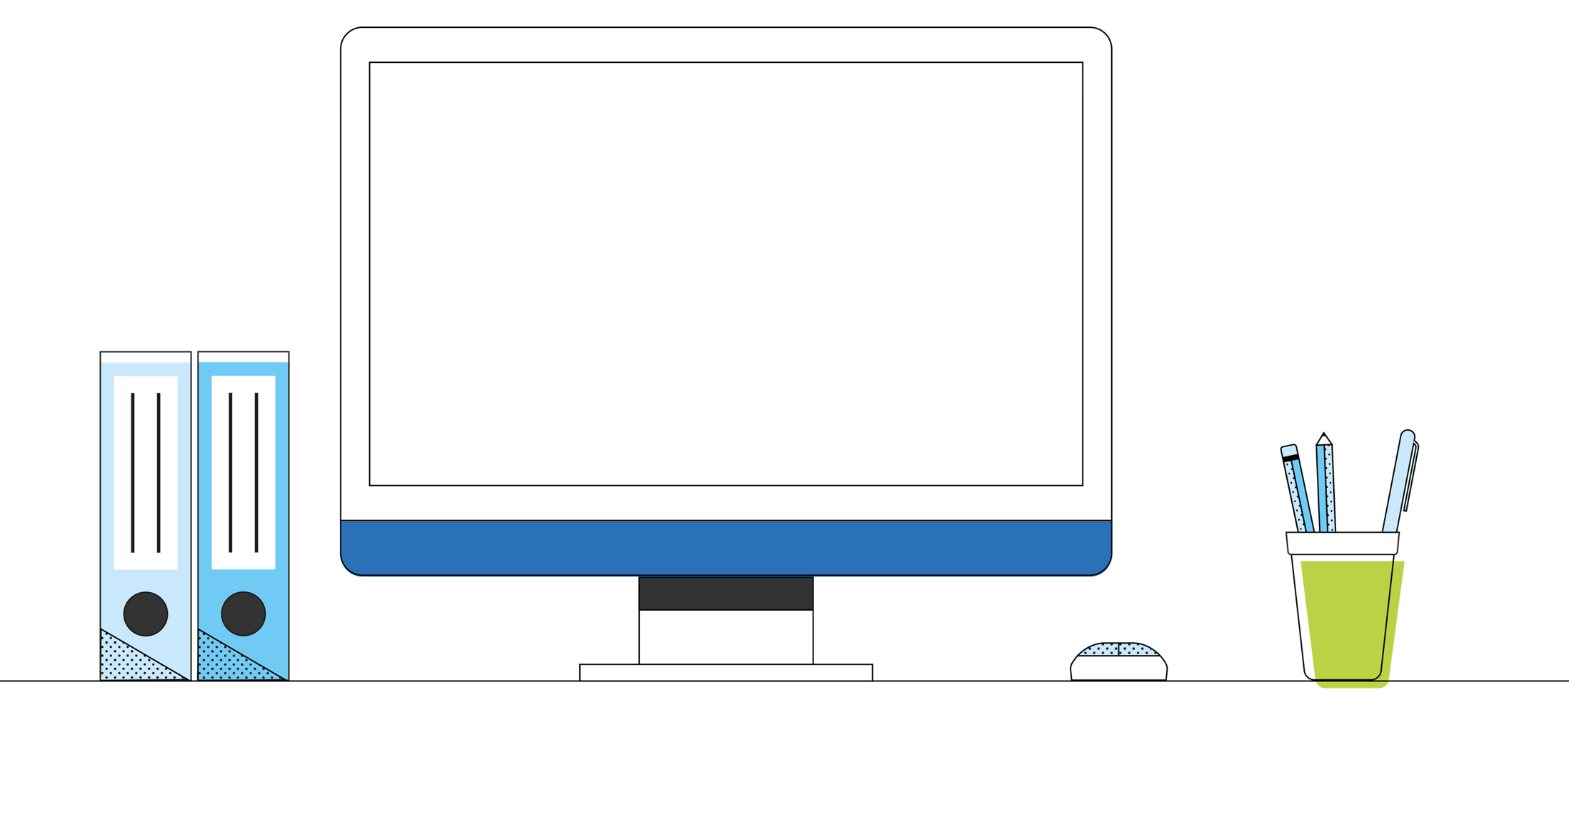
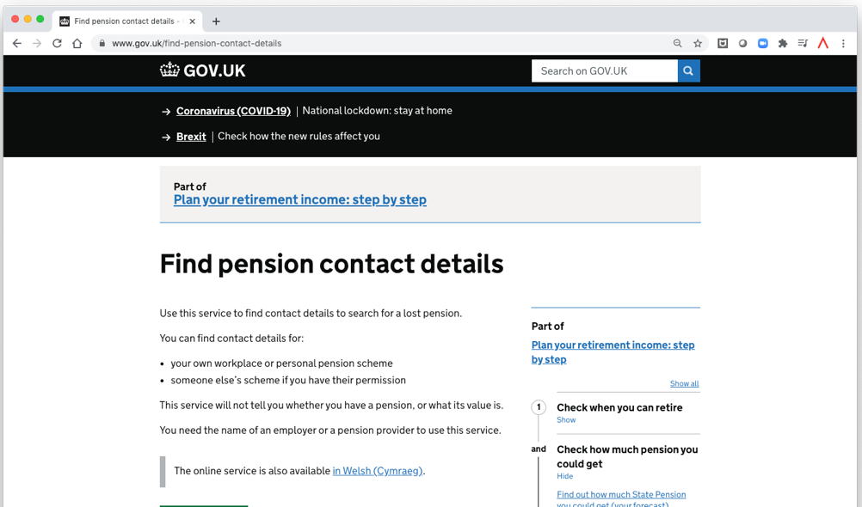
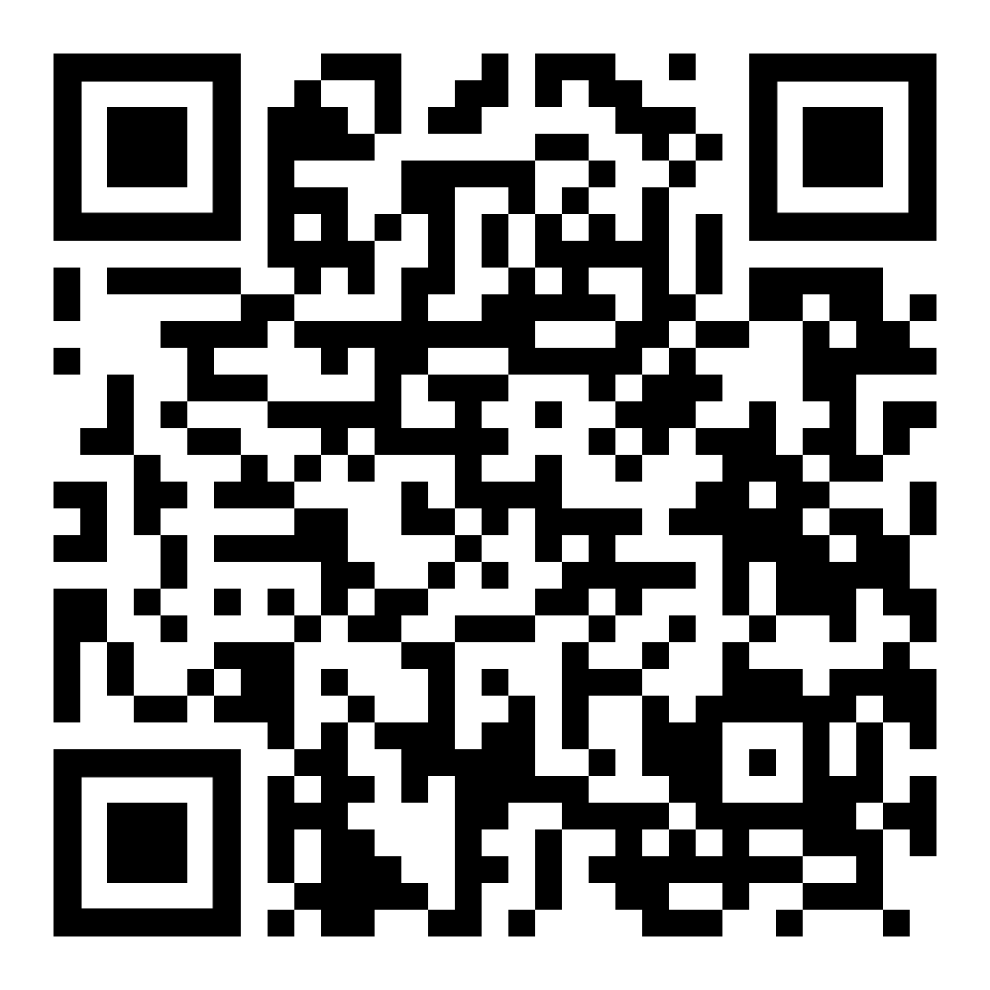
Finding lost pensions
Finding lost pensions

Slide 26
Consolidating your pensions
What other pensions do you have?
Do you know where they are?
Are there benefits or guarantees included?
What are the charges?
What options at retirement do they have?
Could you transfer them?
Do you need financial advice?
Visit unbiased.co.uk
unbiased.co.uk
Visit Manage Your Account to request a transfer pack or to access My Future Now
Manage your account

Slide 27
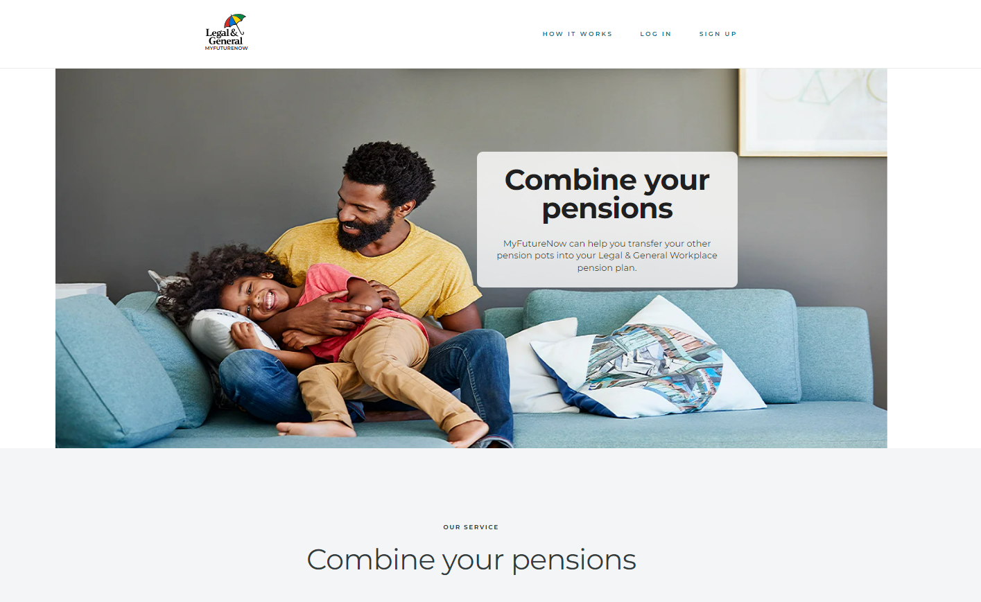
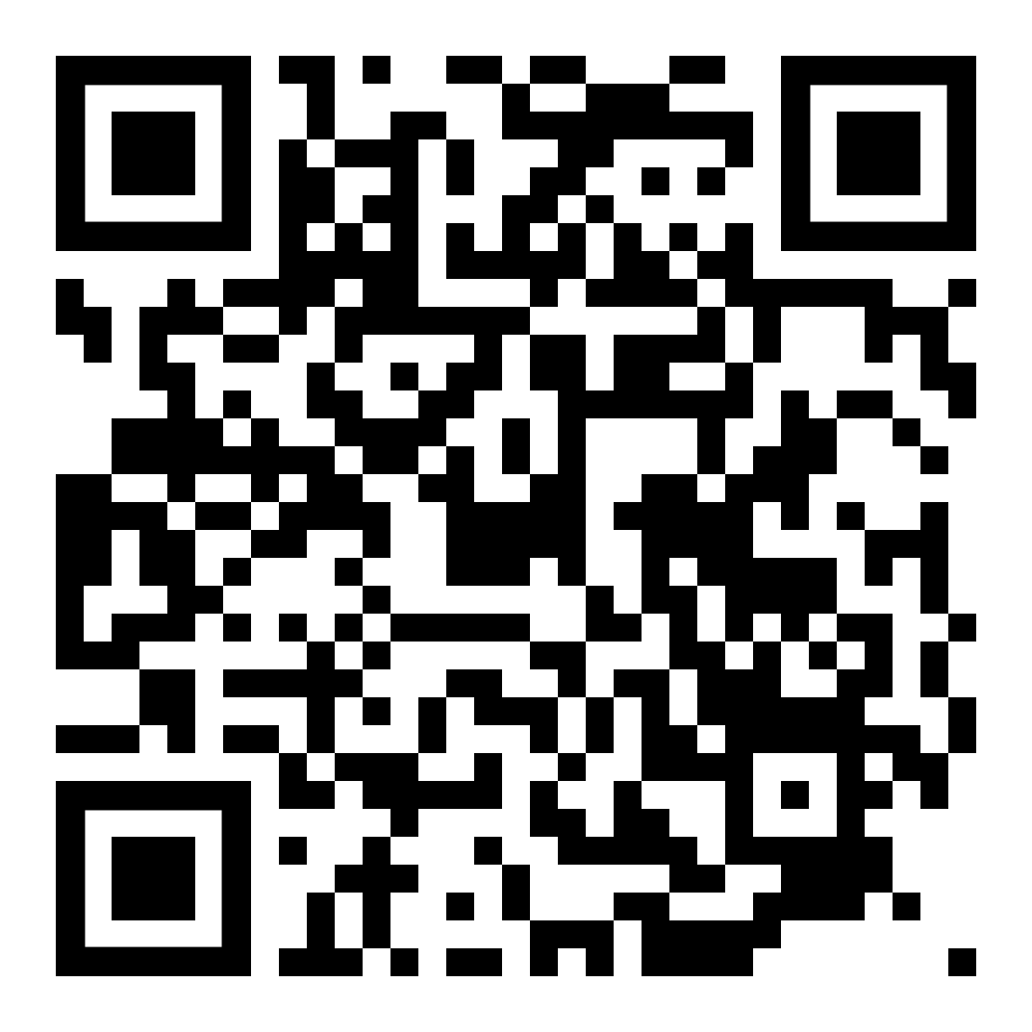
My Future Now
Transferring other pensions to Legal & General
Read our guide to pension transfers, to consider whether it’s right for you, before making a decision to transfer.
Check that we can accept your transfer and, if we can, submit your request via the My Future Now portal.
Go to your online account and register for My Future Now.
If you provide the name of your pension provider and policy number, My Future Now will proceed with your transfer request.
If you only provide the name of your pension provider, My Future Now will trace your pension. Once it’s been found, you’ll be notified and will then have 5 working days to opt out before it’s transferred automatically.
My Future Now

Slide 28

Our resources
28

Slide 29
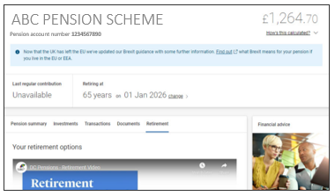
Managing your pension
Keep track of your retirement savings online in Manage Your Account.
legalandgeneral.com/mya

Slide 30
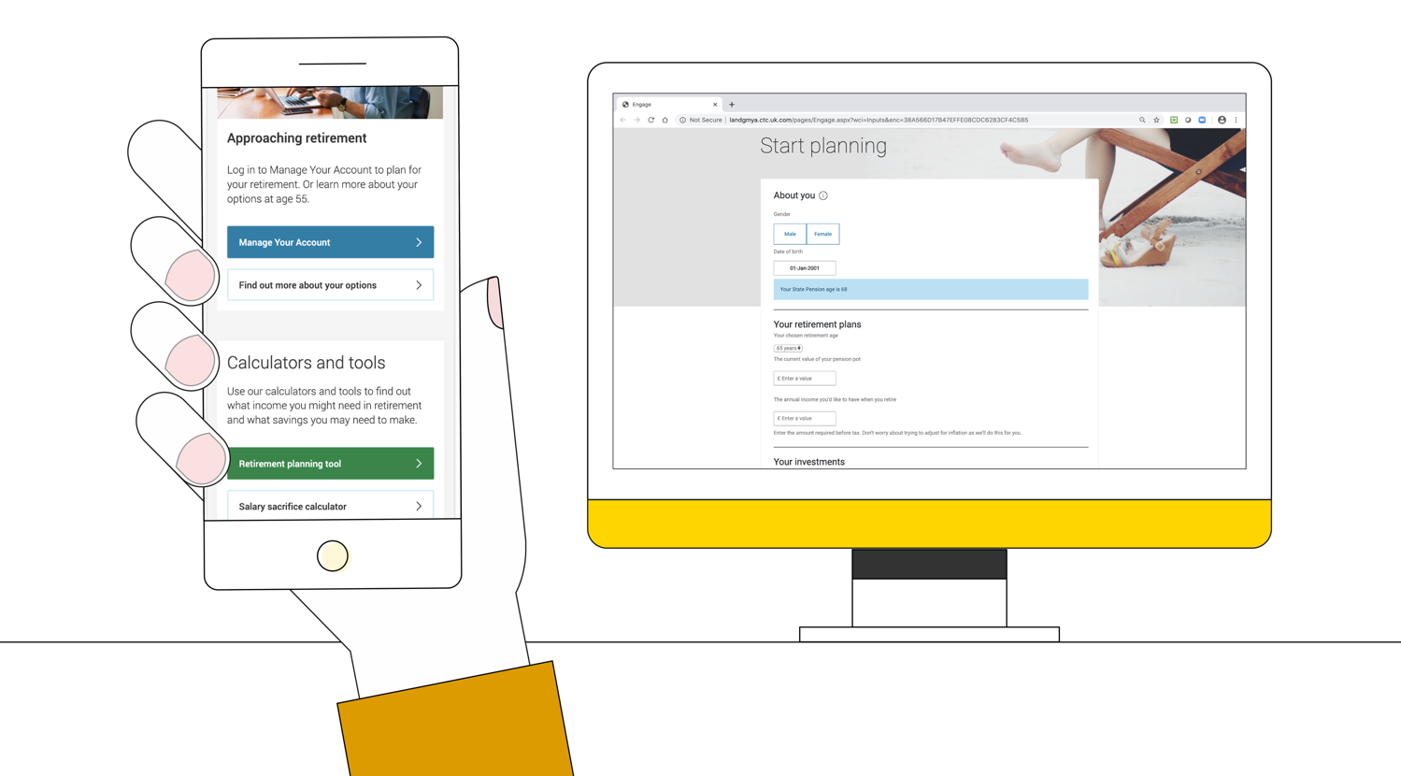
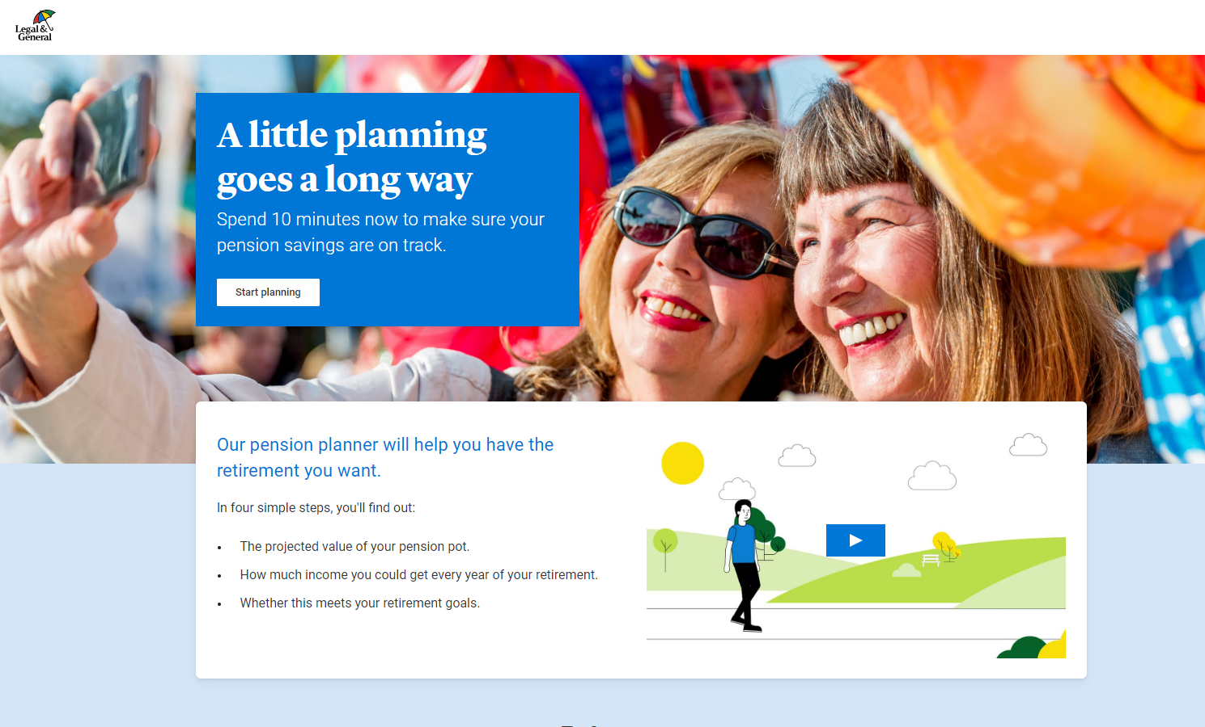
Our retirement planning tool

Slide 31
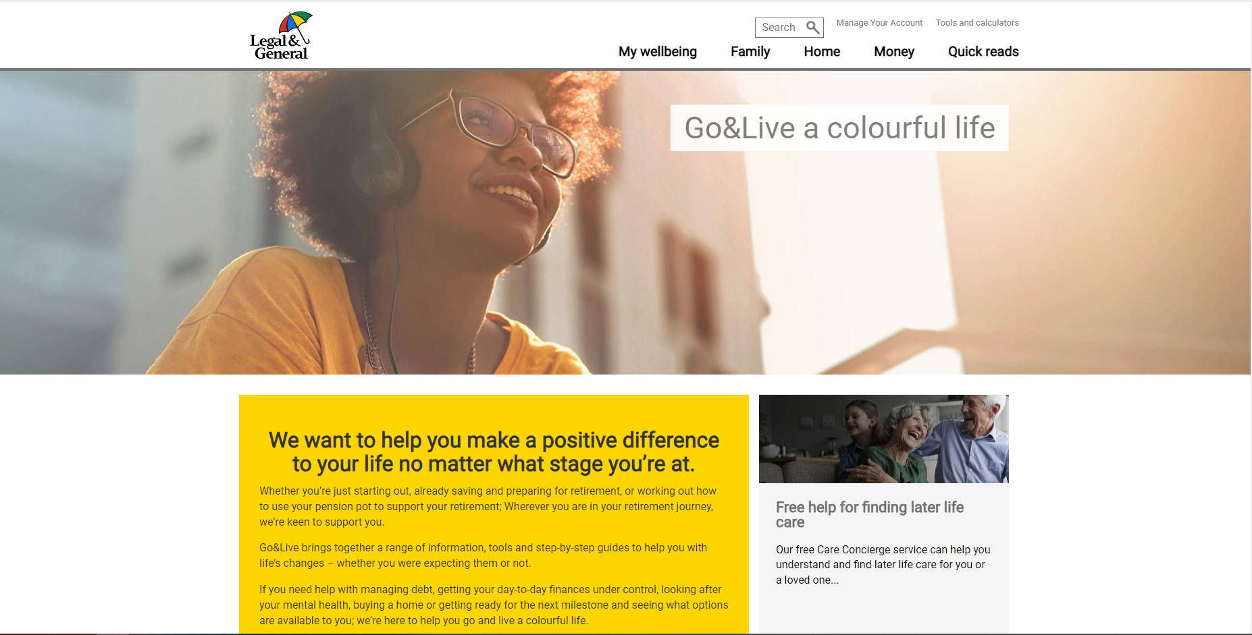
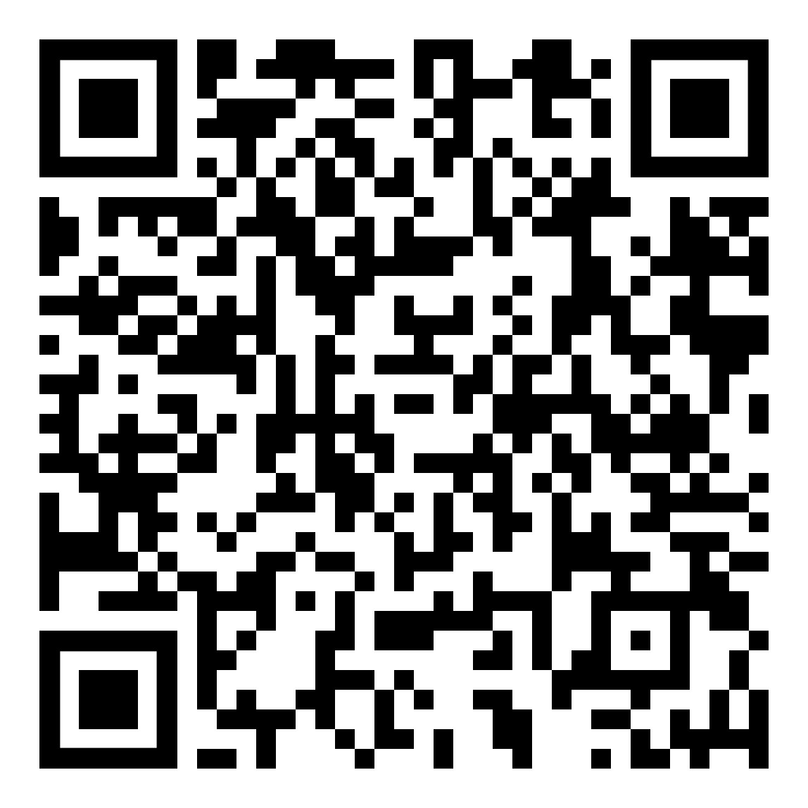
Go&Live
Helping you make a positive difference to your life no matter what stage you’re at.
Go&Live

Slide 32
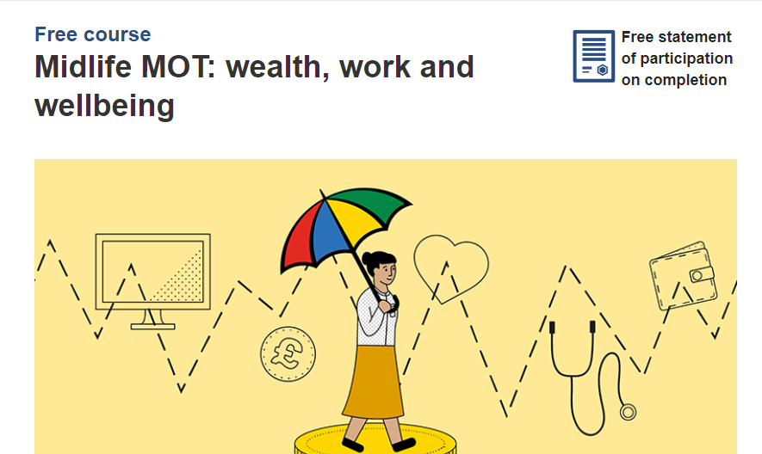
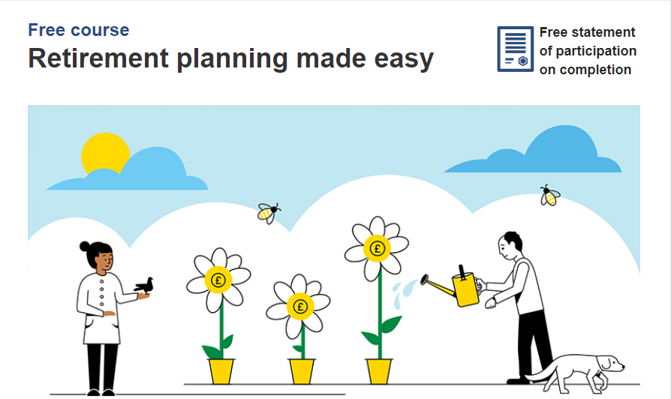
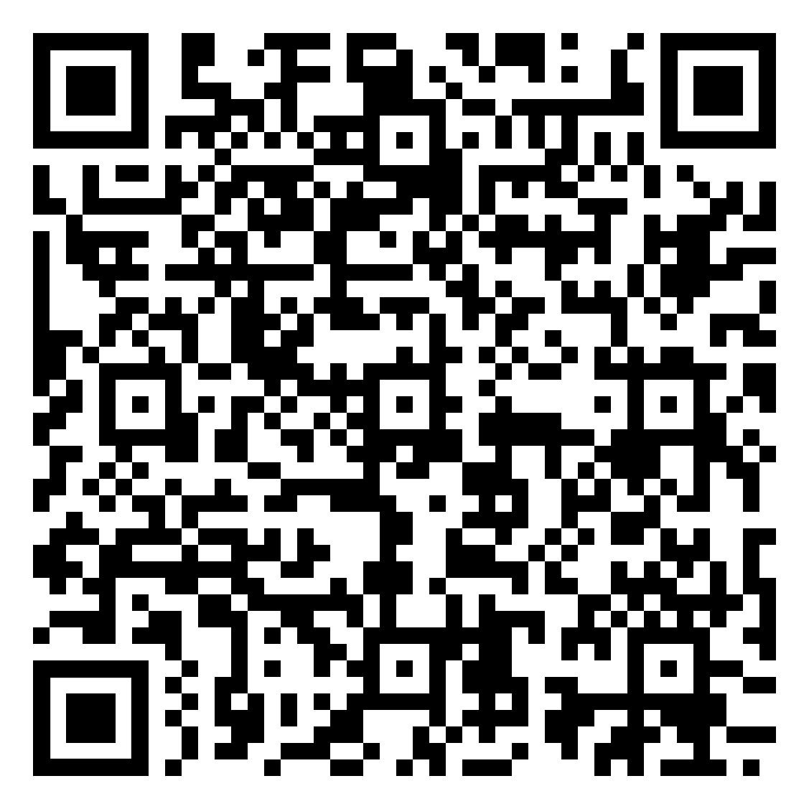
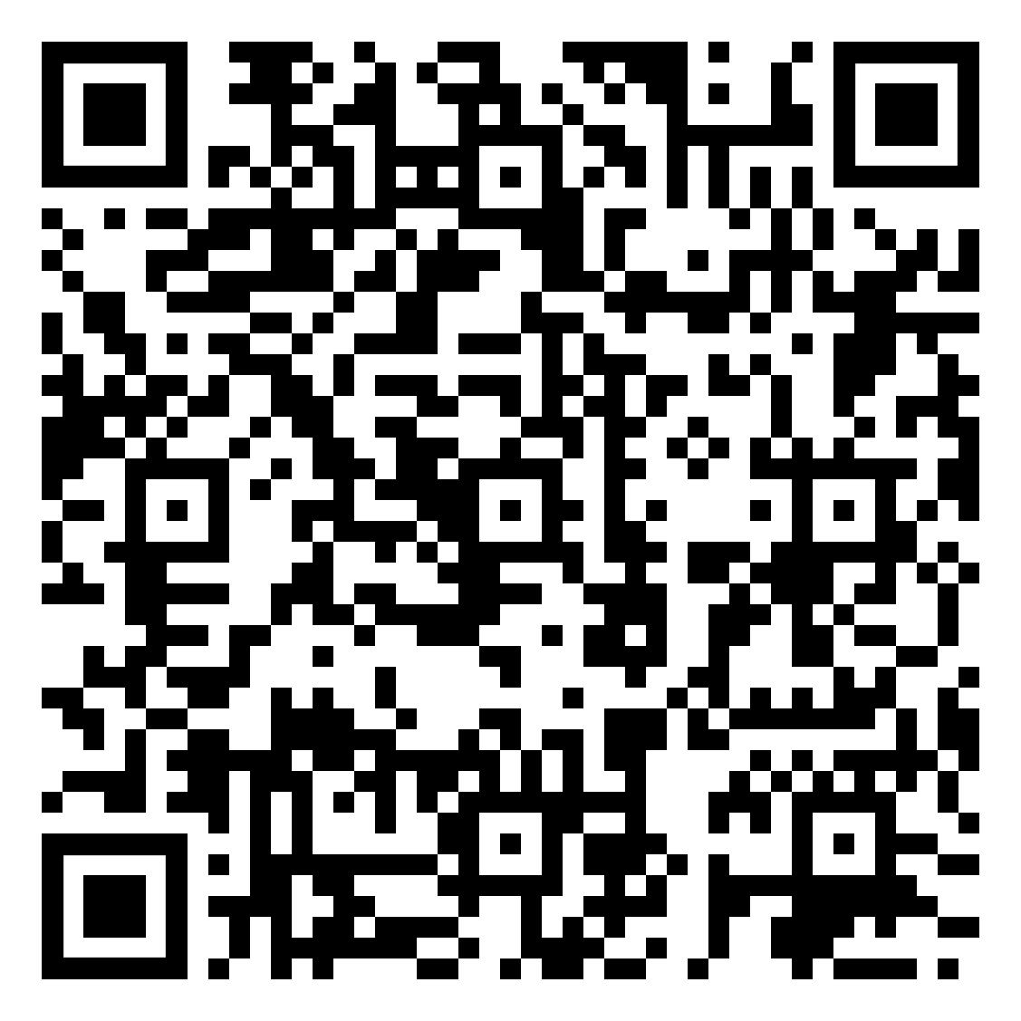
Helping you take the next step
Midlife MOT
Retirement planning made easy
Midlife MOT
Retirement planning made easy

Slide 33

Guidance and advice
33

Slide 34

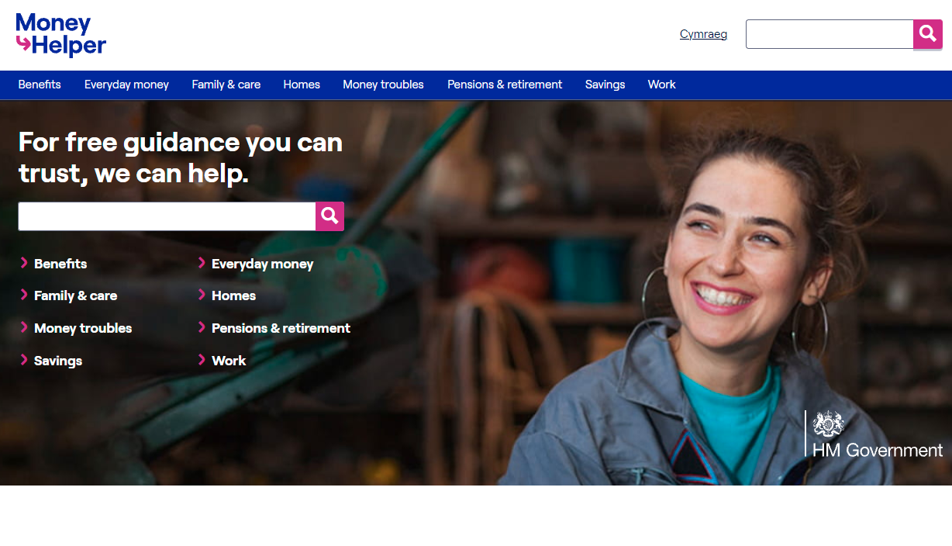
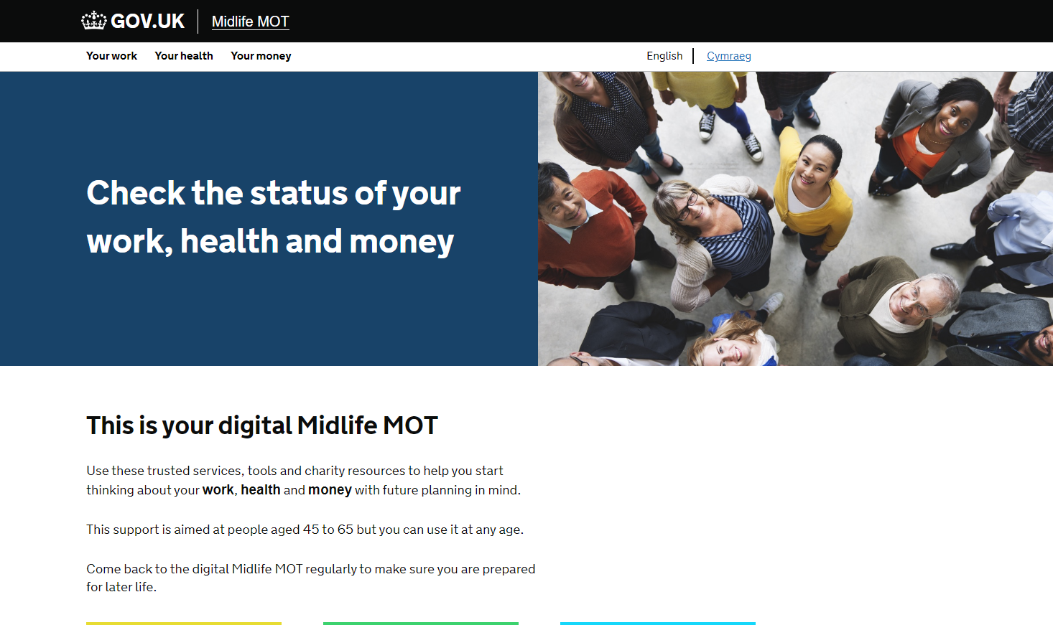
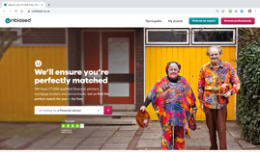


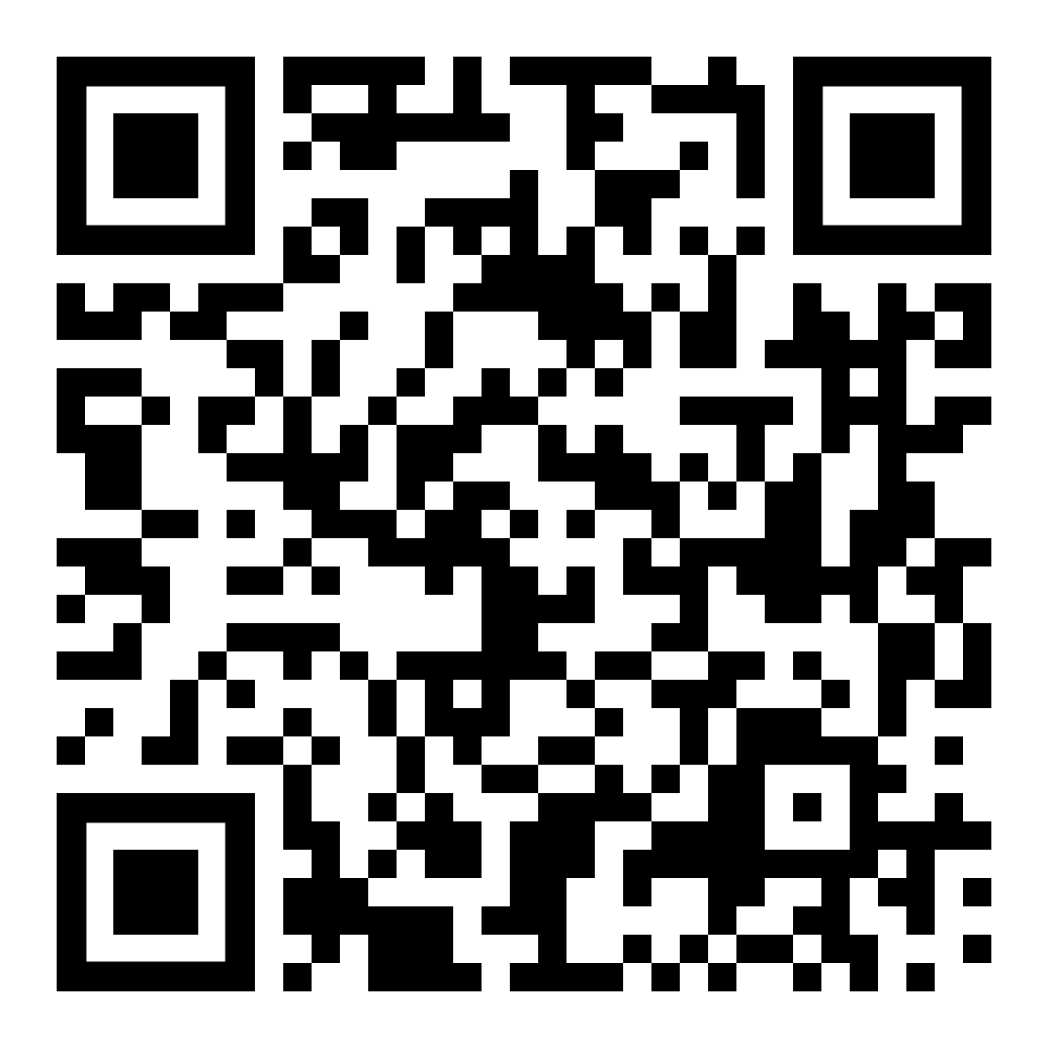
The importance of seeking guidance and advice
There’s lots of support available.
Mid-life MOT
moneyhelper.org.uk
jobhelp.campaign.gov.uk/midlifemot
unbiased.co.uk/

Slide 35

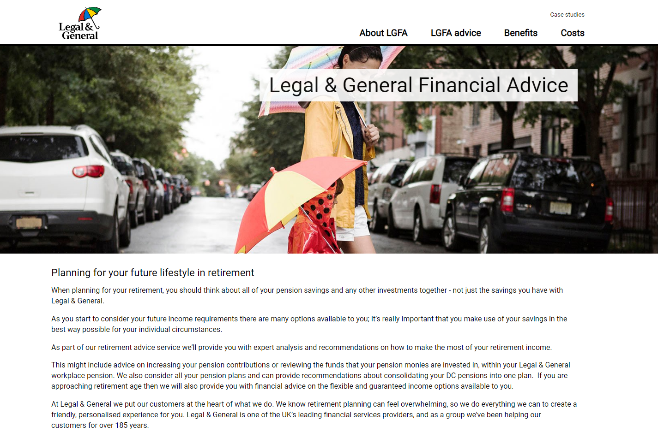
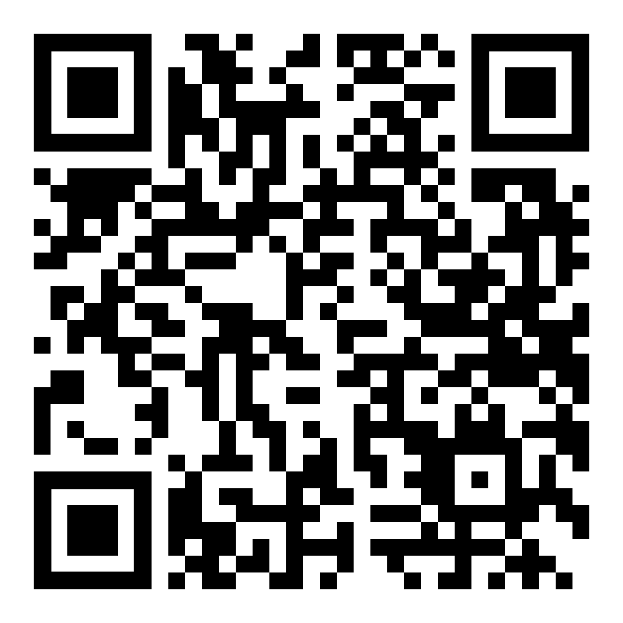
LGFA
Legal & General Financial Advice

Slide 36

Important considerations
36

Slide 37



What will happen …?
What will happen in the event of my death?
What will happen if I move abroad?
What will happen if I leave employment?

Slide 38
Thank you.
Any questions?
Legal & General helpline
0345 070 8686
Call charges will vary. We may record and monitor calls.
Website
www.legalandgeneral.com/uoncrsp
Manage Your Account
legalandgeneral.com/mya
D100680 10/23 DC002423

