Slide 1


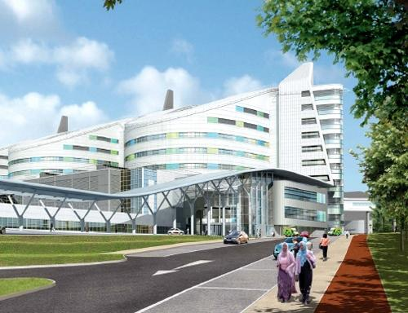

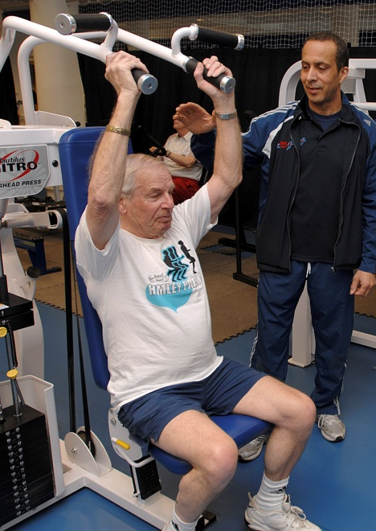
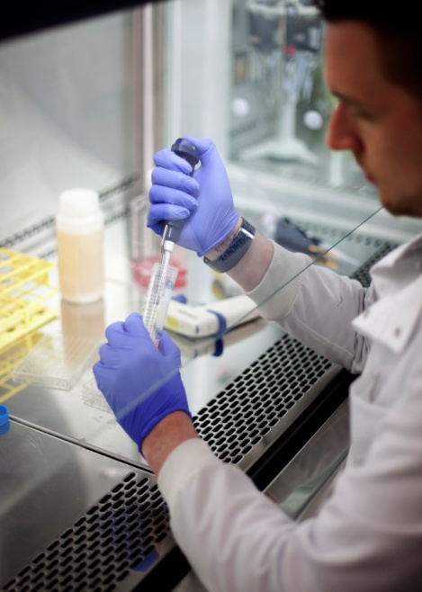


MRC-ARUK Centre for Musculoskeletal Ageing Research
Ensuring Adults are Fit for Old Age

Slide 2
ARUK-MRC Centre for Musculoskeletal Ageing Research
Translating Research Into Clinical Practice
Professor Tahir Masud
Examples of current ongoing Translational Research in the area
Promoting Activity, Independence and Stability in Early Dementia (PrAISED)
Developing and Evaluating a Chair Based Exercise Programme (CBE study)
Nottingham Spinal Health (NoSH) Study
Optimising Care Home Nutrition: Exploring the role of Leucine and Vitamin D
Leucine and ACE Inhibitors as therapies for sarcopenia (The LACE trial)
Incorporating Frailty, Sarcopenia and Nutritional Assessments in Osteoporosis Clinics

Slide 3

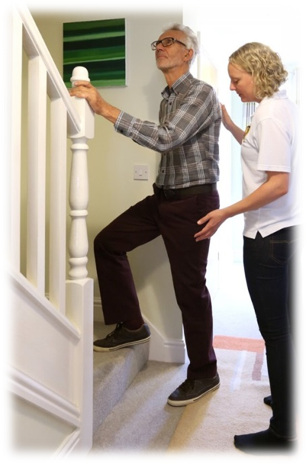
Promoting Activity, Independence and Stability in Early Dementia
(NIHR Programme Grant)
CI: Rowan Harwood
Co-Inv: Pip Logan, John Gladman, Veronika van der Wardt, Sarah Goldberg, Vicky Booth, Vicky Hood , Tahir Masud et al
To develop and test an intervention to enable people with mild dementia to stay independent for longer.
The multi- component intervention includes
Physiotherapy
Occupational therapy
Exercise psychology
Risk enablement
Education/information

Slide 4
WP 5 RCT
WP 2 Optimising uptake and adherence
WP 3 Practicability and feasibility Study
WP 4 Process evaluation
WP 6 Economic analysis and modelling study
WP 7 Preparation for implementation
WP 1 Intervention development

Slide 5
Developing and Evaluating a Chair Based Exercise Programme
(NIHR RfPB Feasibility study)
Leads: Tahir Masud, Katie Robinson
For some older adults taking part in exercise is challenging
CBE may offer a pragmatic solution
Delivered across health and social care with little standardisation
Developed a set of principles for chair based exercise programmes through an expert consensus development process
Research for Patient Benefit feasibility trial to:
        establish the parameters for a future definitive trial
        explore if the CBE programme could be delivered in day centres, care home and community centres
        explore what older people and care staff thought about the intervention

Slide 6
Main findings
Difficulty delivering the intervention at a frequency and intensity to elicit physiological change
Health conditions and fragile health status limited participation
Older people wanted to try ‘proper’ standing and walking but care staff felt seated exercise was the most appropriate exercise in these settings

Slide 7
Nottingham Spinal Health (NoSH) Study
PI: Terence Ong
Co-investigator: Opinder Sahota, John Gladman, Nasir Quraishi
Funder: Dunhill Medical Trust Research Training Fellowship
AIM: Does an ortho-geriatric multidisciplinary model of care improve outcomes for patients admitted to hospital with vertebral fractures?
Currently in the development phase
Review of scientific literature
Analysis of patient characteristics and outcomes
Modelling of care for future feasibility/pragmatic trial

Slide 8
Selected research output
Ong T, et al. Characteristics and outcomes of hospitalised patients with vertebral fragility fractures: a systematic review. Age Ageing 2017. doi:10.1093/ageing/afx079
Ong T, et al. Study protocol for the Nottingham Spinal Health (NoSH) Study: A cohort study of vertebral fragility fractures admitted to hospital. EMRAN 2017:12
Walters S, et al. The prevalence of frailty in patients admitted to hospital with vertebral fragility fractures. Curr Rheumatol Rev 2016:12.244-247
Future research plan
Vertebral augmentation in the management of hospitalised acute vertebral fractures
The role of operative intervention for sacral-pelvic fractures

Slide 9
Optimising Care Home Nutrition: Exploring the role of Leucine and Vitamin D
Leads: Bethan Phillips, Adam Gordon
“CH residents experience greater multi-morbidity and polypharmacy than age-matched community dwellers, and have more prevalent malnutrition- 30% are malnourished with 56% at risk; in particular protein energy malnutrition.
The objective of this project aims to explore, for the first time, the effects of optimal protein intake and/ or amino acid (leucine) supplementation on muscle mass, function and metabolism, in care home residents:
AIM i) to establish current dietary provision and energy/ protein balance in CH residents;
AIM ii) to determine establish the optimal protein load in CH residents; and
AIM iii) to establish the efficacy of 6-months’ “optimal” protein intake ± between-meal leucine supplementation on muscle mass, function and metabolic health in CH residents

Slide 10
AIM iii) to establish the efficacy of 6-months’ “optimal” protein intake ± between-meal leucine supplementation on muscle mass, function and metabolic health in CH residents
How does standard CH nutrition effect muscle ‘health’ over a 6-month period?
Are Leucine supplements less satiating than protein supplements?
Months
0
1
3
6
n=10: standard nutrition
n=10: optimal protein (informed by Aim ii)
n=10: optimal protein + Leucine
n=10 standard nutrition + Leucine
Muscle mass:
*
*
*
*
Body composition:
^
^
Muscle architecture:
~
~
~
~
Muscle function:
*
*
*
*
Which is the most favorable intervention strategy for muscle mass, function & metabolism?
Muscle protein synthesis:
^
^
Appetite:
~
~
~
Muscle mass via BIA
Body composition via DXA (where possible)
Muscle architecture via leg muscle ultrasound
Muscle function via SPPBT, TUG and handgrip (where possible)
Muscle protein synthesis via D₂O and micro muscle biopsy***
Appetite via questionnaires and meal tolerance test
***
Baseline blood and saliva sample
D₂O drink
3 hour saliva sample
6 hour micro muscle biopsy

Slide 11
Leucine and ACEis in Sarcopenia (LACE) Trial
Multicentre RCT (> 15 UK centres including Nottingham/Derby)
CI: Miles Whitham (Dundee)
2 x 2 factorial design
  Perindpopril 4mg + placaebo
  Leucine tds + placaebo
  Perindopril + leucine
  Double placaebo
Primary outcome - SPPB
Secondary oiutcomes:
  Muscle mass
  Falls
  QoL
  Health economics

Slide 12
Incorporating Frailty, Sarcopenia & Nutritional Assessments in Osteoporosis Clinics
Tahir Masud
Mateen Arrain
Vicky Hood

Slide 13
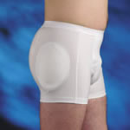
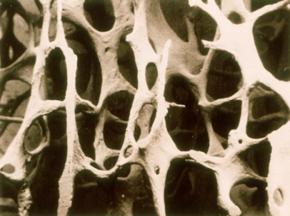
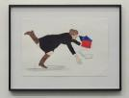
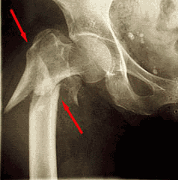
FRACTURE The link between osteoporosis and falls
Osteoporosis
Fracture
Falls
Bone Strengthening Therapy
Identifying and Reducing falls risk
(suboptimal) Nutrition
Sarcopenia
Frailty

Slide 14
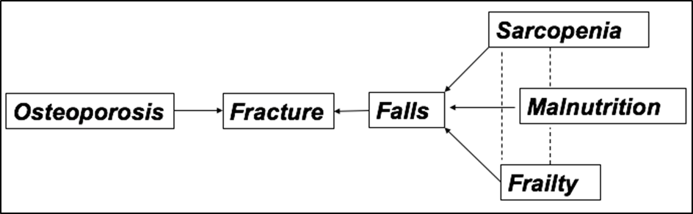

Slide 15
Frailty – Definition
Consensus Staement: Morley JE et al; J Am Dir Assoc 2013
‘. . .a medical syndrome with multiple causes and contributors that is characterised by diminished strength, endurance and reduced physiologic function that increases an individual’s vulnerability for developing increased dependency and/or death.’

Slide 16
Operational definitions: 2 concepts
Accumulation of Deficits (”Rockwood”)
  concept of multisystem disorder
  number of health deficits varies 30-70
  defiicits – symptoms, signs, diseases, disabilities, lab results
  Frailty Index (FI): 0-1
  Frailty = FI > 0.25
  eFI eg from GP data systems
Physical Frailty Phenotype (PFP) (”Fried”)
  Weakness ..............................Grip strength
  Slow walking speed ................Timed walk
  Low physical activity .............. .Kcals / week
  Weight loss (unintentional) .....10 lbs or >5% / year
  Exhaustion ..............................Self Report
  Frail = 3+, Prefrail = 1-2
  Other PFP tools: Frail Scale, Gerontopole Frailty Screening Tool
Notes:
Ken Rockwood- Canada cohorts
Linda Fried Cv health study 5 attributes
Phenotype lowest 20% (strified by sex, and Grip bmi, w speed by ht,

Slide 17
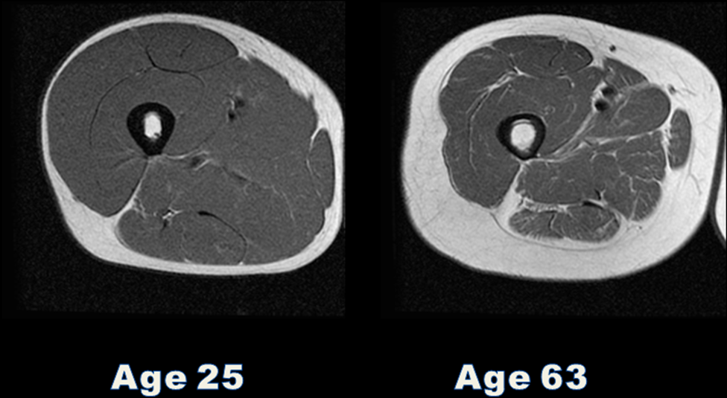
Sarcopenia
Loss of muscle mass and function (strength or performance)
Prevalence increases with age
Associated with disability, morbidity, frailty and mortality
Prevalence varies according to definition
- Japan 13% in older population (mean age 75 yrs)
- Uk 4.6% men, 7.9% women (mean age 67 yrs) (Patel)

Slide 18
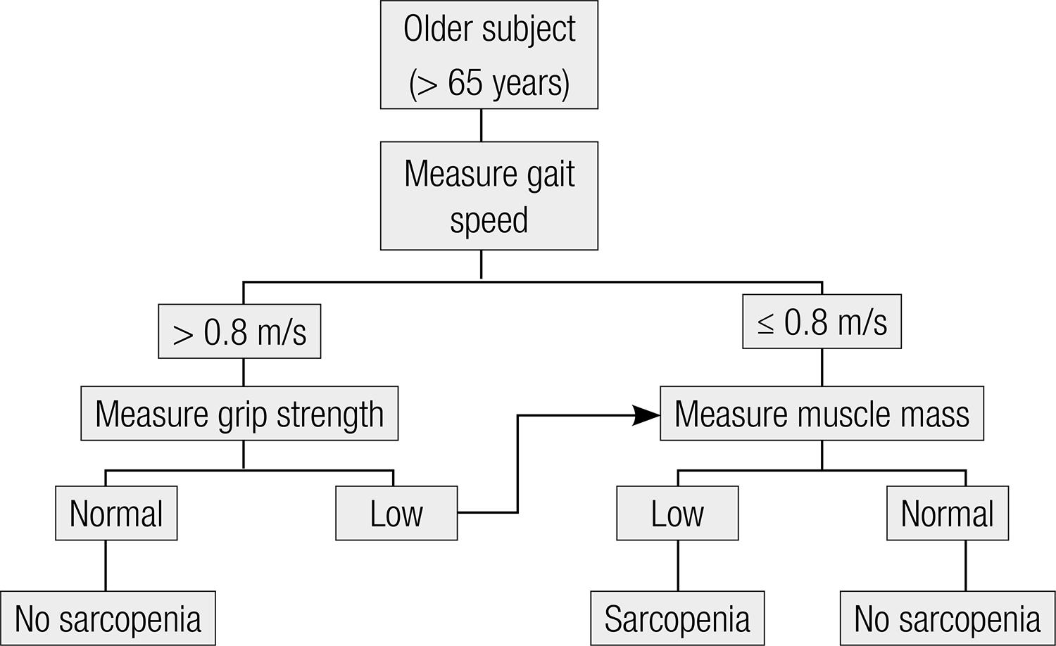
EWGSOP algorithm for diagnosing sarcopenia
Cruz-Jentoft et al Age Ageing 2010

Slide 19
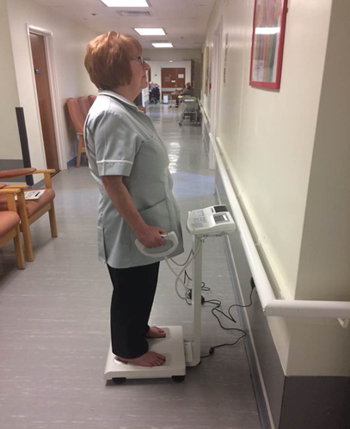
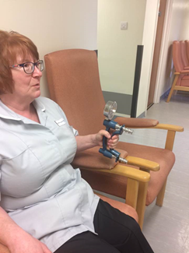
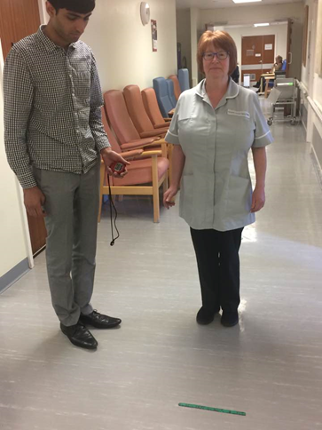

Slide 20
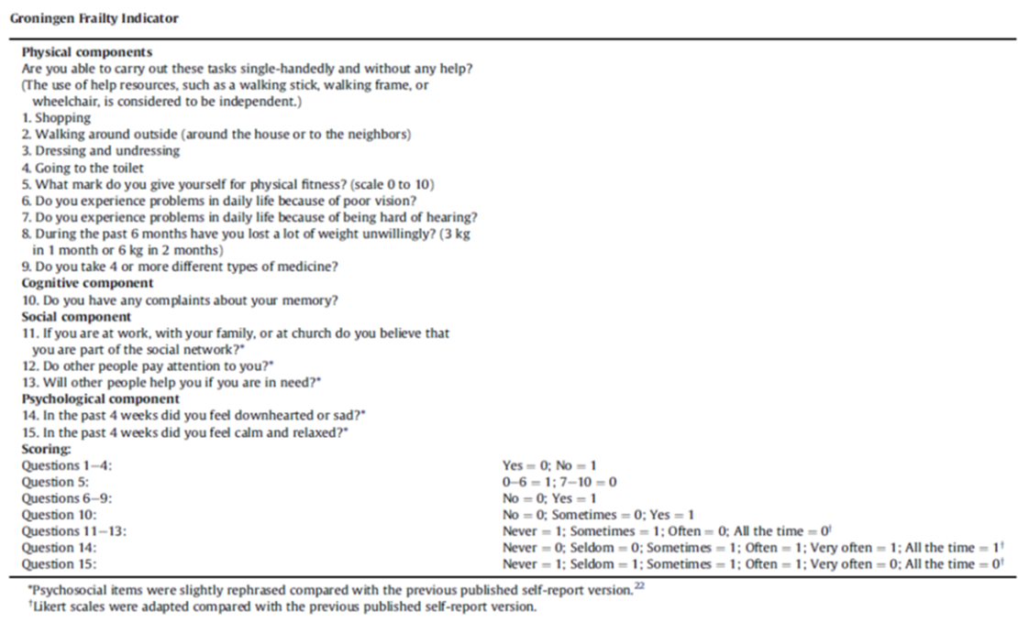

Slide 21
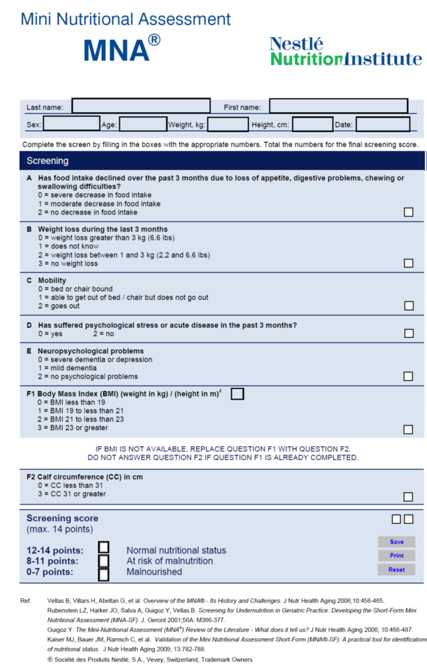

Slide 22
Baseline Characteristics n=63
Age [years, mean (SD)] | 77.6 (7.5)
Age Range [years] | 60-93
Women [number (%)] | 56 (88.9%)
Height [cm, mean (SD)] | 159.0 (9.0)
Weight [kg, median (IQR)] | 59.1 (50.8-70.4)
Body Mass Index [kg/m², median (IQR)] | 22.2 (19.9-27.8)
Gait Speed [m/s, median (IQR)] | 0.8 (0.5-1.1)
Grip Strength in women [kg, mean (SD)] | 16.9 (6.2)
Grip Strength in men [kg, mean (SD)] | 27.0 (7.1)
Muscle mass in women [kg/m², median (IQR)] | 6.20 (5.65-6.70)
Muscle mass in men [kg/m2, median (IQR)] | 8.00 (6.20-8.80)
Groningen Frailty Indicator score [median (IQR)] | 5.0 (3.0-8.0)
Mini-Nutritional Assessment-SF [median (IQR)] | 13.0 (11.0-15.0)
Calf Circumference [cm, median (IQR)] | 33.7 (31.3-36.2)
Physical Activity Levels [number (%)]
0 < once a month | 20 (31.7)
1 between once a week and once a month | 0 (0)
2 ≥ once a week and < 5 times per week | 30 (47.6)
3 ≥ 5 times per week | 13 (20.6)

Slide 23
Results
Prevalence
Sarcopenia 41.0%
Frailty 66.7%
Malnutrition 7.9%
Malnutrition or at risk of malnutrition 28.6%

Slide 24
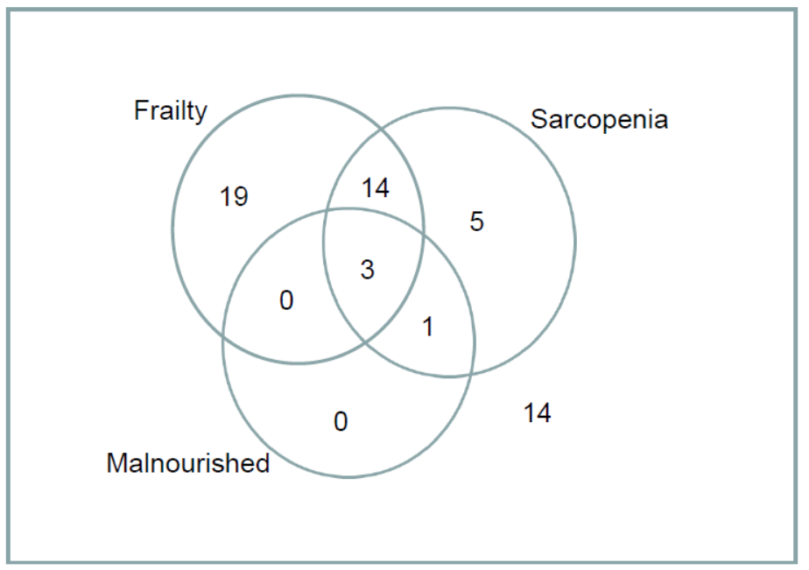

Slide 25
Predictors of Frailty (Logistic Regression)
Independent variable | Wald Statistic | Exp β [OR] (95%CI) | P
Age (years) | 0.38 | 1.04 (0.92 – 1.18) | 0.548
Gait Speed (m/s) | 5.78 | 0.026 (0.001 – 0.511) | 0.016
MNA-SF score | 3.04 | 0.78 (0.58 – 1.03) | 0.081
Physical Inactivity (categorical) | 2.20 | 6.29 (0.55 – 71.61) | 0.138
Grip strength (categorical) | 2.25 | 3.98 (0.66 – 24.14) | 0.134

Slide 26
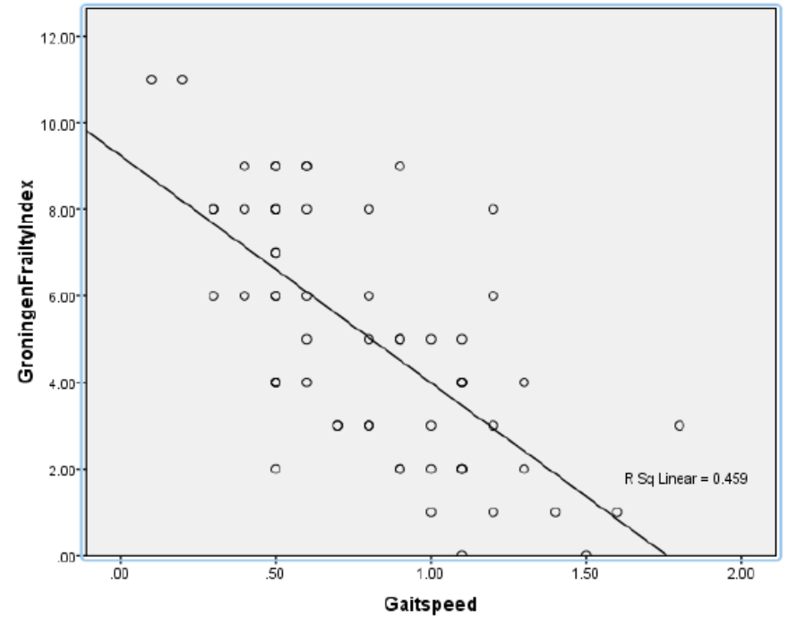
Spearmans r -0.666, p< 0.001

Slide 27
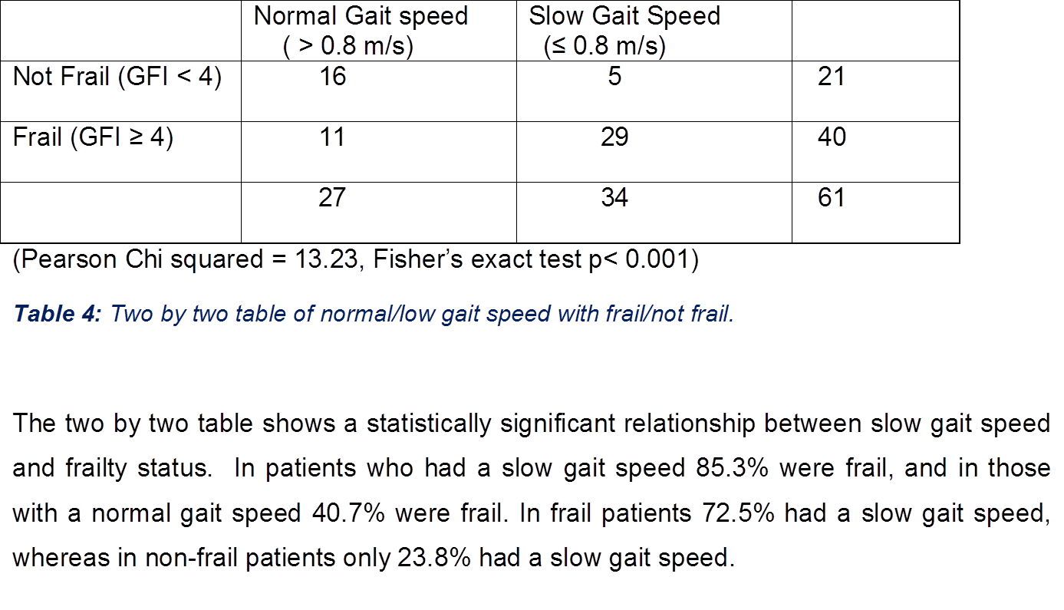

Slide 28
Predictors of Sarcopenia (Univariate Logiostic regression)
Independent Variable | Wald statistic | Exp β [OR] (95%CI) | P
Age (years) | 0.21 | 1.00 (0.93 – 1.07) | 0.885
Sex | 2.71 | 4.31 (0.76 – 24.52) | 0.100
Height (cm) | 0.02 | 1.00 (0.95 – 1.07) | 0.877
Weight (kg) | 4.84 | 0.96 (0.92 – 0.99) | 0.028
BMI (kg/m²) | 8.36 | 0.80 (0.69 – 0.93) | 0.004
Frailty (GFI) | 3.80 | 1.23 (1.00 – 1.52) | 0.051
MNA-SF score | 7.92 | 0.72 (0.58 – 0.91) | 0.005
Calf Circumference (cm) | 7.21 | 0.77 (0.64 – 0.93) | 0.007
Physical Inactivity | 2.92 | 2.89 (0.88 – 0.35) | 0.087
Multivariate logistic regression model (forward stepwise method) only
    BMI (log likelihood 14.33, P <0.001) and
    Physical inactivity (log likelihood 5.15, p=0.027)
remained independently predictive of sarcopenia

Slide 29
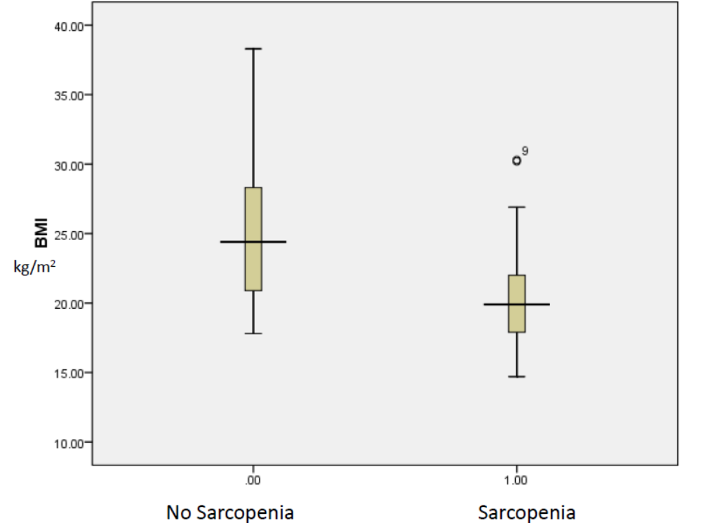
Mann Whitney U=175, p<0.001].

Slide 30
Mann Whitney U= 195, p=0.002

Slide 31
Pearson’s r 0.77, p< 0.001

Slide 32
Conclusions
Assessments for frailty, sarcopenia and malnutrition can easily be incorportaed in busy osteoporosis clinics
Bio-impedance is a practical and easy to use tool to measure muscle mass in busy clinics
Gait speed shows potential as an easy to use surrogate test for sarcopenia
Calf Circumference shows potential as a surrogate for muscle mass

Slide 33
The ultimate goal of all health related research is to apply it to people
Translational Research is the vital progression from basic science research

