Slide 1
University of Nottingham Initial Teacher Education Interviews 2020-21
Notes:
Hello and welcome to the University of Nottingham School of Education.
My name is Stef Sullivan and I am the Director of ITE, overseeing all our primary and secondary teacher training programmes.
My aim here is to tell you a little bit about our courses and why we are so proud of them.
In your interview you will be able to ask questions and learn more about the specific route you have applied for.

Slide 2
Busting some myths
You are training to be a teacher so, of course, you are mostly in school! – your time in school starts from week one of the course
When you are in university you have a very different experience to being an undergraduate – it is not sitting in silence in large lecture theatres!
We do challenge you to engage with research but only to make you a better teacher – everything you do is linked to practice
We are not ‘out of touch ex-teachers’ who don’t understand the real world – university tutors are all highly experienced teachers and now expert teacher educators and we work in partnership with practising expert teachers
Notes:
Before focusing on our programmes I thought it would be helpful to bust a few myths that are out there about university-led teacher training.
One comment we often hear is that people want to be in school as soon as possible and don’t want to be stuck in a university. Of course you would want that and as a trainee teacher you will want to be mostly in schools. On all our programmes, your first school experiences start in week one of the course and over the year you spend the majority of your time in schools
Your university experience as a beginning teacher is completely different to an undergraduate experience. You are not coming in for huge whole course lectures where you sit in silence listening. When you are in university you are actively working with tutors and peers constantly exploring teaching and learning
It is true that as a university we will expect you to engage with theory and research but this is always to make you a better teacher – so, for example, we might explore research about childhood development to understand how children learn and what you should do as a teacher or we might explore theories about behaviour for learning to help you analyse what is and is not working in your classroom
We are not out of touch or retired teachers living in an ivory tower! We are all very experienced teachers who are now dedicated to being expert teacher educators. So just as a teacher would constantly think about their pupils’ learning and progress and how to support them we think about beginning teachers’ learning and progress and how to support you. We complement the expert teachers you will work with in schools, both of us offering you something different but equally important.

Slide 3
Why come to a Russell Group university to train to be a teacher?
We have a reputation that is recognised globally
We are part of a vibrant, and well-established community of teacher educators and educational researchers
We can draw on national and international expertise and cutting edge research and innovation
Why is this important for a trainee teacher?
Our courses are underpinned by high quality research into teaching and learning and teacher development
We offer you unique experiences
Your qualification is recognised for its quality
Notes:
Now that’s out the way, I want to start thinking about why you might choose Nottingham for your teacher training and I think there are some really important reasons why this would be a good idea!
Firstly, as a Russell Group provider of ITE we have a global reputation and we are part of a very well established community of teacher educators and educational researchers. We work closely with each other and this enables us to draw on national and international knowledge and expertise to ensure our courses are cutting edge and innovative.
I think this means you get a unique experience as a beginning teacher:
You gain access to world-renowned figures in fields of education, for example one of our professors of learning sciences works with all our student teachers to explore the very latest research about children’s learning, how the brain develops and the part memory plays in learning
You are able to engage with innovative approaches to teacher development, for example we have experts in lesson study who have helped us design experiences where a large group of our student teachers all observe a live lesson together and then explore the learning that has taken place with the class teacher
We work with a wide range of partners, beyond schools to develop initiatives for our programmes. For example, we are currently exploring ways of working with Nottingham Castle to help trainee teachers access and appreciate the learning opportunities our local attractions offer
These are just a few examples of what we are able to do as a Russell Group university, there are many more that we can share with you at interview.
I think the final thing that is worth saying is that a PGCE from a Russell Group university is recognised for its quality. It tells an employing school that you have engaged deeply with research about teaching and learning as well as constantly developing your skills as a teacher in the classroom. It is a qualification that is recognised internationally as well as nationally and it is the perfect basis for further study if you decide to continue your own education in the future.

Slide 4
Why come to the University of Nottingham?
Our courses are underpinned by a carefully constructed ITE curriculum that is built on national and international research into ITE
Our partnership is special
We are expert teacher educators
We have a strong focus on subject expertise and pedagogy
We offer a personalised approach to your journey that takes account of your strengths and areas of interest with a range of enrichment and support opportunities
You qualify with a PGCE alongside QTS and this gives you 60 Masters level credits
Notes:
But, why Nottingham in particular?
All our courses are underpinned by a carefully constructed curriculum that we have developed. Our work in this area has been presented nationally and is recognised as being innovative and unique.
I will talk more about our partnership shortly but it genuinely is special and is key to everything we do
This third point is, I think, really important. Through our partnership you will work with amazing school-based teachers and mentors but you will also work closely with university tutors. Our role is to constantly think about your education as a beginning teacher and, whilst we are all experienced teachers, we are now expert teacher educators putting you at the heart of everything we do so you can focus on the pupils you are teaching.
We have a very strong focus on subject expertise and have a team of specialist tutors for each subject we offer at secondary. Our primary team is made up of really experienced teacher educators who have different specialisms across the primary curriculum.
We strongly believe that becoming a teacher is a very personal journey, people progress at different rates, they have different strengths and interests and they have different personal beliefs and values. Our courses aim to support you develop as an individual. We challenge you to explore what type of teacher you want to be and why and then help you realise your vision through a personalised approach to supporting you.

Slide 5
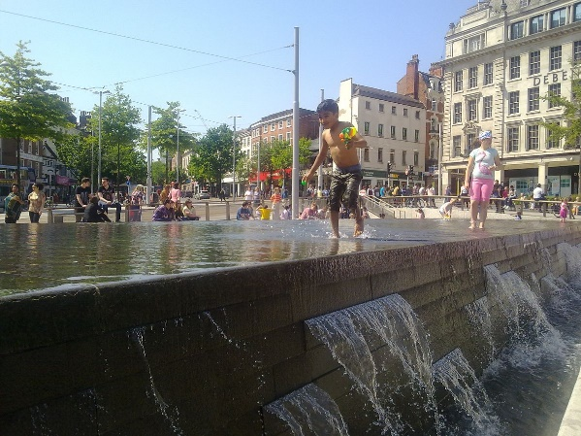
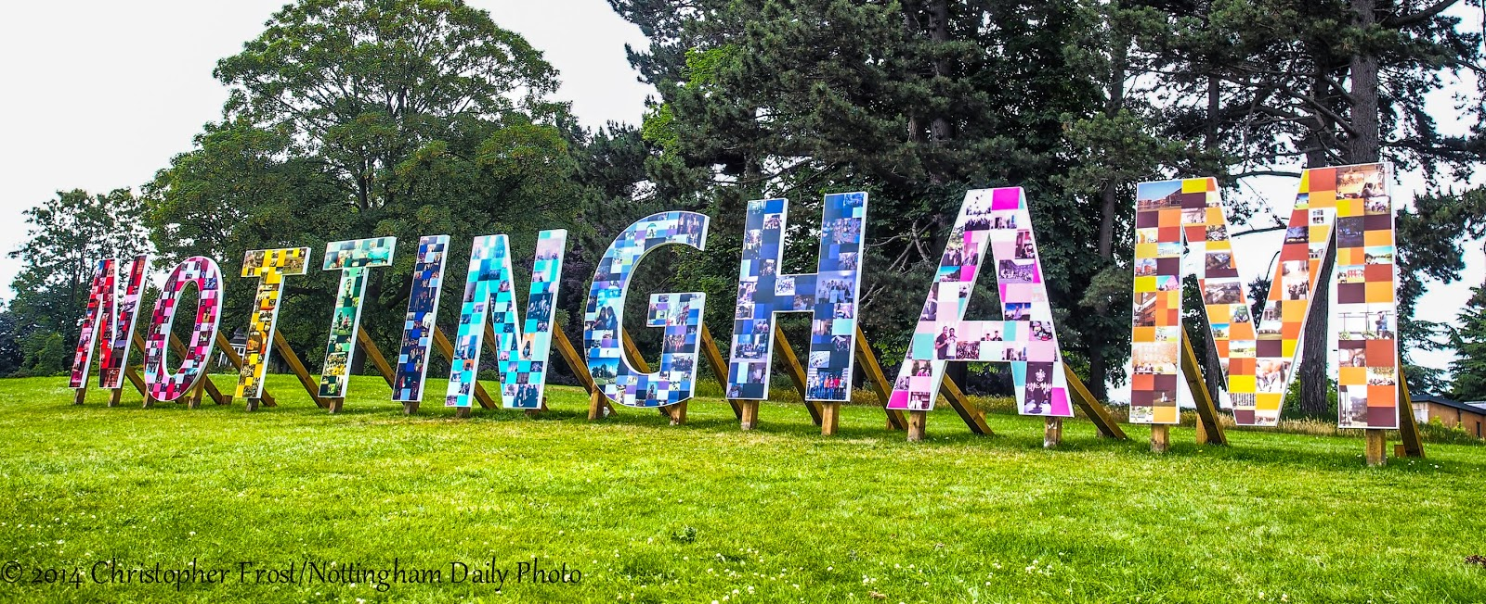
Why come to the city of Nottingham?
One of Europe's’ cleanest cities
Sunday Times one of ‘the best cities to live’
‘Great city with thriving arts, music scene and nightlife’
Rough Guide 2019
‘One of the happiest places to work in the UK’ Guardian
UNESCO City of Literature 2016
Excellent transport networks and Guardian’s Climate champion overall winner (carbon neutral by 2028)
Cutting edge university campuses
Notes:
If that hasn’t sold you then why not focus on the city of Nottingham and why it is such a lovely place to be. We have a thriving social and cultural scene, we have wonderful parks and countryside on our doorstep and we are perfectly positioned in the UK for travelling around the country when you have time off.

Slide 6
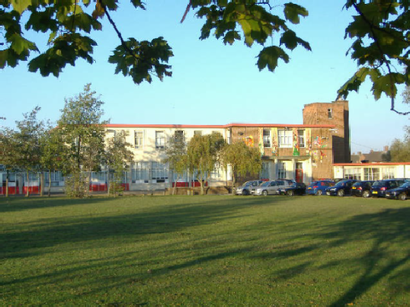
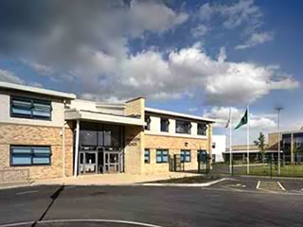
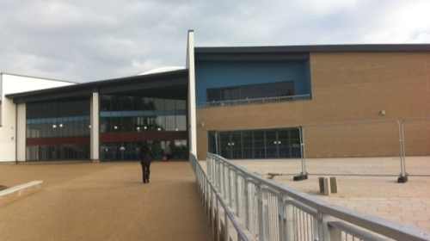
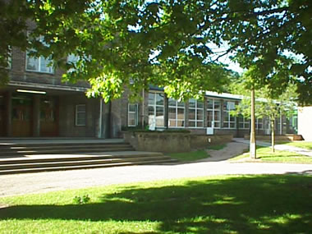
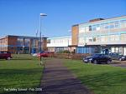
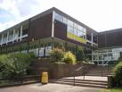
Our partnership
“The shared vision and ethos, which permeates the partnership, is characterised by very strong and active partnerships with schools, a highly inclusive approach, high expectations, the relentless pursuit of excellence and the continual drive to improve further in order to enhance the quality of training and ensure trainees enter the profession as good or outstanding teachers.”
Most recent Ofsted report
A long history
Unique contributions from different experts
Reciprocal, collaborative and open
Creative and innovative
Notes:
So to our partnership. We work with around 150 to 200 school in the local region and we really believe our partnership is special!
We have a long history of working collaboratively with our local schools and we recognise that we all bring different expertise to the table which adds to the richness of what we can offer our beginning teachers.
Our schools are very varied – we work with some of the largest schools in the region and some of the smallest, we have schools that have a special focus (for example on languages, science and technology or inclusion), we have schools that serve some of the most affluent communities in the region and schools that face challenging circumstances for a whole range of reasons. What all our schools have in common is a commitment to supporting the next generation of teachers.
Our schools are heavily involved in the design of our programmes and curriculum and we are committed to creativity and innovation as we develop approaches and initiatives.
I have put this Ofsted quote up as for the last three Ofsted inspections which span over fifteen years a similar comment recognising the quality of our partnership has appeared in every report!

Slide 7
Our ITE curriculum framework – Strands of specialised teacher knowledge
Notes:
We have a very carefully designed curriculum that underpins all our ITE programmes.
We believe that the knowledge and skills an effective teacher has is very specialised. Not everyone can be a teacher and it doesn’t matter how well you know something yourself, to teach it to someone else needs new and very expert knowledge. We have broken this down into a set of key strands and you explore these throughout the course, gradually developing your understanding and expertise in each area.
I suspect most of these areas you would expect to see in a curriculum for beginning teachers – of course we focus on what it means to be a professional, we look at subject knowledge for teaching, we explore different pedagogies, we teach you how to plan and teach lessons and how to assess learning, we explore barriers to learning like special needs and have a strong focus on inclusion and we constantly think about the different relationships we build as teachers, how we manage behaviour in the classroom and how we communicate with parents.
The strand that may be less obvious but that we strongly believe in is the one entitled ‘Teacher as Thinker’. Throughout the course we will challenge you to think about your own learning and help you develop your own personal philosophy about how children learn and what that means to teaching. We will expect you to engage with research to shape your thinking and we will expect you to be intellectually curious. For us it is this way of being and thinking that will help you navigate the many situations and challenges you will experience through your career as a teacher and it is this way of being that will help you maintain your passion and love for the job.

Slide 8
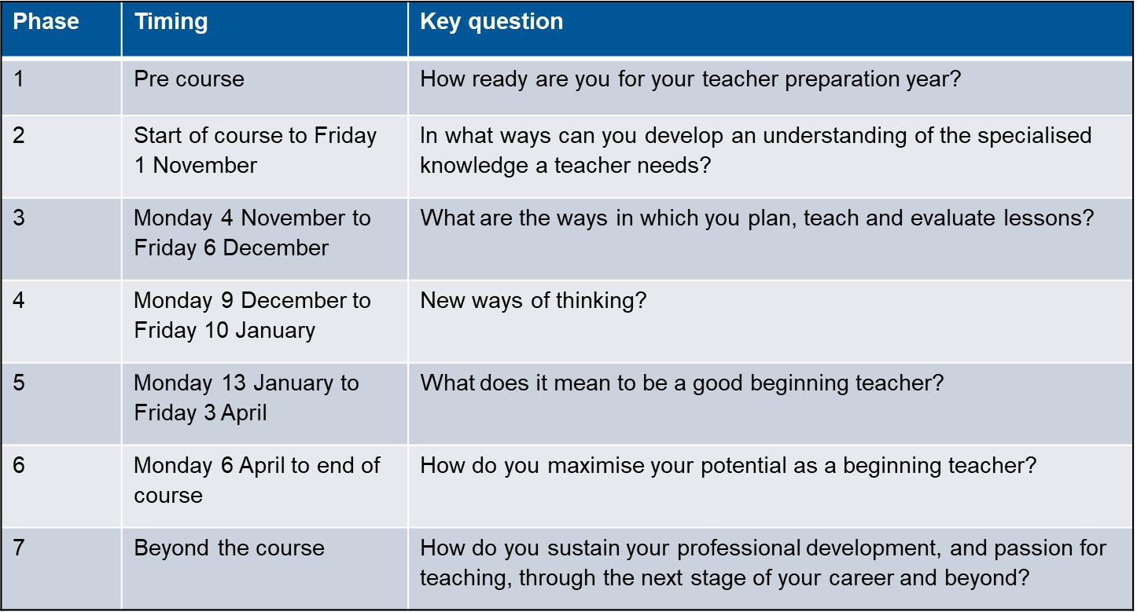
Our ITE curriculum framework – Phases of your journey as a beginning teacher
Notes:
Alongside thinking about the knowledge and skills a teacher needs to develop we have thought carefully about the journey a beginning teacher goes on and have created a set of phases for each course. Each phase has an overriding inquiry question so you, and everyone working with you, has a clear focus for that period of time. Feedback from our students has shown that this is particularly helpful in enabling them to understand what they should be thinking about at any point and in reassuring them that they don’t need to know or be able to do everything straightaway. So, for example, if you look at the phases of our secondary programme which is shown here, if by Christmas I have an understanding of the different ways in which I can plan, teach and evaluate lessons then I am doing ok. It doesn’t mean that all my lessons go well or that I am managing classes perfectly, it simply means that I can see how to put a lesson together and make some sort of sense afterwards of why it did or did not work. There is plenty of time through the rest of the course to then develop and perfect what I am doing.
The development of this framework has been a huge piece of work and we drew on national and international research about beginning teacher development as well as the expertise within our partnership to create it. Our work has been presented at different national fora and is recognised as unique and innovative.

Slide 9
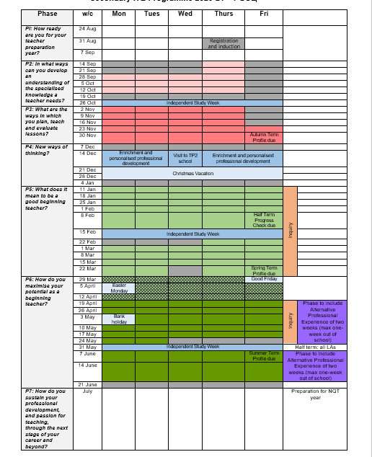
The ITE year
Notes:
I know one of the things that you will be asking is what does this look like in reality.
On each course you will spend time in at least two schools and each programme has an overview like this that shows how your time is split between school and university. This is an example of the secondary PGCE programme. Where a day is blocked out as grey you are in university. Any other colour you are in school. So this shows you straightaway, as I said before, that you are in school from week one of the course and that the majority of your time over the year is based in a school.
The different colours mean different things on each course and at interview a member of staff will be able to talk in more detail about the programme you have applied for.

Slide 10
School-based learning
Carefully structured programme to scaffold your progress each term
Gradual build-up of teaching
Observations across all key stages with expert teachers
Weekly mentor meetings
Involvement in all aspects of school life
Notes:
When you are in school there is very carefully structured programme of learning and experiences to support your progress. We don’t throw you in at the deep end and we firmly believe that learning to become a great teacher isn’t about doing as many lessons as you can as quickly as possible. It is about gradually building up your experiences and working with experienced teachers in lots of different ways. So to begin with this might be planning lessons together or it might be that you take part of the lesson or work with a group of pupils before teaching full lessons yourself.
You will have protected time with your mentor each week to explore your progress, discuss teaching and learning and agree targets for development.
Importantly you will be given opportunities to engage with all aspects of school life. This might include helping out at, or even running your own, after school club or it could be going on school trips. It will also be doing the more day to day things like carrying out break duty and joining in staff meetings!

Slide 11
University-based learning
Working with a large group of beginning teachers of your subject or phase
Modelling of teaching approaches you can use in your classroom
Exploring research and practice
Keynote inputs from experts
Peer teaching and learning
Exploring and practising all elements of being a teacher in a ‘safe’ space
Notes:
As I said before, when you are in university it is not like doing an undergraduate degree. A university day is a full day from 9 to 4.30. Most of your time you will be in a classroom with a large group of beginning teachers all learning to teach the same age group or subject. Because of the size of our provision we are able to do this really easily and it means you are constantly working with experts of your age group or subject. We think this is really important. Where there are very small numbers of trainees of a subject then training understandably has to be generic and make sense to a teacher whether they are primary or secondary and regardless of the subject they are learning to teach. We can ensure our teaching has a very strong focus on what you have chosen to teach. So we can, for example, explore behavior management with a specific focus on what that looks like in a history classroom or a Key Stage 1 classroom.
Sometimes you will get keynote inputs from experts from the School of Education. So this might be one of our special needs time talking to you about what is known about autism or it might be a member of staff who is part of a national funded research project exploring the latest approaches to assessment in the classroom.
All the time we will be trying to model to you teaching approaches you can use in your classroom and we will reflect on your experiences as a learner to make sense of what teaching approaches work when. We will expect you to work with, and learn from, each other and we know that one of the most important bits of the course is how you support each other.
What is really important is the university provides you with a space that is away from school, and away from colleagues who you teach with, to talk about your experiences and make sense of how you are feeling We know from student evaluations that this is valued very highly.

Slide 12
What our course design allows
We can revisit key concepts about teaching and learning through a spiral curriculum
We can constantly connect theory and practice, both in school and the University
We can have a strong focus on subject expertise and pedagogy
We can offer personalised support and enrichment
We can have a strong focus on individual wellbeing and identity
Notes:
So our curriculum and the design of our courses enable us to do a whole range of things that we feel make our programmes so good.
We can keep revisiting ideas, gradually building both your understanding and your practical expertise
We can genuinely connect theory and practice – so you are not expected to read something or explore a theory for an academic purpose, you are always doing it to become a better teacher
We can have a really strong focus on subject expertise both at primary and secondary
We can personalise your experience through support and enrichment opportunities
And, really importantly we can have a strong focus on wellbeing and supporting you to develop your own professional identity

Slide 13
Personalised support
Personal tutor
Mentor
Coordinator/ITE Lead
School of Education Welfare Officer
Notes:
Just to say a little more about support and enrichment
In terms of support you will have a personal tutor that will work with you throughout the year. They will visit you in school, they will have regular tutorials with you and they will be there for you at any point when you need support or want to discuss anything.
In school you will have a personal mentor. They will have dedicated time to support you, they will attend regular development sessions at the university and they will know your programme well. Actually many of our mentors are ex students so they have a firsthand knowledge of what you are going through!
In each school there will also be a coordinator or ITE lead who oversees all the trainee teachers in the school and provides an additional layer of support and guidance.
Finally because you are a University of Nottingham student you will also be able to draw on all the support and guidance any student would have access to. The School of Education has a dedicated welfare officer and they are there to talk to but also to guide you to further support if it is needed.

Slide 14
Enrichment
Alternative school experiences
SEND opportunities
Immersion days
MHFA England First Aider Youth course
Support groups:
Career changers
Care givers
Internationally educated students
LGBTQ
Notes:
In terms of enrichment we offer a wide range of additional activities and experiences that you can choose from to explore personal areas of interest.
On all courses there are opportunities for alternative experiences in different settings. These experiences differ from course to course but could include spending some time in a school that has a specific expertise, for example expertise in working with children whose first language is not English. It might be having a week’s experience in a special school or helping out at a special school’s Christmas party. It could be a whole course immersion day where you all go to a school for a day where there is a carefully planned focus on a particular issue.
All of our student teachers have the opportunity to complete a two day course run by Mental Health First Aid England which accredits them as a Mental health First Aider Youth.
We run a range of support groups each year for different groups of students such as career changers or internationally educated students. You may wonder why I have listed these here and not in the previous section on support. That is because, whilst they are offering a supportive space where students with similar challenges can get together our focus is on seeing the assets that different groups of students bring to their role as a teacher and so the groups focus on the strengths of these students and how they can enrich a school’s offering to pupils.

Slide 15
Assessment
Meeting the Teachers’ Standards leading to Qualified Teacher Status
Assignments
Notes:
Finally I want to say something about how we assess you.
In terms of assessment there are two key elements to how we assess you.
By the end of the course you need to have met all the Teachers’ Standards which are a national set of standards that all trainee teachers must meet. We take an holistic approach to assessing whether you have met the standards. We do not expect you to gather pieces of evidence to tick off against each standard. With our partnership, and underpinned by our curriculum framework, we have developed an approach to monitoring your progress that avoids this and enables you to be involved in the process. Our key message is that if you are engaging successfully with all elements of your course you will be meeting the standards and it is only if you are facing difficulties that it is helpful to separate them out to identify the key areas you need to work on.
In terms of assignments you will have two assignments that focus on teaching and learning. These are very much embedded in your practice. So, for example, you might plan a sequence of lessons based on research, teach the lessons and evaluate the pupils’ learning or you might have to explain your personal philosophy of teaching and learning in your subject and justify the approaches you take as a teacher drawing on research and theory. You will then have a third assignment that is a report of a small scale piece of research that you carry out in your main placement school. This might, for example, be exploring pupils’ perceptions about a particular issue so that this can inform your teaching. The key is that the assignments are not separate stand alone essays done for the university, they are linked to what you are doing in school and designed to make you a better teacher.

Slide 16
University of Nottingham ITE
Interviews
Notes:
So that gives you a whistle stop tour of our ITE programmes and, hopefully, helps you understand our passion for teacher education and the uniqueness of our courses.
The next stage for you will be to have an interview. This will include an opportunity to get to know us a bit better and ask questions. We will be able to get to know you and hear about why you want to be a teacher.

Slide 17
Fundamental mathematics and English skills
Before being recommended for QTS you must be able to demonstrate competence
In your individual interview we will discuss your current confidence - we want you to be honest!
There are pre-course resources to support you to develop
You will be supported to make progress during the course
Notes:
You will have details about what to prepare for your interview that are specific to the course you have applied for but one thing we know you may have questions about and that we will want to discuss with you at interview is fundamental maths and English skills.
For all beginning teachers starting a course from September 2020 they will have to demonstrate their competence in the four areas you see here by the end of their training programme.
This has replaced the QTS tests that applicants used to have to pass before starting a programme

Slide 18
Fundamental mathematics and English skills
Speaking, listening and communicating are fundamental to a teacher’s role. Teachers should use standard English grammar, clear pronunciation and vocabulary relevant to the situation to convey instructions, questions, information, concepts and ideas with clarity. Teachers should read fluently and with good understanding.
Writing by teachers will be seen by colleagues, pupils and parents and, as such, it is important that a teacher’s writing reflects the high standards of accuracy their professional role demands. They should write clearly, accurately, legibly and coherently using correct spelling and punctuation.
Teachers should use data and graphs to interpret information, identify patterns and trends and draw appropriate conclusions. They need to interpret pupil data and understand statistics and graphs in the news, academic reports and relevant papers.
Teachers should be able to complete mathematical calculations fluently with whole numbers, fractions, decimals and percentages. They should be able to solve mathematical problems using a variety of methods and approaches including: estimating and rounding, sense checking answers, breaking down problems into simpler steps, and explaining and justifying answers using appropriate language.
Notes:
Our approach to this will be the same as our approach to how we assess our students against the teachers’ standards. We like to consider an individual’s abilities and competencies holistically and we avoid tests and collecting pieces of evidence to tick off as much as we possibly can!
At interview we would like to discuss with you how confident you feel about these skills and share with us what support you think you might need in order to be fully competent in all areas by the end of your training programme. Based on this discussion we might direct you to resources to engage with before the course and then through the course there will be regular opportunities for further development.

Slide 19
University of Nottingham ITE
Interviews
Notes:
So, to return to your interview. We aim to make the interview experience as welcoming as we can so please try not to worry about it! I hope this has given you a good flavor of the university of Nottingham and that you are now excited to have a conversation with us. Good luck!

