Slide 1
University Strategy Team Presentation
xx 2020
Notes:
Notes are included throughout this presentation offering insight into the strategy development and implementation, further sources of information, and discussion prompts to support consideration in teams of “what the strategy means for us”

Slide 2
Introduction
The changing strategic context
How the Strategy was developed
Walk-through Strategy content
Implementing the Strategy - Plans
What it means for us
Notes:
[Select as appropriate depending on the focus of the meeting or event]

Slide 3
A new strategy for a changing context
New national political context
Brexit
Augar review of fees and funding
Changing research funding opportunities
Global trends including:
Globalisation
Knowledge acquisition and identity
Living in an ICT saturated world
Healthy living
Migration
Notes:
Changing and challenging times
Social, political, cultural and economic contexts in which we are operating
The kinds of drivers that the University is responding to through this strategy
Clearly linked to our vision – “we embrace the opportunities presented by a changing world”

Slide 4
How we developed our Strategy
“The Strategy was the result of an extensive consultation with staff and students on all our campuses, and it therefore provides an ambitious and positive direction of travel in what are undoubtedly testing times.”
December 2019
Professor Shearer West
Vice-Chancellor
November 2018
21st Century Consultation
July – September 2019
White Paper Consultation
October - December 2019
Ratification & Publication
March - April 2019
Green Paper Consultation
Notes:
Different approach to suit the rapidly changing context – high level and durable statement
We have favoured simplicity over complexity to produce a Strategy that everyone in our community can understand, support and reflect in their work
Summary of the Strategy development timeline – Extended period to work with the whole University community on the development of the new strategy
21st Century University
Green Paper Consultation
White Paper Consultation
Published in December 2019
Three stages of consultation – more than 26,000 pieces of feedback
Thanks to staff for engaging through events, group responses and individual responses
[Further info – reports and consultation comments from each stage are available on the Strategy website]

Slide 5
University Strategy – Mission and Vision
Mission
We have inspiring campuses in three countries, energising us to be a globally engaged university that is also committed to making a difference in our cities and regions.
We empower and support students and staff to collaborate in learning, scholarship and discovery across all realms of knowledge, solving problems and improving lives.
We are stewards of a pioneering and entrepreneurial tradition of creativity and innovation.
Vision
To be a university without borders, where we embrace the opportunities presented by a changing world, and where ambitious people and a creative culture will enable us to change the world for the better.
Notes:
Walk through each section of the strategy
[Discussion prompts – how does our department vision align with the University’s vision]

Slide 6
University Strategy – Values
The strategy articulates decisively a core set of principles and values, which are shared across our global institution. These will embed everything we do individually and within / across our teams.
Values
In all we do, we value…
Inclusivity | Ambition | Openness | Fairness | Respect
Notes:
Particular focus on the values:
Values-based strategy
The values link through all we do – will feature in all supporting delivery plans, ADC process and Building a Culture for Success
[Discussion prompts – how can we ensure we reflect these values in everything we do?]

Slide 7
University Strategy – Strategic Goals
Solving Problems and Improving Lives
Contributing to Sustainable Development Goals
Embedding Collaboration in all that we do
Supporting Potential
Developing the Campus Experience
Cultivating a Global Mindset
Fostering Creativity, Discovery and Experiment
We have seven strategic goals, each of which can be expressed in the work of our Faculties, Schools, Professional Services areas – and our own individual work day-to-day.
Notes:
Key themes which emerged from the Green Paper consultation were further confirmed through White Paper consultation – feedback confirmed that these goals:
provided the right direction
Were sufficiently ambitious
Supported decision making
Were relevant
[Discussion prompts – which of these are particularly relevant to our area? What would good look like? Who would we need to collaborate with?
Exercise prompt – With blank copies of the Strategy, highlight all of the sections that are relevant to the team – how much are we already doing these, what could we do that is new or different?]

Slide 8
University Strategy – Enablers
A series of strategic enablers will ensure the University fosters an inclusive environment that supports the mental and physical wellbeing of our community, empowers everyone to achieve their potential, continues to improve transparency and enhances teaching, research and the student experience.
Enablers
People | Infrastructure | Governance | Compliance | Financial Sustainability | Risk
Notes:
6 enablers which underpin the strategic goals, supporting our effectiveness and “getting the basics right”
Better use of our assets, decision making, support for future ambition and innovation
[Discussion prompt – Which of these are particularly relevant to our area? What would good look like? Who would we need to collaborate with?]

Slide 9
Implementing the Strategy
This is the start rather than the end of the process.
Implementation 2020 onwards
Strategic Delivery Plans
Align strategic finances
Link to Business Planning, ADCs etc
Notes:
Publishing the new Strategy was the start rather than the end of the process
Over the coming months - work collaboratively across our University community to implement the Strategy – starting in 2020/21 and continuing for many years to come
Starting now – developing plans and aligning our processes with the Strategy

Slide 10
Notes:
Full overview on one slide of the Strategic Planning Framework – lots involved so break down to walk through
The blue boxes are University prescribed plans/ frameworks – Strategy reflected through business plans and cross-cutting thematic Strategic Delivery Plans
The orange boxes reflect the HR processes – aligning balanced frameworks with the strategy and providing clarity through team plans and individual staff objectives how everything contributes to the Strategy
The grey boxes reflect the many other plans and frameworks that are in place and developed locally
Arrows show bottom-up innovation, and that through all we do there are links to risk and performance
[Discussion prompt – can we see which levels of plans on here our work will relate to?]
Next slides will walk through key elements of this Framework to help better understand how it fits together and what work is underway

Slide 11
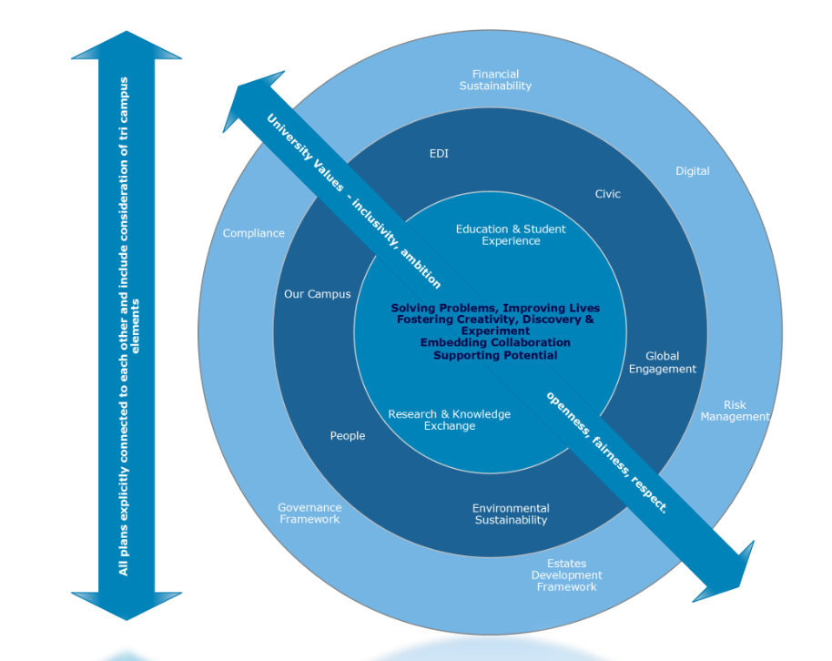
Implementation - Strategic Delivery Plans
Aligned to the Goals and Enablers
Cross-cutting issues
Pragmatic approach
Notes:
Strategic Delivery Plans – these are cross-cutting thematic plans, aligned to the goals and enablers of the strategy
Inner circles link to strategic goals
Outer circle links to enabling activities
Plans are being developed pragmatically – different areas have different starting points
Values are embedded throughout all
Education & Student Experience, Research, Global Engagement are intended to be fully tri-campus
Other plans will set out a global mission and vision, but will contain elements to be delivered locally
Further information – guidance on the development of Strategic Delivery Plans is within the Resources section of the Strategy website

Slide 12
Business Planning 2019 / 20
Notes:
Overview of the business planning process – each year looking ahead for 3 years
Business Plans are developed at University Level, Faculty Level, and Professional Services Department Level (Finance and Infrastructure, Registrar’s Department, HR)
Business area priorities are aligned with Strategic Priorities

Slide 13
Business Planning - Process Summary
Autumn Term
New University Strategy & Performance Framework finalised.
Spring Term
Student intake targets for Y1 agreed.
Summer Term
Faculty Balanced Framework finalised.
Faculty / PSD strategic priorities considered against draft strategy and MTFP.
Intake target reporting completed.
LRF1 modelling undertaken.
DVC & Faculty intake target meetings completed.
LRF2 modelling undertaken.
March Panel
Faculty / PSD planning templates, activity plans and risks finalised.
Confirmation and clearing planning undertaken.
June Panel
Discussion focused on performance.
Opportunity to identify areas for in-depth review.
December Panel
Completion of the planning template building through the year, including identifying dependencies, inconsistencies and gaps across priorities
Notes:
- Business Planning activity happens throughout the full year – it is the process which aligns student number planning, financial modelling and strategic priorities.
A key focus of this process is managing the dependencies between tasks and between departments
[Discussion prompt – thinking about dependencies, which other parts of the business do we need to work closely in order to deliver our work most effectively? Are these relationships working well? How could they be improved?]

Slide 14
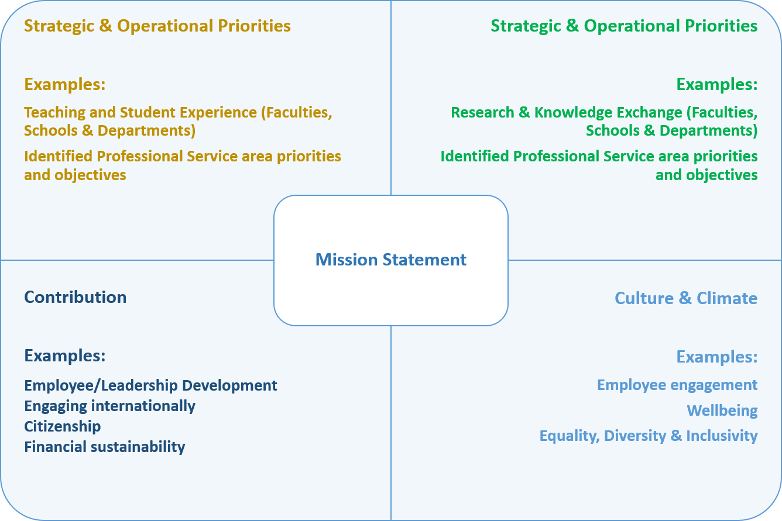
Areas of the Balanced Framework
Populated by Faculties / Schools / Departments / Professional Service Areas using existing information
Provides context in ADC around ‘bigger picture’
Individual contribution can be recognised in the context of the wider University aims/priorities
Mechanism to help plan and agree future priorities aligned with priorities
Notes:
[option to include local Balanced Framework for presentation audience]
- The Balanced Framework is part of the HR ADC process – setting out clear priorities for each department to show where staff objectives contribute directly to the delivery of the University’s strategy

Slide 15
Implementation - Balanced Framework Approach
University Strategy
Faculty / Professional Service Area priorities
School / Department priorities
Individual objectives and contribution
Notes:
How the Balanced Framework links from University Strategy through to individual objectives and contributions
ADC training available at the moment for appraisers and appraises

Slide 16
Performance Framework Principles
Values
Clarity
Independent
Benchmarking
Longevity
Availability
Cascadable
Performance-oriented
Notes:
The University’s Performance Framework is being developed, and KPIs also form an important part of planning at all levels – how can we monitor and measure that we are delivering the desired outcomes?
More information will be published as the Performance Framework is finalised
Key principles have been agreed
[Discussion prompt – what are the useful things for us to measure in our area to ensure we are achieving our outcomes?]

Slide 17
Embedding the new strategy
University of Nottingham Strategy
Are you clear on what the strategy means and how to explain & communicate it?
Which elements of the strategy are particularly relevant to different parts of the Faculty?
How will we embed it into our local strategies, plans & processes?
What does the strategy mean for your Teaching & Research priorities?
What opportunities are there to embed the new values in your work, behaviours and communications?
How will you ensure that your managers / leaders discuss & embed the new strategy with their teams?
University Strategy website resources
Nottingham.ac.uk/strategy
scu@nottingham.ac.uk
Notes:
Focus now is on embedding the Strategy – examples of the questions posed to us that we need to be considering and of further information available.
Support and advice available from Planning, Performance and Strategic Change team – email address shown

Slide 18
Q&A

Slide 19
What does this mean for us…….?
What opportunities does the new strategy present?
How does our team plan link to the new strategy?
How can we demonstrate the values in all we do?
How can we support the implementation of the new strategy?
Notes:
[tailored – questions can relate specifically to the business area/ team, to reflect on existing plans and how they align, or to support the development of new plans]

